Slide 1
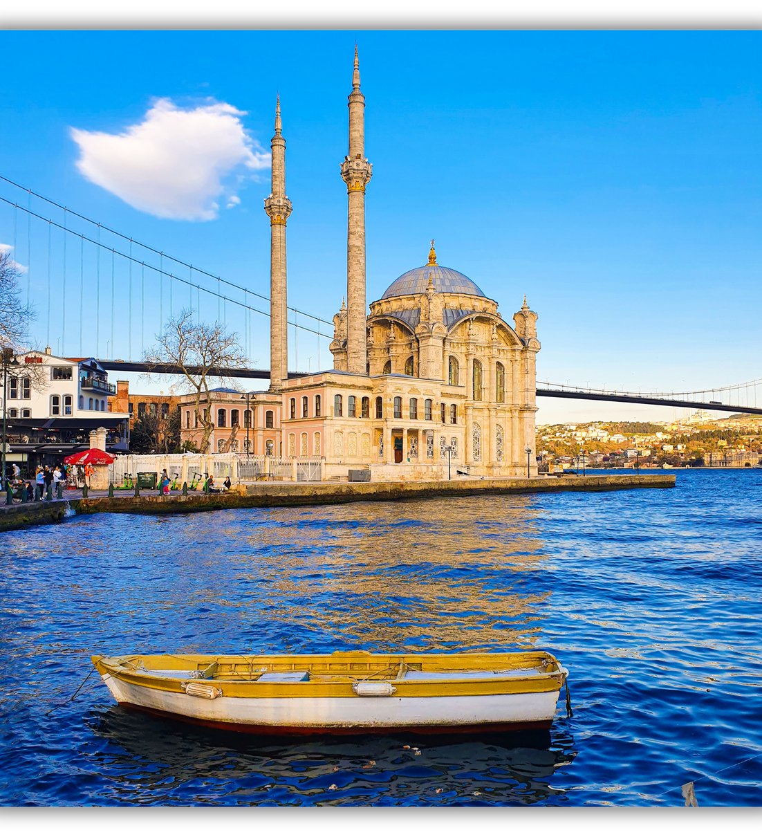

A TASTE OF TÜRKIYE
The Rich Heritage of Turkish Wine

Slide 2
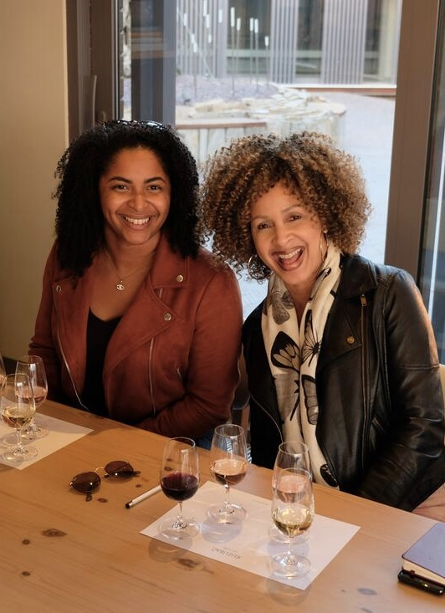
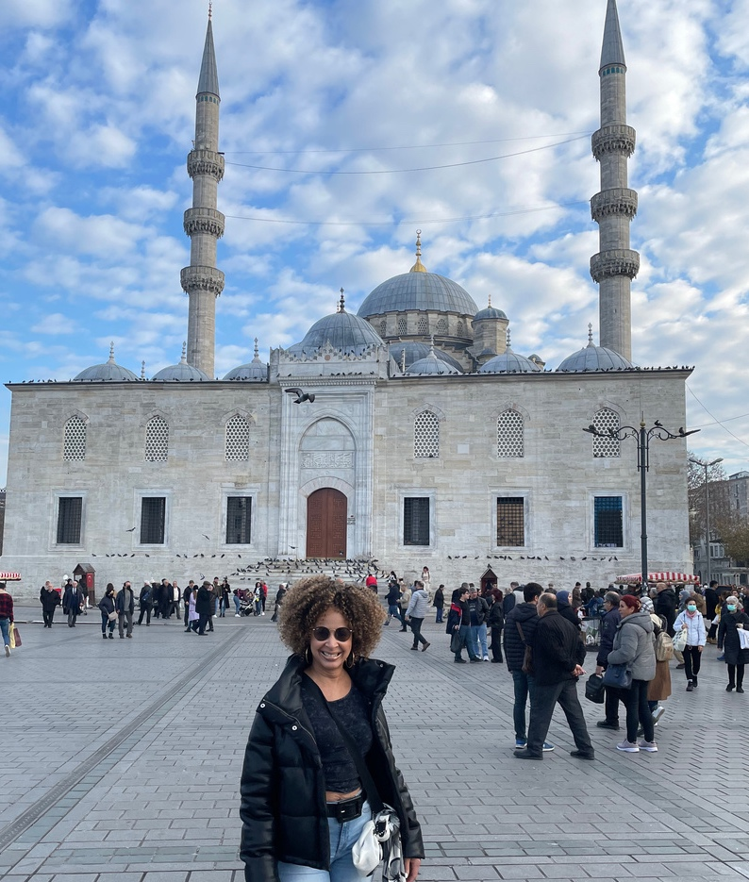
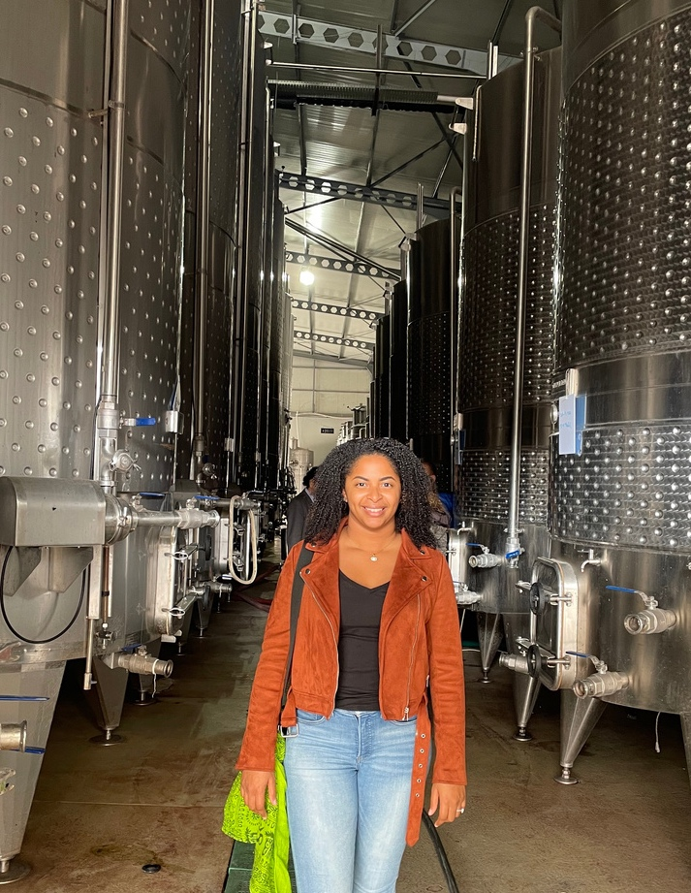
OUR STORY
Our journey began when Lisa and Alexis, a mother-daughter duo, avid enthusiasts of winery exploration and culinary delights, drew inspiration from their travel experiences to establish Ruby Imports. Together, they leverage their combined expertise and networks to fulfill Ruby Imports' mission of enriching the market with exceptional Turkish wines.

Slide 3
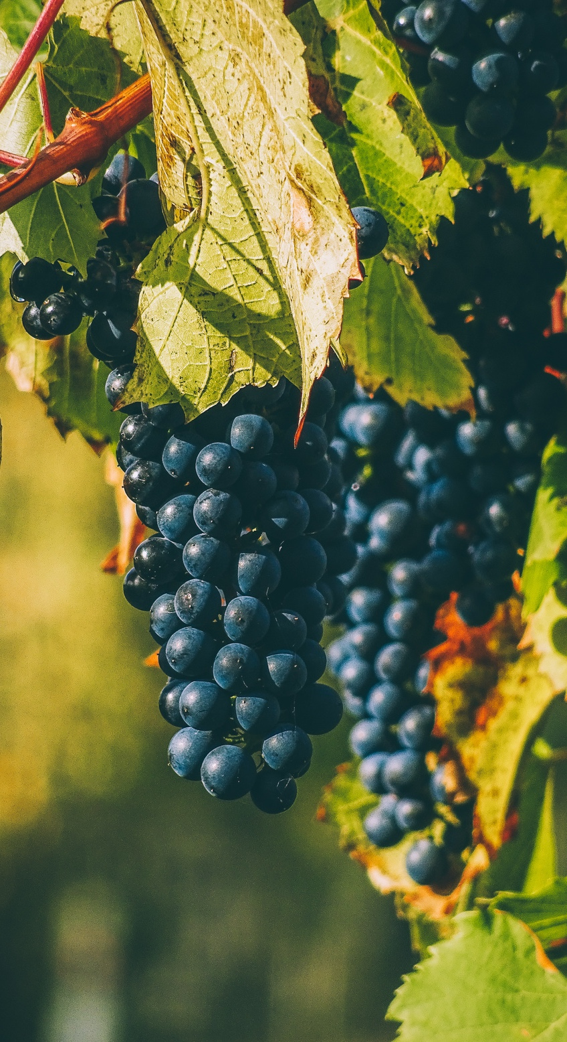
THE RICH HERITAGE OF TURKISH GRAPES
Origins of Vitis Vinifera
The origin of Vitis Vinifera has been traced to Transcaucasia, located south of the Caucasus Mountains and encompasses Eastern Turkey, Armenia, Azerbaijan, Georgia, and Northern Iran.
Turkey's Grape Diversity
Turkey boasts a diverse gene pool of grapes, with more than 600 indigenous varieties.
A Millennia-Old Tradition
Wine has been produced in Turkey for well over 7,000 years, showcasing the country's deep-rooted connection to viticulture.
Vineyard Area
With a total of 420,000 hectares planted, Turkey holds the 5th largest vineyard area in the world (OIV, 2021).

Slide 4
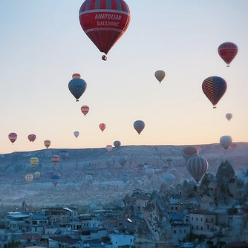
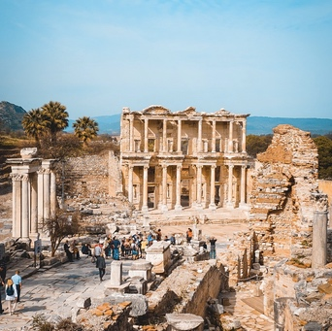
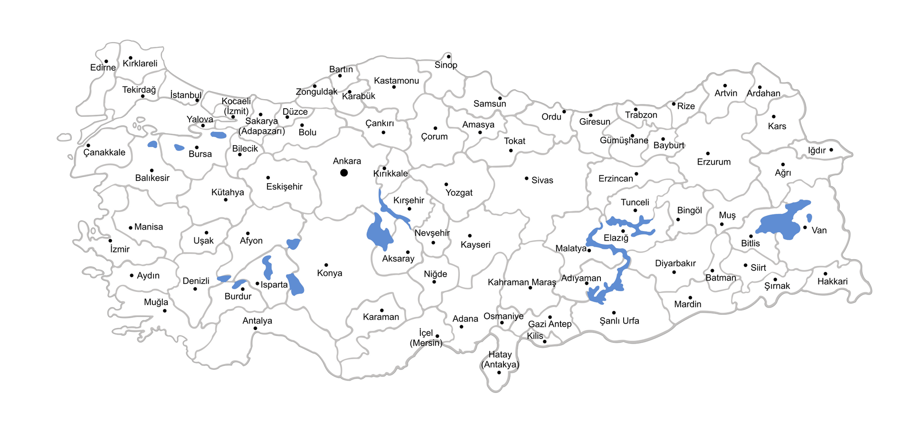

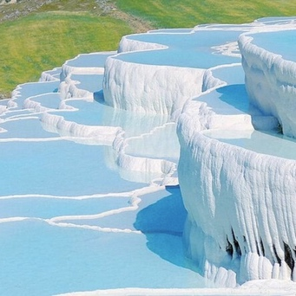
Cappadocia
REGIONS
Soils consisting of sand, sandstone, and decomposed volcanic tuff make up the region's soil and help to produce grapes that are used to make nearly 20% of all Turkish wine.
Urla
This region plays a significant role, contributing to over half of Turkey's wine production.
Çal
This plateau, ranges from 850 to 1200 meters in altitude and represents 20% of the nation's vineyard area and wine grape production.

Slide 5
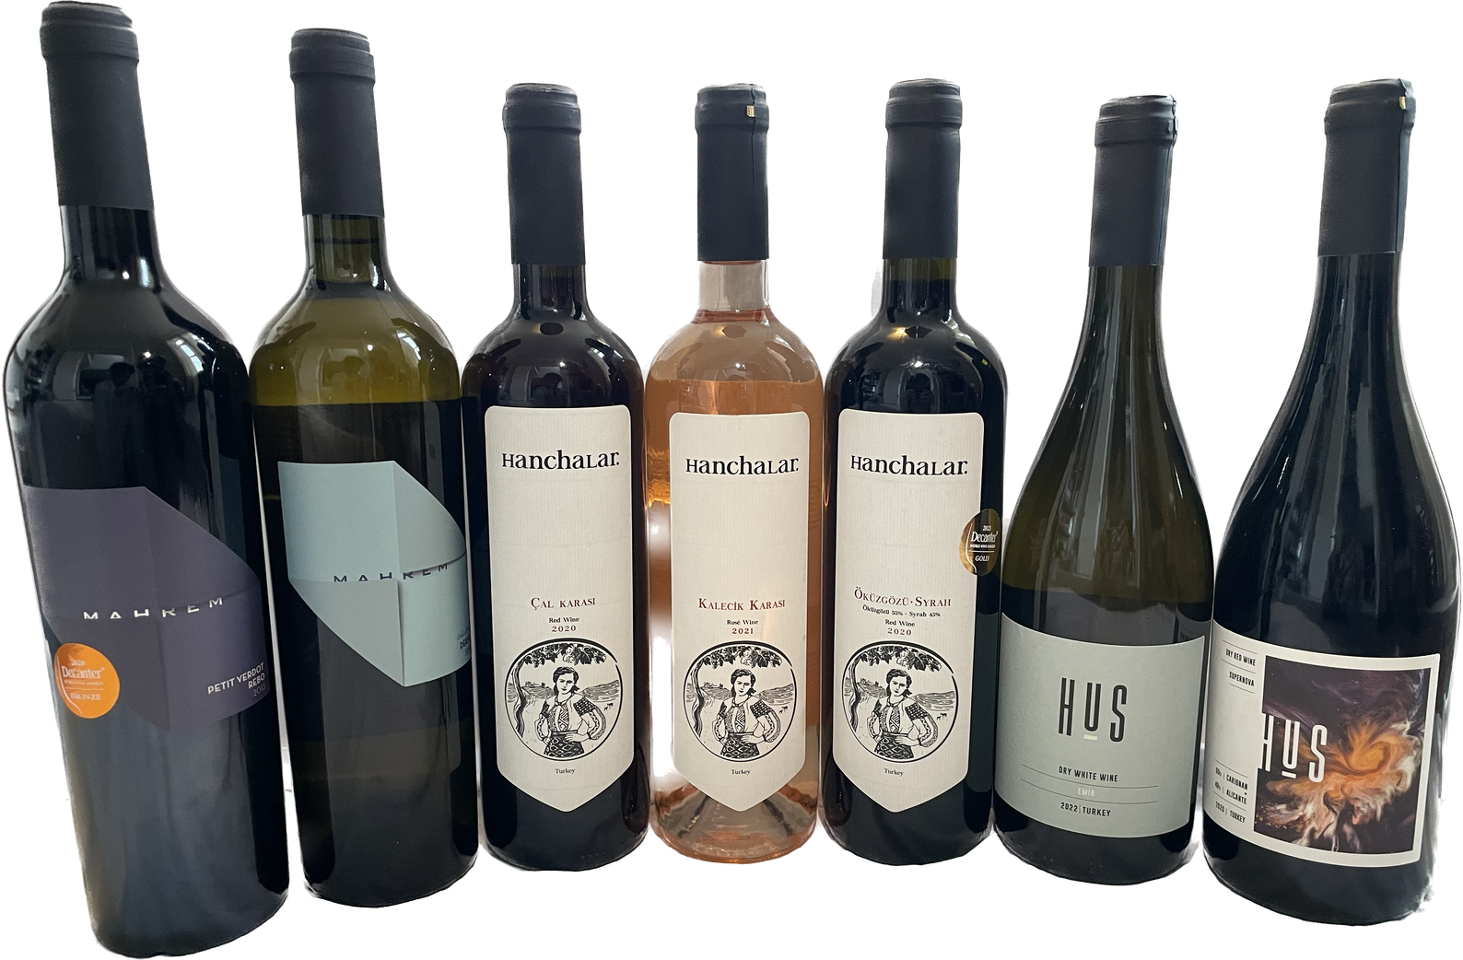
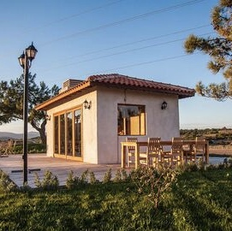

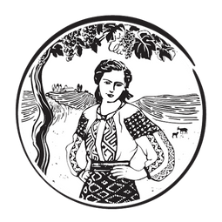
OUR PRODUCERS
Mozaik Winery
HUS WInery
URLA
URLA
ERDEL WINERY
ÇAL

Slide 6

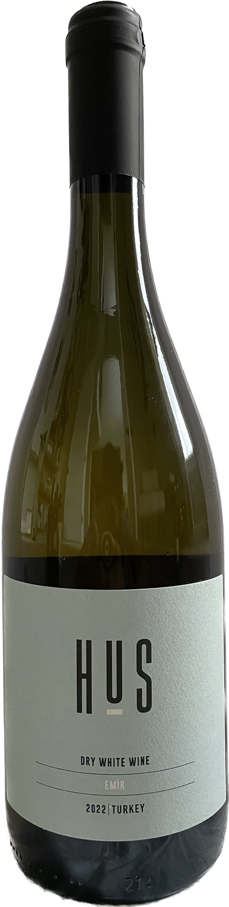

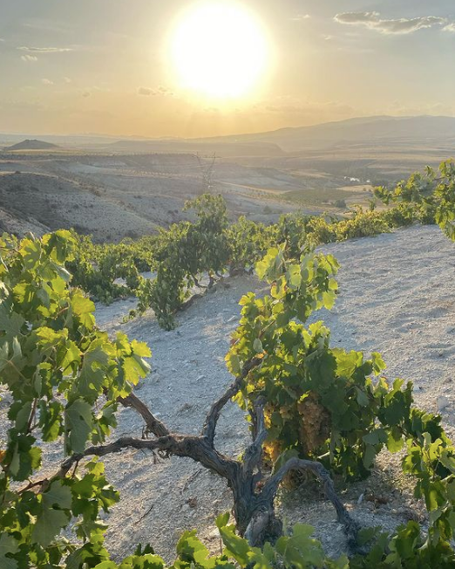




HUS Winery
2022 EMIR
100% Emir
Nevşehir/Cappadocia
Volcanic Soil
Aged for 6 months in stainless steel tanks
Emir means “lord/prince” in Turkish

Slide 7
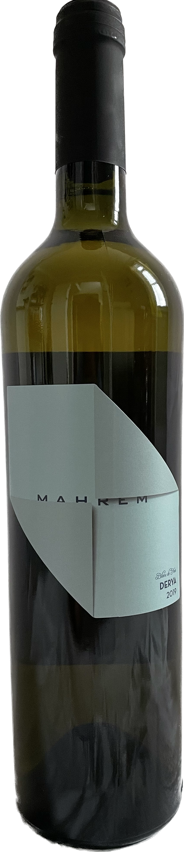
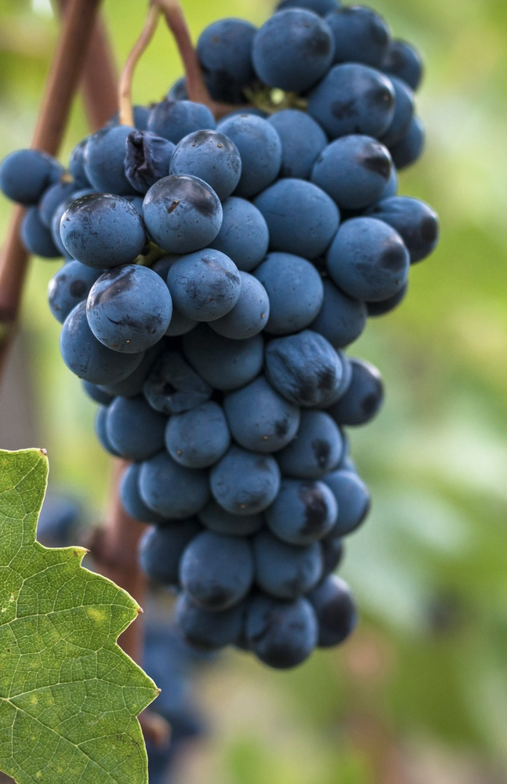
Mozaik Winery
2019 DERYA
100% Sangiovese
İzmir/Urla
Yellow clay (calcareous) rich in limestone
Maceration and Malolactic fermentation in stainless steel
Named after the winemaker's daughter

Slide 8
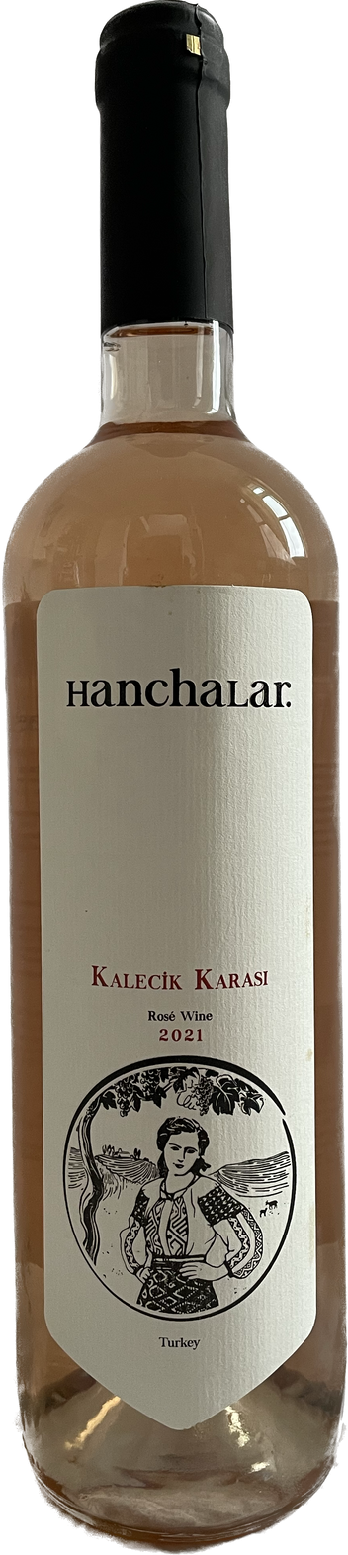
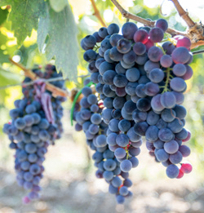
2021
KALECIK KARASI
Erdel Winery
100% Kalecik Karası
Denizli/Çal
Clay-limestone and mineral rich soils
Fermentation in stainless steel tanks
One of the most widely known grapes in Turkey

Slide 9
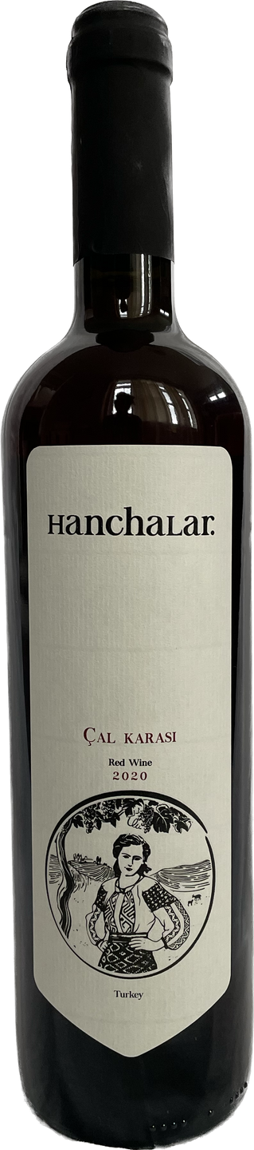
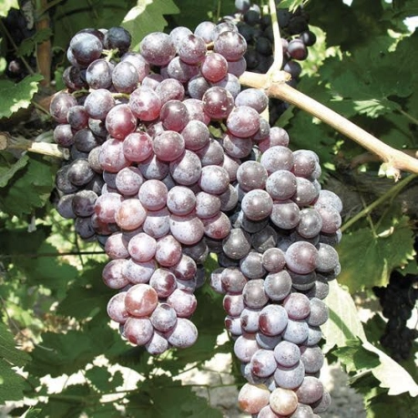
2020
ÇAL KARASI
Erdel Winery
100% Çal Karası
Denizli/Çal
clay-limestone and mineral rich soils
Fermentation in stainless steel tanks
AKA Liatiko in Crete

Slide 10
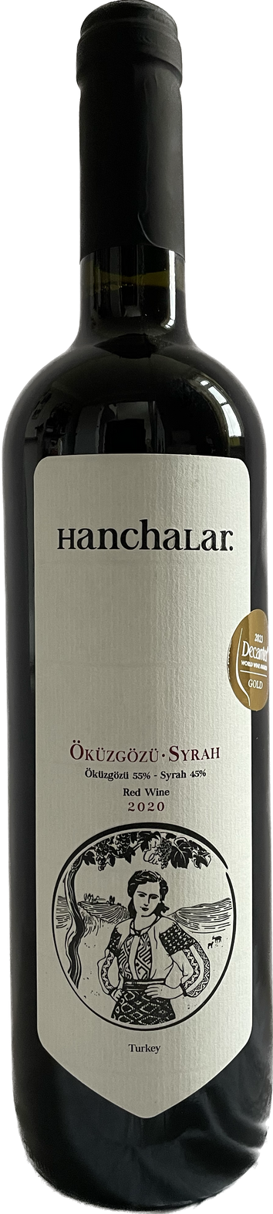
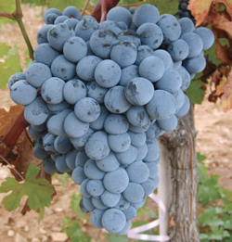
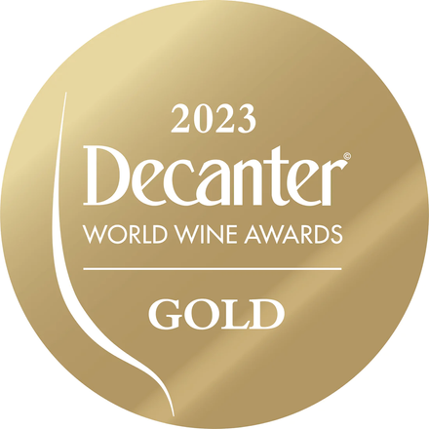
2020
ÖKÜZGÖZÜ-SYRAH
Erdel Winery
55% Öküzgözü + 45% Syrah
Denizli/Çal
Clay-limestone and mineral rich soils
Fermentation in stainless steel tanks
Öküzgözü means “Ox’s eye

Slide 11
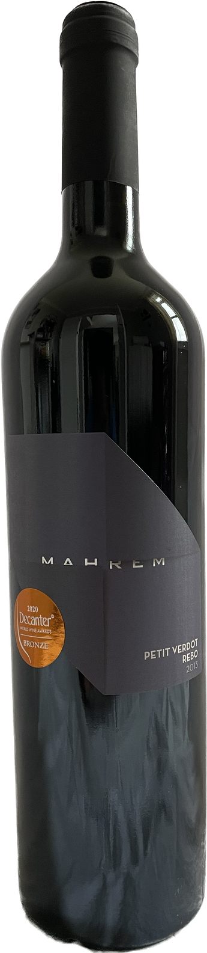
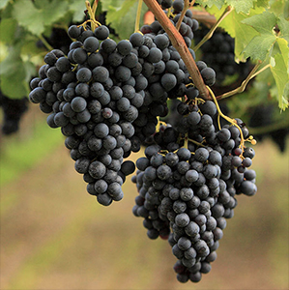
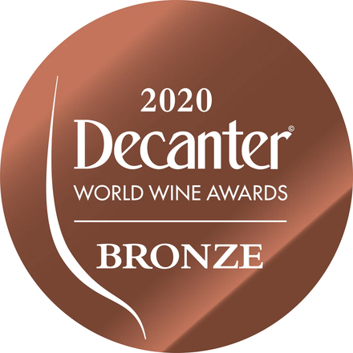
2013 PETIT VERDOT-REBO
Mozaik Winery
50% Petit Verdot + 50% Rebo
İzmir/Urla
Yellow clay (calcareous) rich in limestone
Maceration and Malolactic fermentation occur in American and French oak over 18 months
Rebo is a dark-skinned crossing of Merlot and Teroldego

Slide 12
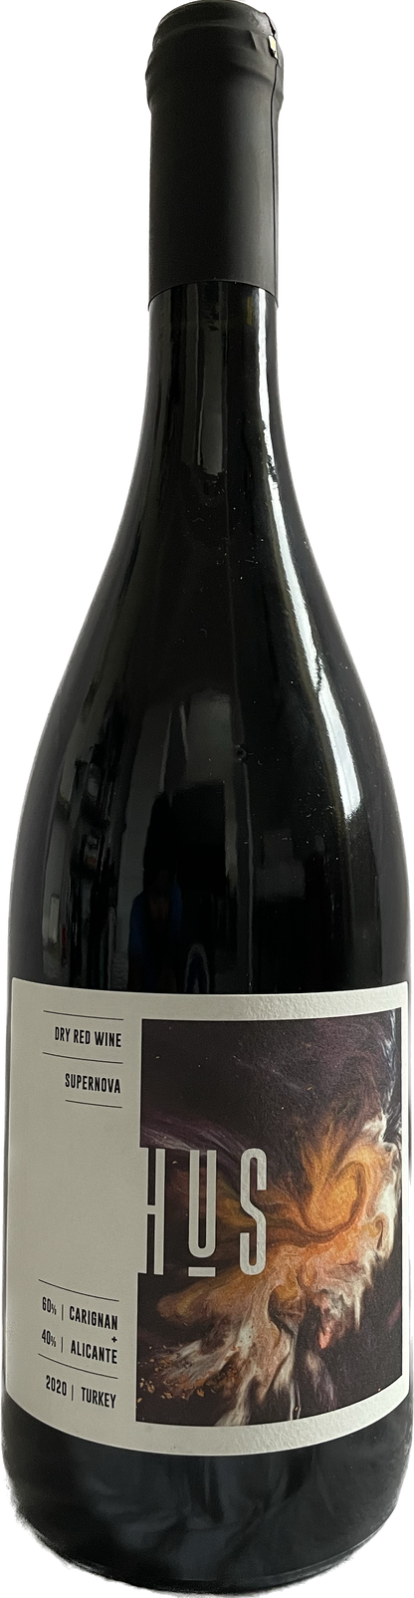
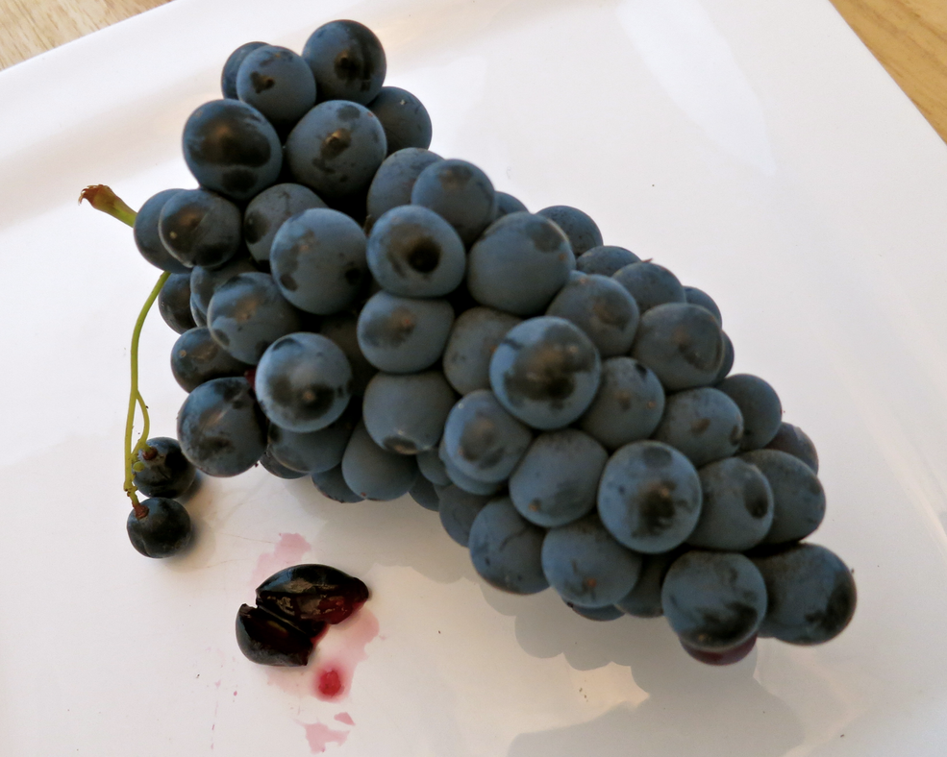
2020 SUPERNOVA
HUS Winery
60% Carignan + 40% Alicante
İzmir/Seferihisar/Beyler
Schists and Slates with high iron content
Carignan ages for 15 months in new French oak barrels. Alicante undergoes fermentation in a stainless steel tank
Alicante is a teinturier grape known for its red flesh

Slide 13
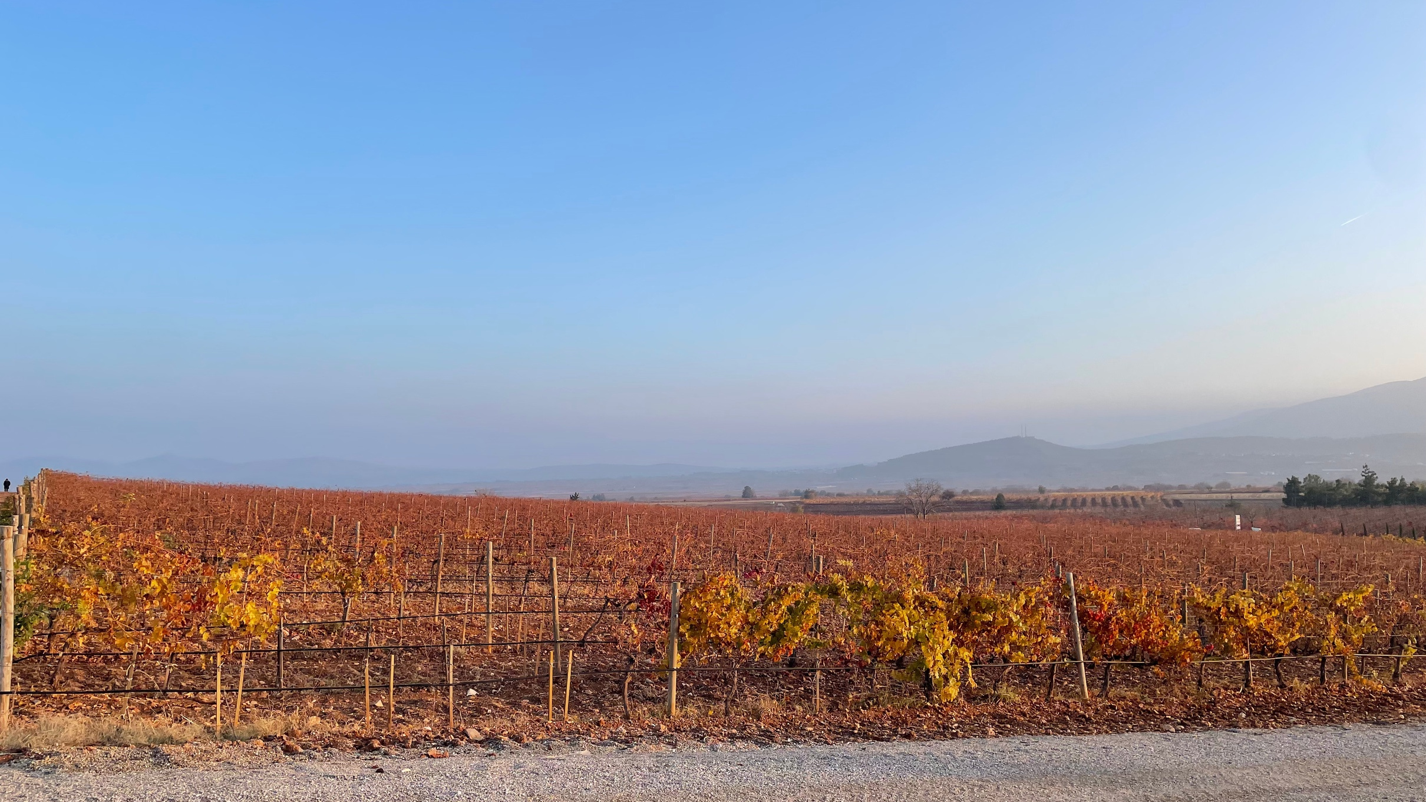
KEEP IN TOUCH
+571-331-5734
hello@rubyimportswine.com
rubyimportswine.com

