Slide 1
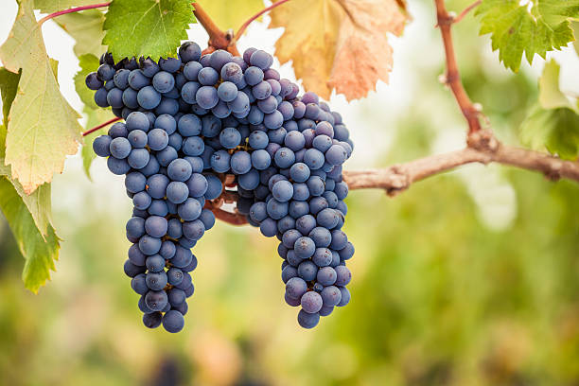
Pinot Noir

Slide 2


Slide 3


Slide 4
Generic Pinot Noir Facts
Pinot Noir is a very old varietal, and the father of a wide family known as Noiriens, which include Chardonnay, Aligoté, Auxerrois, Gamay and about a dozen others.
The first written record of the varietal called Pinot Noir dates from 1375.
Grapes are thin-skinned and delicate, violet-blue in color, and grow in small, compact bunches that somewhat resemble a purple pinecone (pin (earlier: pineau) = pine).
Pinot Noir is referred to as “the heartbreak grape”. It is a capricious varietal that is difficult to grow. Tight packing makes them susceptible to mildew and rot.
It requires a cool climate and excellent air drainage to thrive and express its full complexity.

Slide 5
More Pinot Noir Facts
The thin skins and low levels of phenolics lend pinot to producing mostly lightly colored, medium-bodied and low-tannin wines. But that also allows them to take on the characteristics of their environment. Pinot is the “quintessential interpreter of terroir”.
Young pinots have a bright ruby or garnet color, and tend to have red fruit aromas of cherries, raspberries, and strawberries.
As the wine ages, pinot’s color becomes more “brick”ish and it may develop more vegetal and "barnyard" aromas that can contribute to the complexity of the wine.
Pinot Noir is extremely susceptible to bottle shock. It can take up to a year to get back to where it was when bottled.
Pinot Noir is grown in nearly 30 countries, but mostly in France, Germany, and the United States.

Slide 6
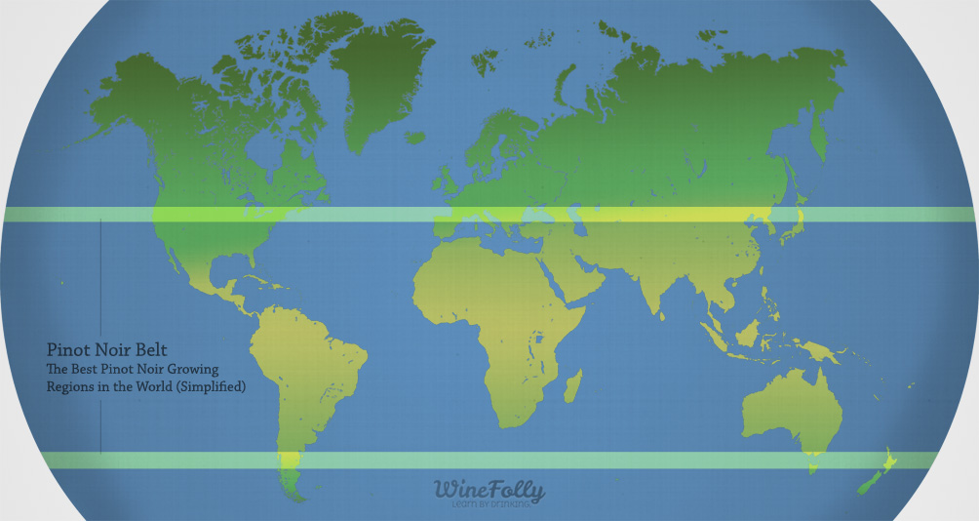

Slide 7
French (Bourgogne) Pinot Noir
France is the #1 producer of Pinot Noir, accounting for 35% of all French vine acreage.
Bourgogne Pinot Noir is considered the benchmark for all other Pinot Noirs.
Bright ruby color, tinged with violet when young. Pales to “brick” with age.
Young French Pinot Noirs suggest fresh blackcurrant, cherry, pepper, cinnamon.
As Pinot Noir ages, the flavors seem more “cooked”, like jam or pie filling.
French Pinot Noirs are generally soft and rounded in the mouth, with delicate tannins.

Slide 8
Oregon (Willamette Valley) Pinot Noir
Willamette Valley is triangular, about 100 miles long and 60 miles across at its widest point. Probably dug out by as many as 40 Ice Age floods, leaving good rich sediment behind.
First Pinot cuttings were brought to Willamette in 1959 by Richard Sommers, from the Carneros region of Napa.
The Valley climate provides a long grape-growing season that is said to be ideal for Pinot Noir. Spring is oftentimes rainy and summers are warm with cool evenings.
Pinot Noir accounts for 90% of vineyard space.
Nearly half of Willamette Valley’s vineyards are certified sustainable.
Strict labeling – Pinot Noir means at least 90% Pinot Noir (vice national standard of 75%) and the bottle can’t say “Willamette” unless 95% of the grapes are grown there.

Slide 9
German (Rheinhessen) Pinot Noir
Germany is the 3rd largest Pinot Noir producer in the world, behind France and U.S..
It is their #1 red grape; 11% of total acreage.
Spӓtburgunder (literally, “late burgundy”) has been grown there for over 1100 years.
Rheinhessen region has a climate very similar to Willamette Valley.
Aromas of blackberry, cherry, strawberry, elderberry, pepper, baking spices.
Can be made two ways:
- Classic: mild-bodied, low tannins
- Modern: full-bodied, rich in tannins

Slide 10
Italian (Trevenezie) Pinot Noir
The Trevenezie IGT was established in 1995. It is in northeastern Italy, on the southern edge of the Alps. It includes Friuli, and most of their grapes (1200 hectares – about 60%) are whites, esp. pinot grigio.
Production is low (~3.5 tons/acre) because they prefer quality over quantity.
Soil is rich in limestone and dolomite, and very hilly. Vineyard names often include the word “ronchi” which means terraced.
Pinot Noir is typically blended with Chardonnay to make Metodo classico sparkling wines, sometimes with a touch of Pinot Bianco and Pinot Grigio.
Well-crafted still Pinot Noir from the Italian Alps will offer fresh flavors of raspberry, strawberry, often with mint or licorice, complemented by of notes of forest floor, vanilla and white pepper. Tannins are typically low.
Because Pinot likes it cool, growers prefer the western slopes of the Alps, so the vines only get afternoon sun.

Slide 11
Argentina (Patagonia) Pinot Noir
Patagonia is the southernmost wine region in South America, overlapping Argentina and Chile.
Pinot Noir is the 3rd most-planted red, behind Merlot and Malbec.
The climate is cool and dry, with a high temperature differential between night and day. The mountainous soils are rich in minerals and provide good drainage. Proximity to the sea provides excellent air drainage.
Argentinian Pinot Noir exudes cherry, strawberry and vanilla, and tends to be high in acidity due to the high elevation and cool climate it's grown in.
The Rio Negro region in the far south of Argentina has some of the oldest vines in the country, with some of their Pinot Noir dating back to the early 20th century.

Slide 12
New Zealand (Marlborough) Pinot Noir
Pinot Noir was not bottled commercially in New Zealand until 1987. Now the leading red export, accounting for 7% of all production (5600 hectares) and 4% of all exports.
Southern New Zealand is quite chilly – average highs in growing season around 63 degrees – but good day/night temp differential. Very dry and breezy – ideal for Pinot Noir.
A “typical” Marlborough Pinot will have red fruit aromas and bright raspberry, cherry and plums on the palate. Wines typically have a fresh, subtle acidity that is complemented by their linear structure and even tannins. The Southern Valleys tend to produce fuller-bodied wines.
New Zealand Pinots tend to age quickly and well. 2-5 years is optimum.
Allegedly, a Pinot Noir vine was smuggled into New Zealand from Bourgogne about 50 years ago. It was confiscated by a customs officer, Malcolm Abel, who was also a winemaker. He paid for the vine’s quarantine and sent it off to be analyzed. He planted and shared the cuttings until they were all over New Zealand.

Slide 13
Pinot Noir Quotes
"God made Cabernet Sauvignon whereas the devil made Pinot Noir“ – Andre Tchelistcheff
“Pinot Noir is the most feminine of grapes - beautiful, fickle, moody, spiteful, elegant, truculent, sexy, and absolutely delicious.” - Rod Phillips
“Pinot Noir sometimes seems better suited to the care of psychiatrists than winemakers.” - Lettie Teague
“The makers of Pinot Noir are lunatic-fringe; questers after the holy grail.” - Marc de Villiers
“When you fall in love with wine, you end up loving Pinot Noir.” - Gina Gallo
“Pinot Noir is a true living species, like humans: a joy to be with one day and a moody bastard the next.” - Maurice DiMarino
“There is no better reward for the winemaker than to put a great Pinot Noir in the bottle.” - Winemaker Gary Farrell
“A great Pinot Noir brings you as close to God as any wine can.” - Matt Kramer
“If you drink no Noir, you Pinot Noir.” - Anonymous

Slide 14
King Maui 2021
Marlborough
New Zealand
13% ABV
"A Pinot Noir for everyone and anyone. This is a lighter-style wine delivering notes of baked red fruits and a subtle earthiness. Pair this Marlborough bottle with grilled meat and hearty fare."

Slide 15
Dr. Heidemanns-Bergweiller 2020
Rheinhessen Region, Germany
12% ABV
“This elegant and approachable German
Spätburgunder displays delicious flavors of
cherries and red berries. It is a fragrant
and balanced wine with a soft, fruity
finish. Pair with pasta or grilled meats.”

Slide 16
Dagger Leaf 2021
Willamette Valley, Oregon
13.5% ABV
“Aromas of red berry, vanilla cream, cedar
and light spice deliver a vibrant palate
with notes of red berry fruit, raspberry
with a soft, lingering finish. Medium
in body, this pairs beautifully with
mushroom risotto, or roasted meats.”

Slide 17
Casalino 2023
Trevenezie IGT, Italy
12.5% ABV
“Silky smooth with well defined red
berry and red currant flavors that
persists against silky, smooth tannins
on the lively finish. The perfect
accompaniment to grilled or roasted
red meats, poultry, flavorful vegetarian
entrees, and risottos.”

Slide 18
Héritiers Benoit
Pépé Maurice 2022
Bourgogne, France
13% ABV
“This is a juicy pinot with forest wood,
cloves, mushrooms and red berry fruit
on the nose. It’s medium-bodied, gently
spicy and fresh. Easy tannins.”

Slide 19
Koskil 2021
Patagonia, Argentina
13.5% ABV
“Notes of cherries, wild strawberries,
pomegranate peel and light spices. Fresh
and crunchy with medium body and soft
tannins. It has a smooth silky texture and
a delicious fruit profile, with notes of
blue flowers. Flavorful finish.”

Slide 20
Gabriele Rausse Vin Gris de Pinot Noir | $25.00
King Maui 2021 | $16.99
Dr. Heidemanns-Bergweiller 2020 | $19.99
Dagger Leaf 2021 | $21.99
Casalino 2023 | $10.99
Héritiers Benoit Pépé Maurice 2022 | $19.99
Koskil 2021 | $16.99

Slide 21
Questions?

