Slide 1


Slide 2


Slide 3
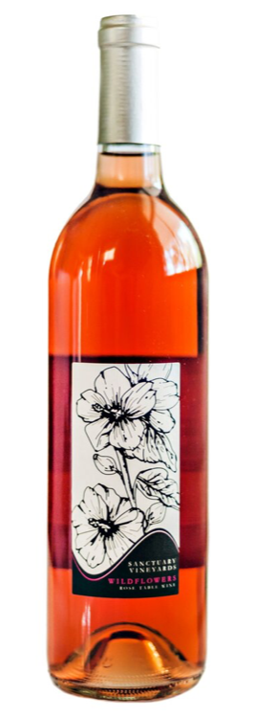
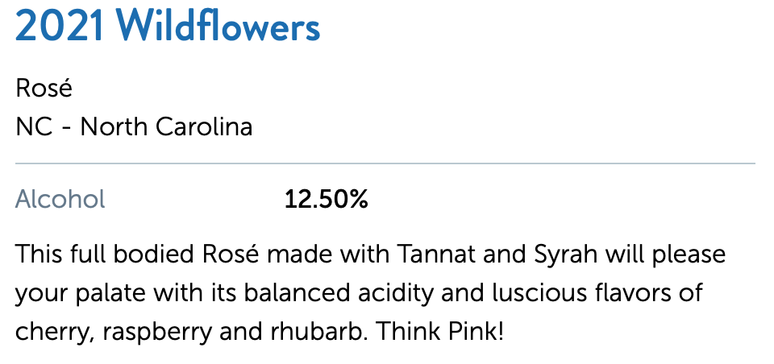
Wildflower - equal parts Syrah and Tannat - not a saignee - its a whole cluster press, which gives it more body and less astringency.

Slide 4
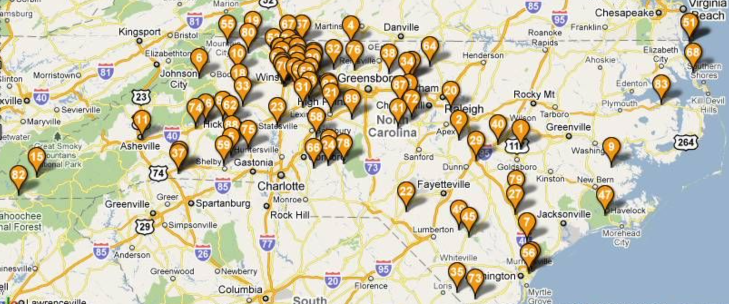
North Carolina Wineries

Slide 5
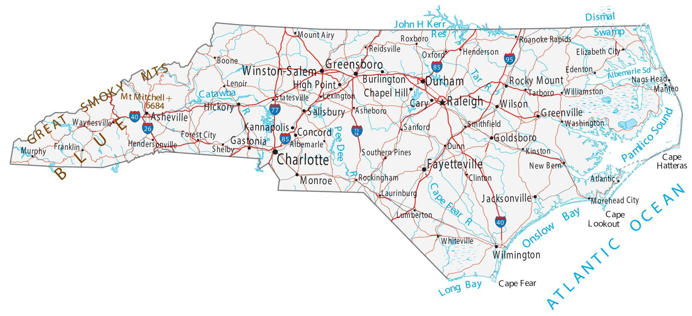

May 2023

Slide 6
Fast Forward one Month

Slide 7

June 2023

Slide 8


Why “Sanctuary?”

Slide 9
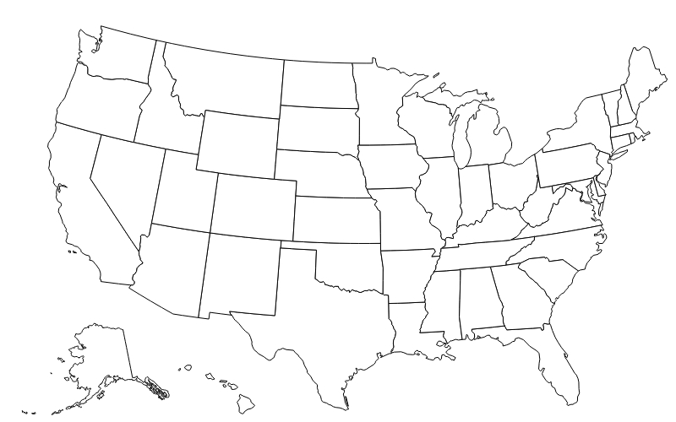


2008

Slide 10
2009

Slide 11


Slide 12
North Carolina Wine
Are there any good NC wines, East of Rt 95?

Slide 13
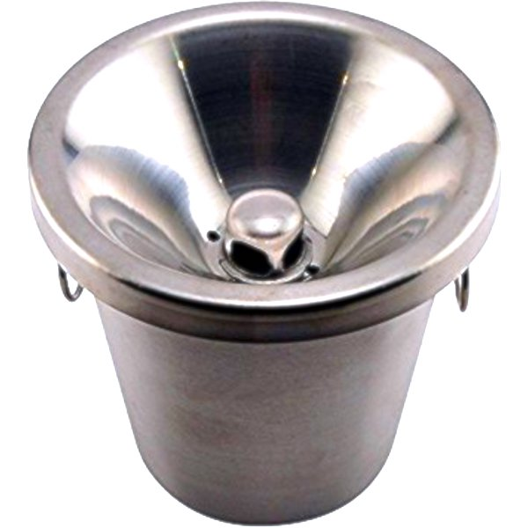
North Carolina Wine
Are there any good NC wines, East of Rt 95?

Slide 14
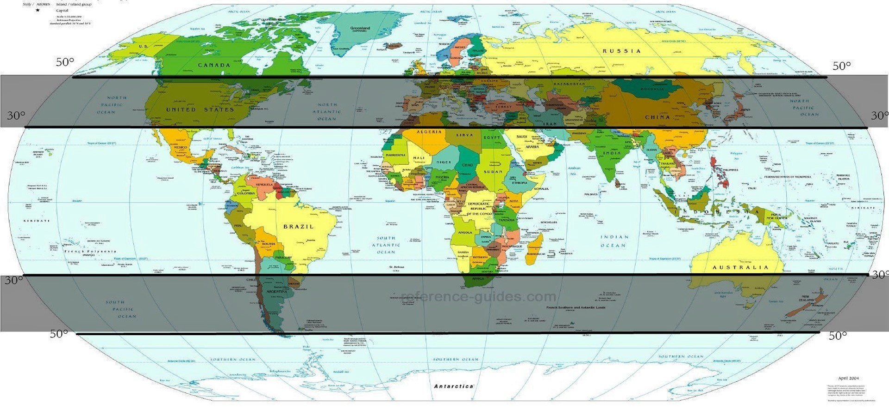
Where?
Nashik, India

Slide 15
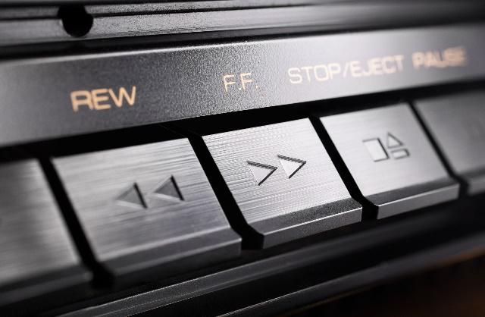

Slide 16
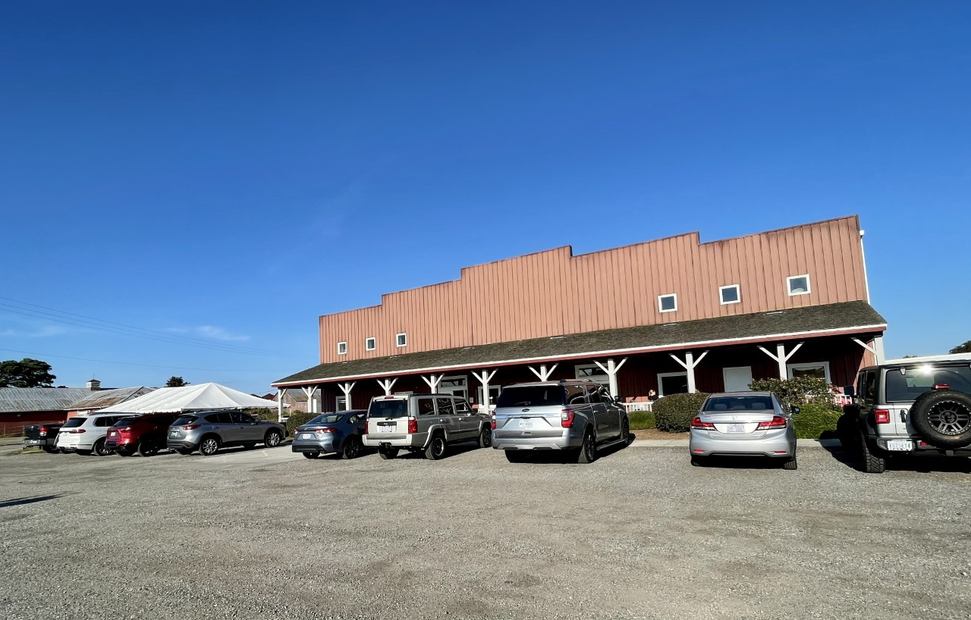

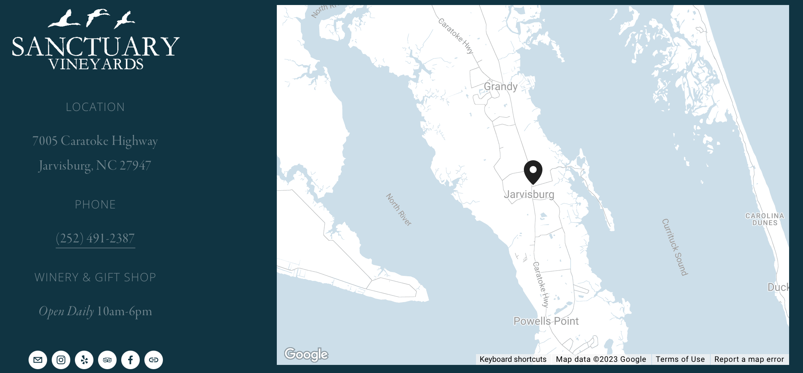

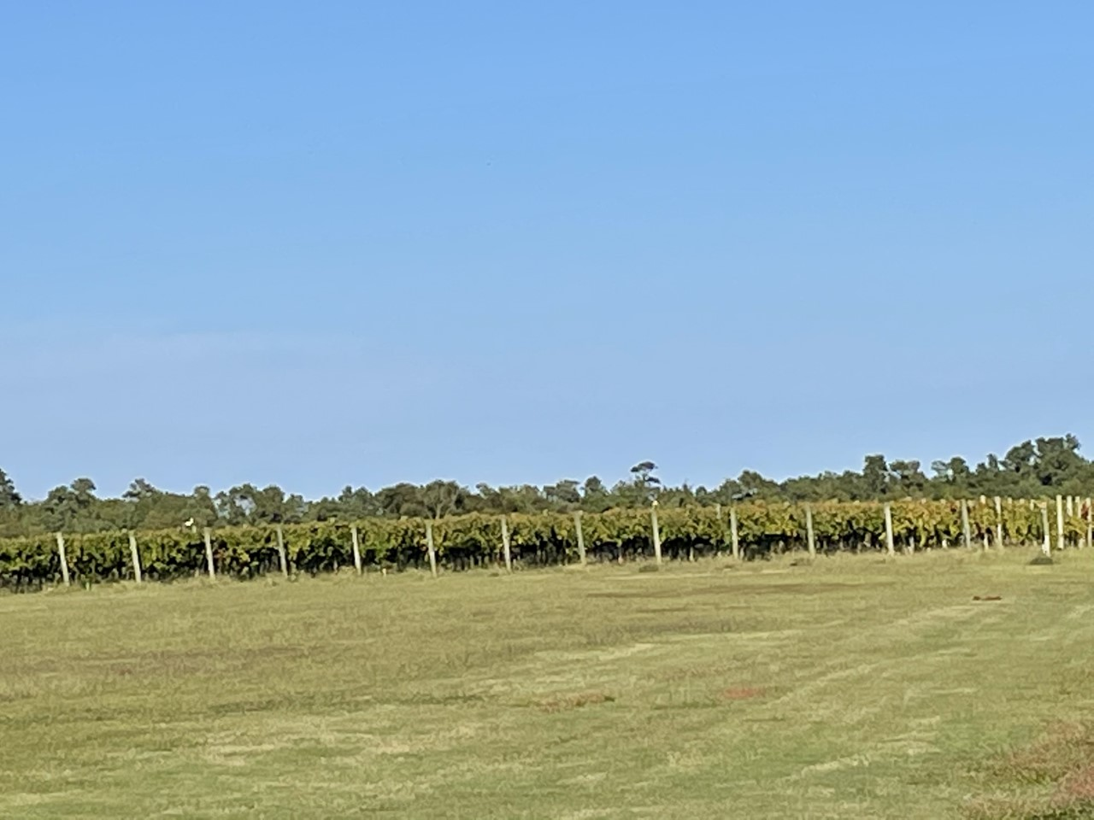

Slide 17
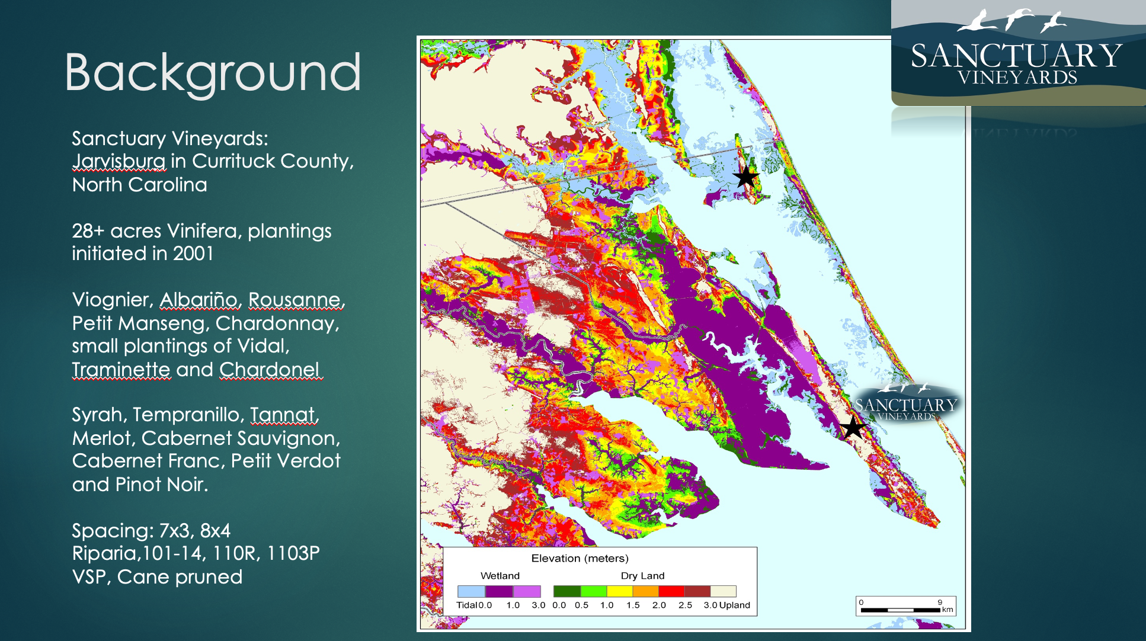

Slide 18


Slide 19
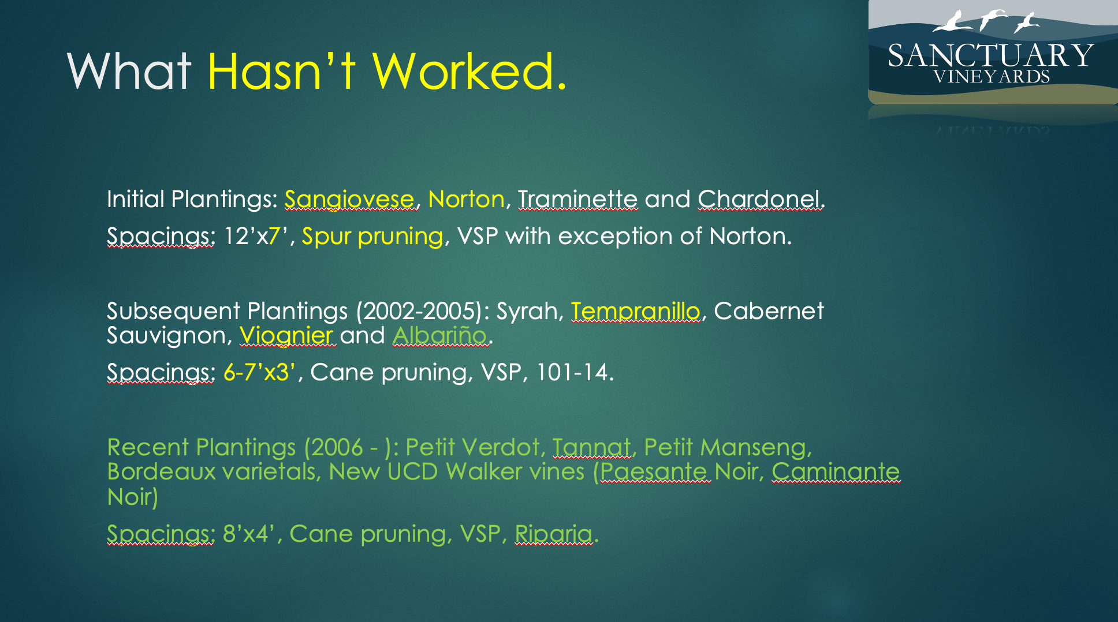

Slide 20
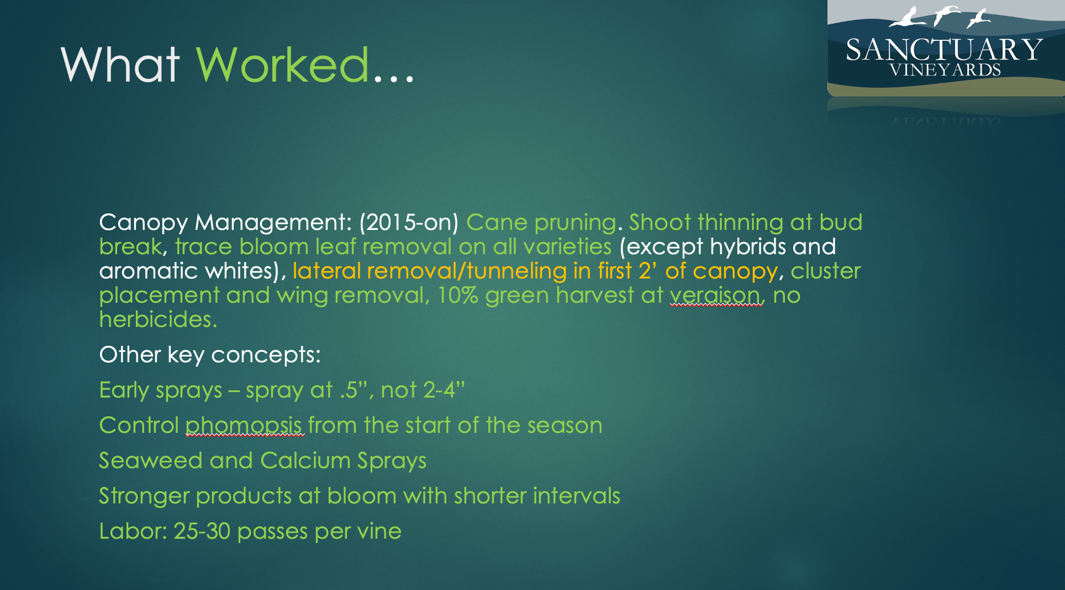

Slide 21
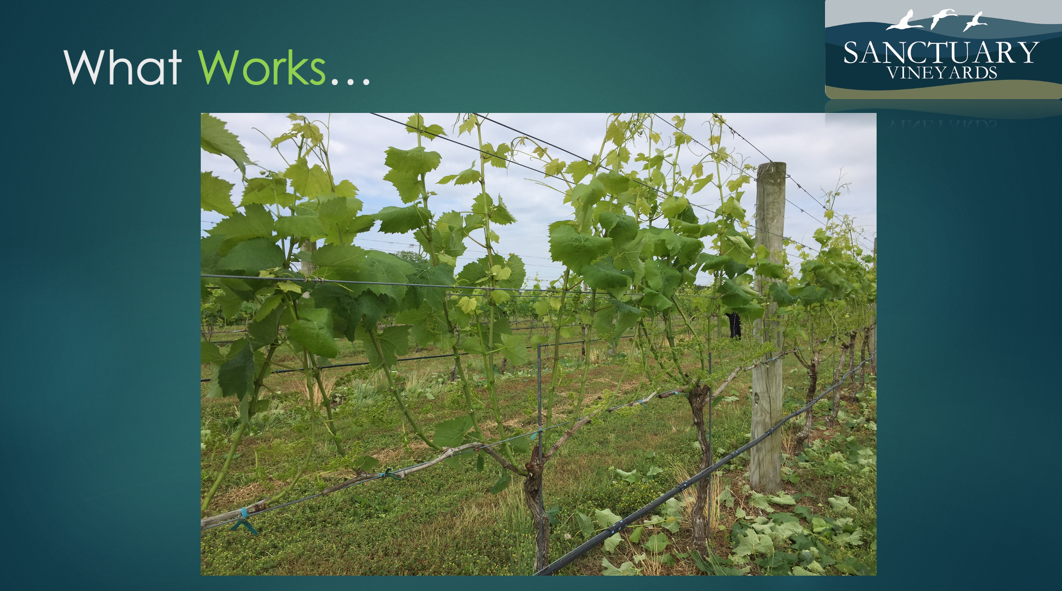

Slide 22
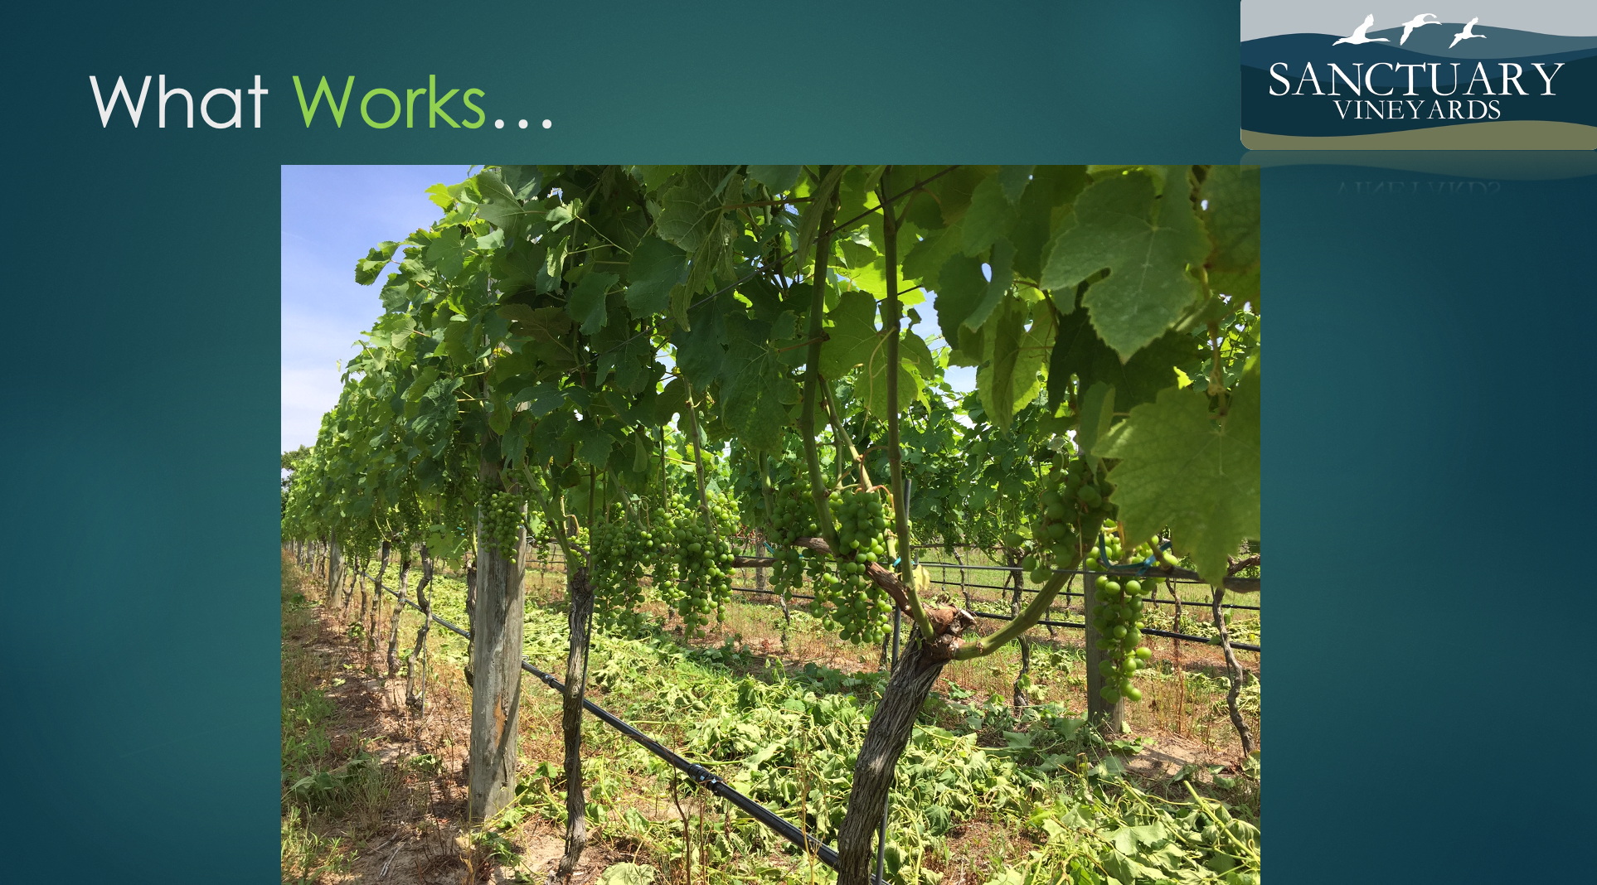

Slide 23
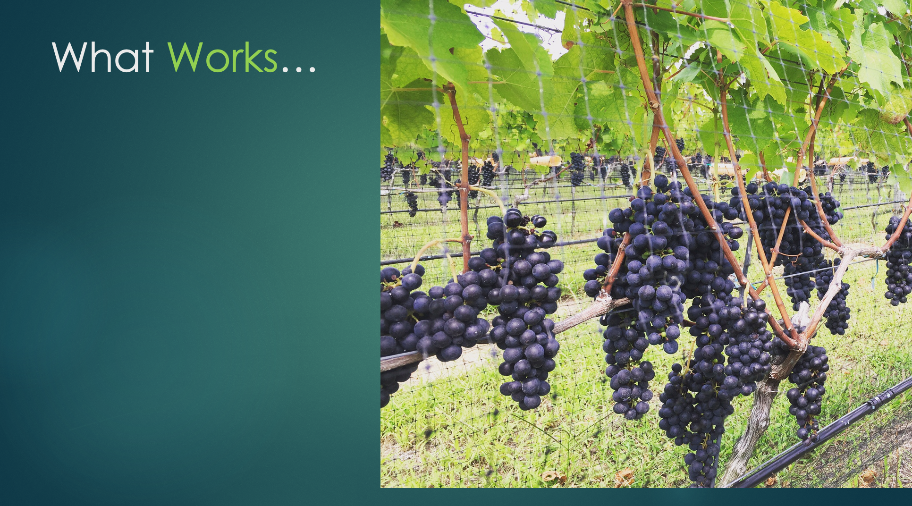

Slide 24
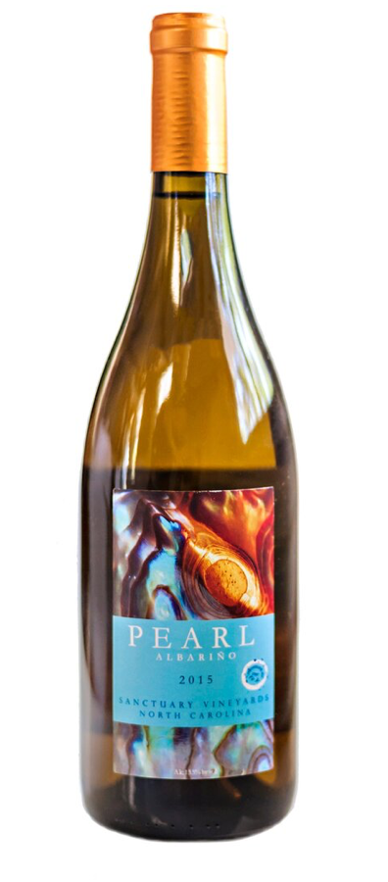
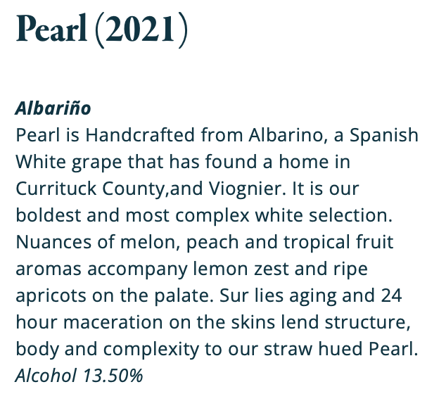

Pearl - pure Albarino - some skin contact prior to press, lees stirring, no oak.

Slide 25
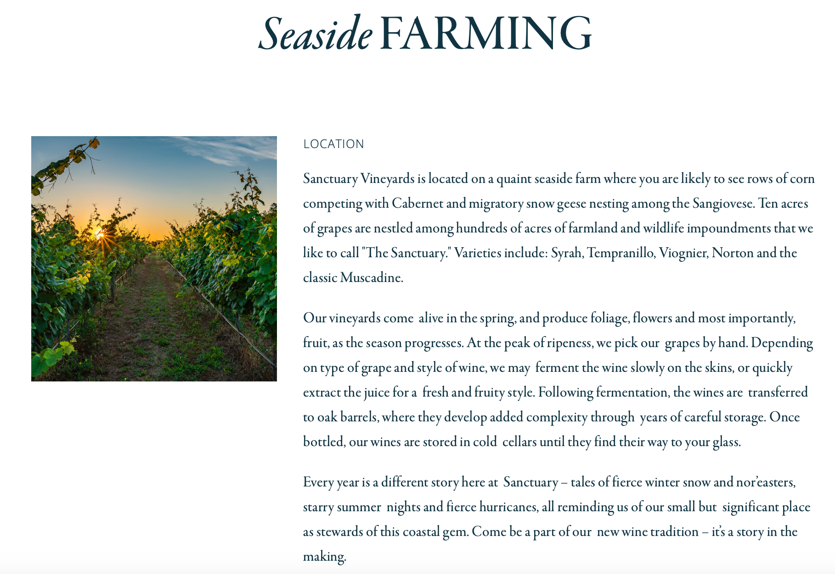

Slide 26
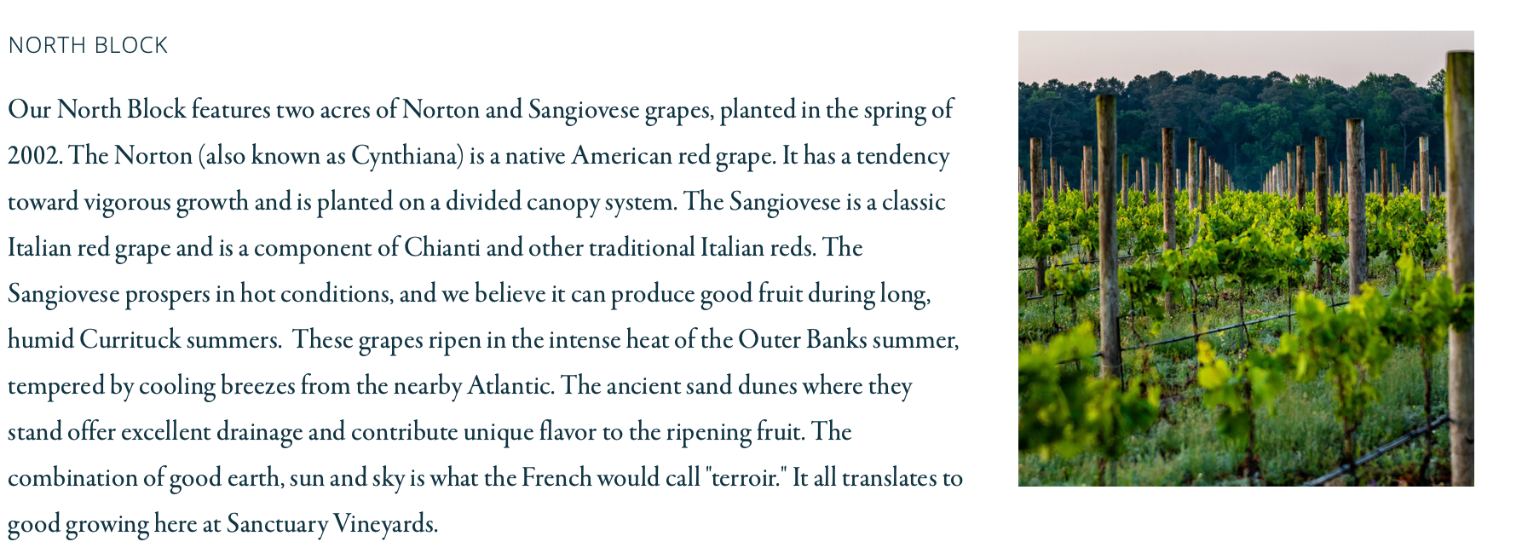
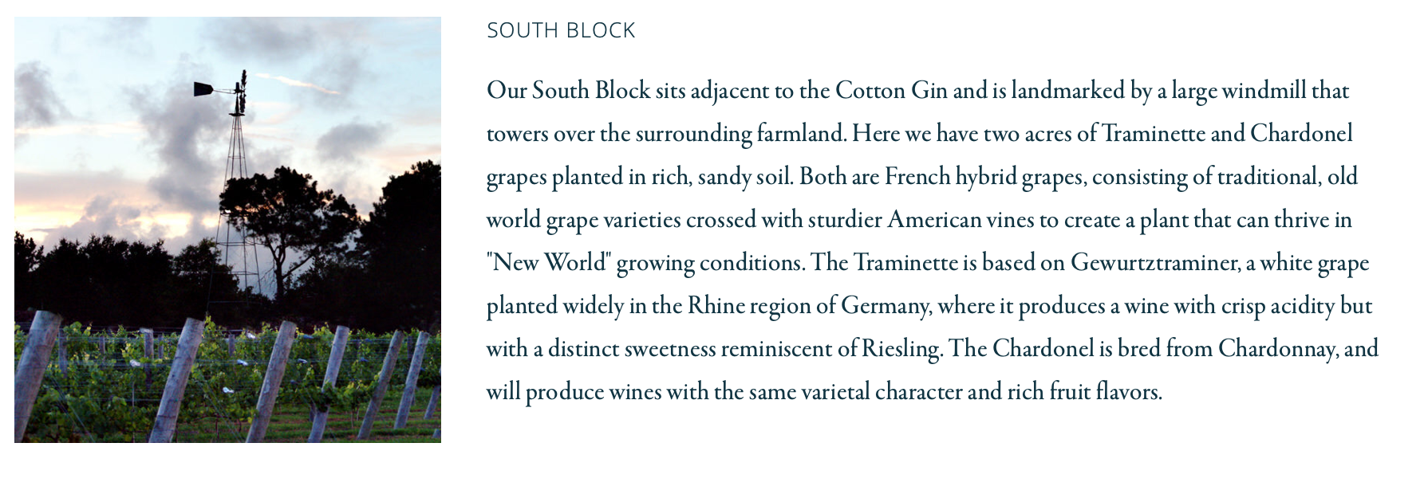

Slide 27
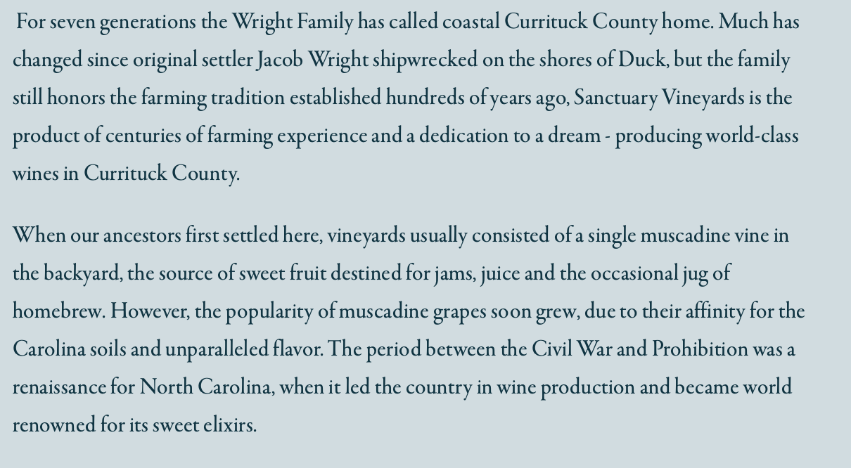

Slide 28
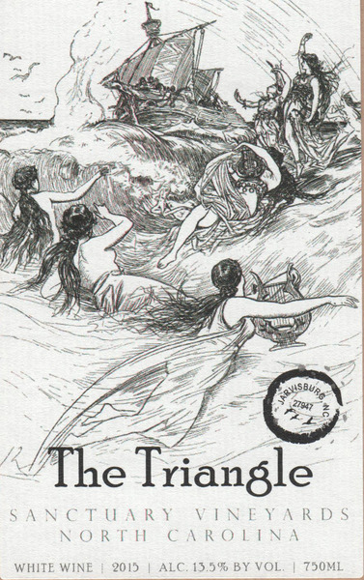

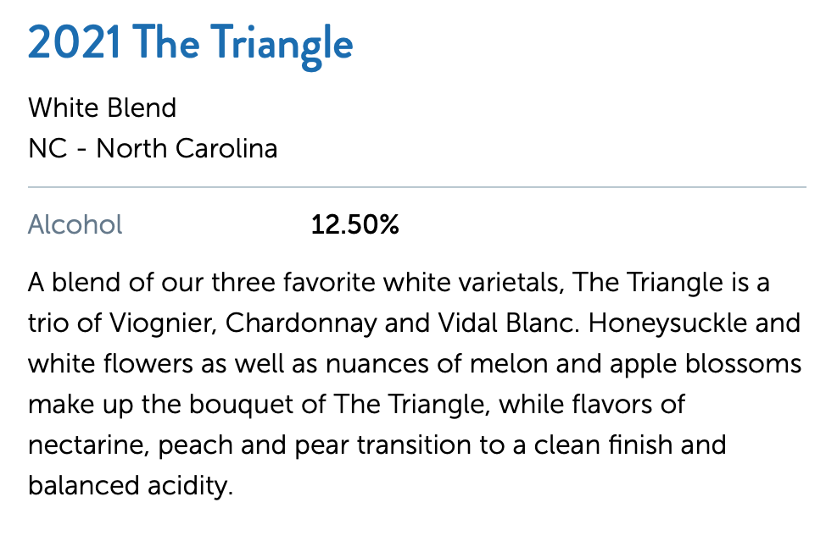
Triangle - Viognier driven - more lees stirring than other wines.

Slide 29
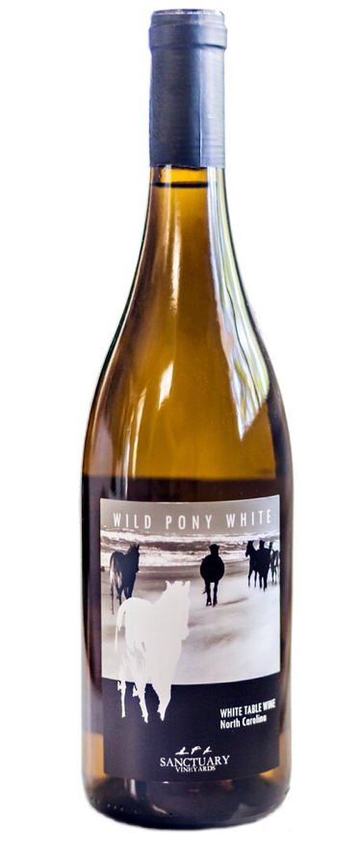
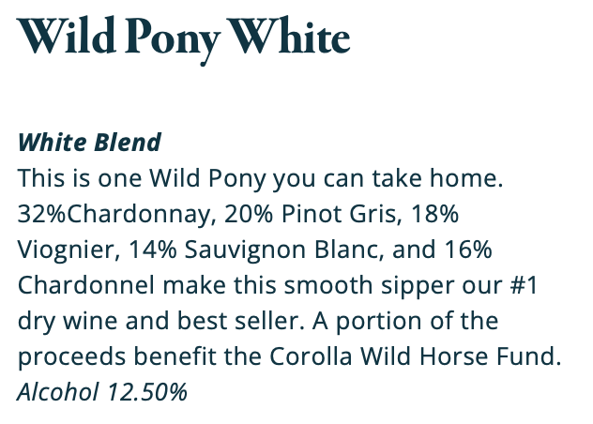


Slide 30
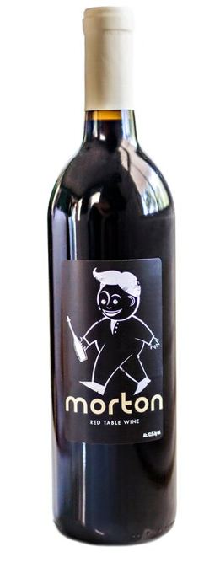
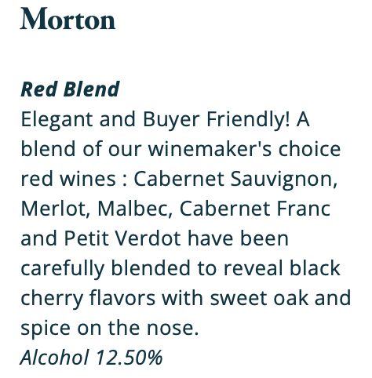

Wine 4 Morton
Morton - The kitchen sink - but so good in this vintage as we had an abundance of high quality Bordeaux varietals that would usually be blended in Reserve wines.

Slide 31
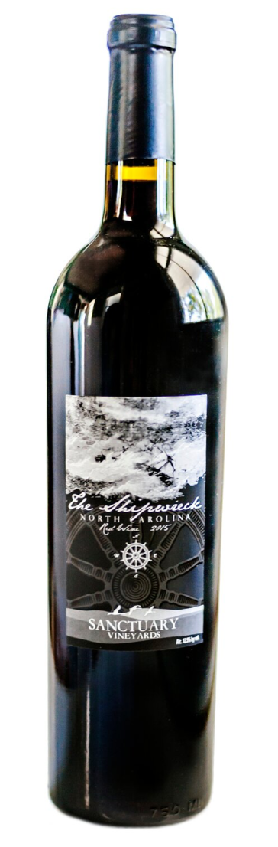

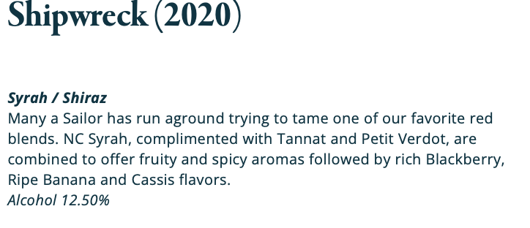

Slide 32

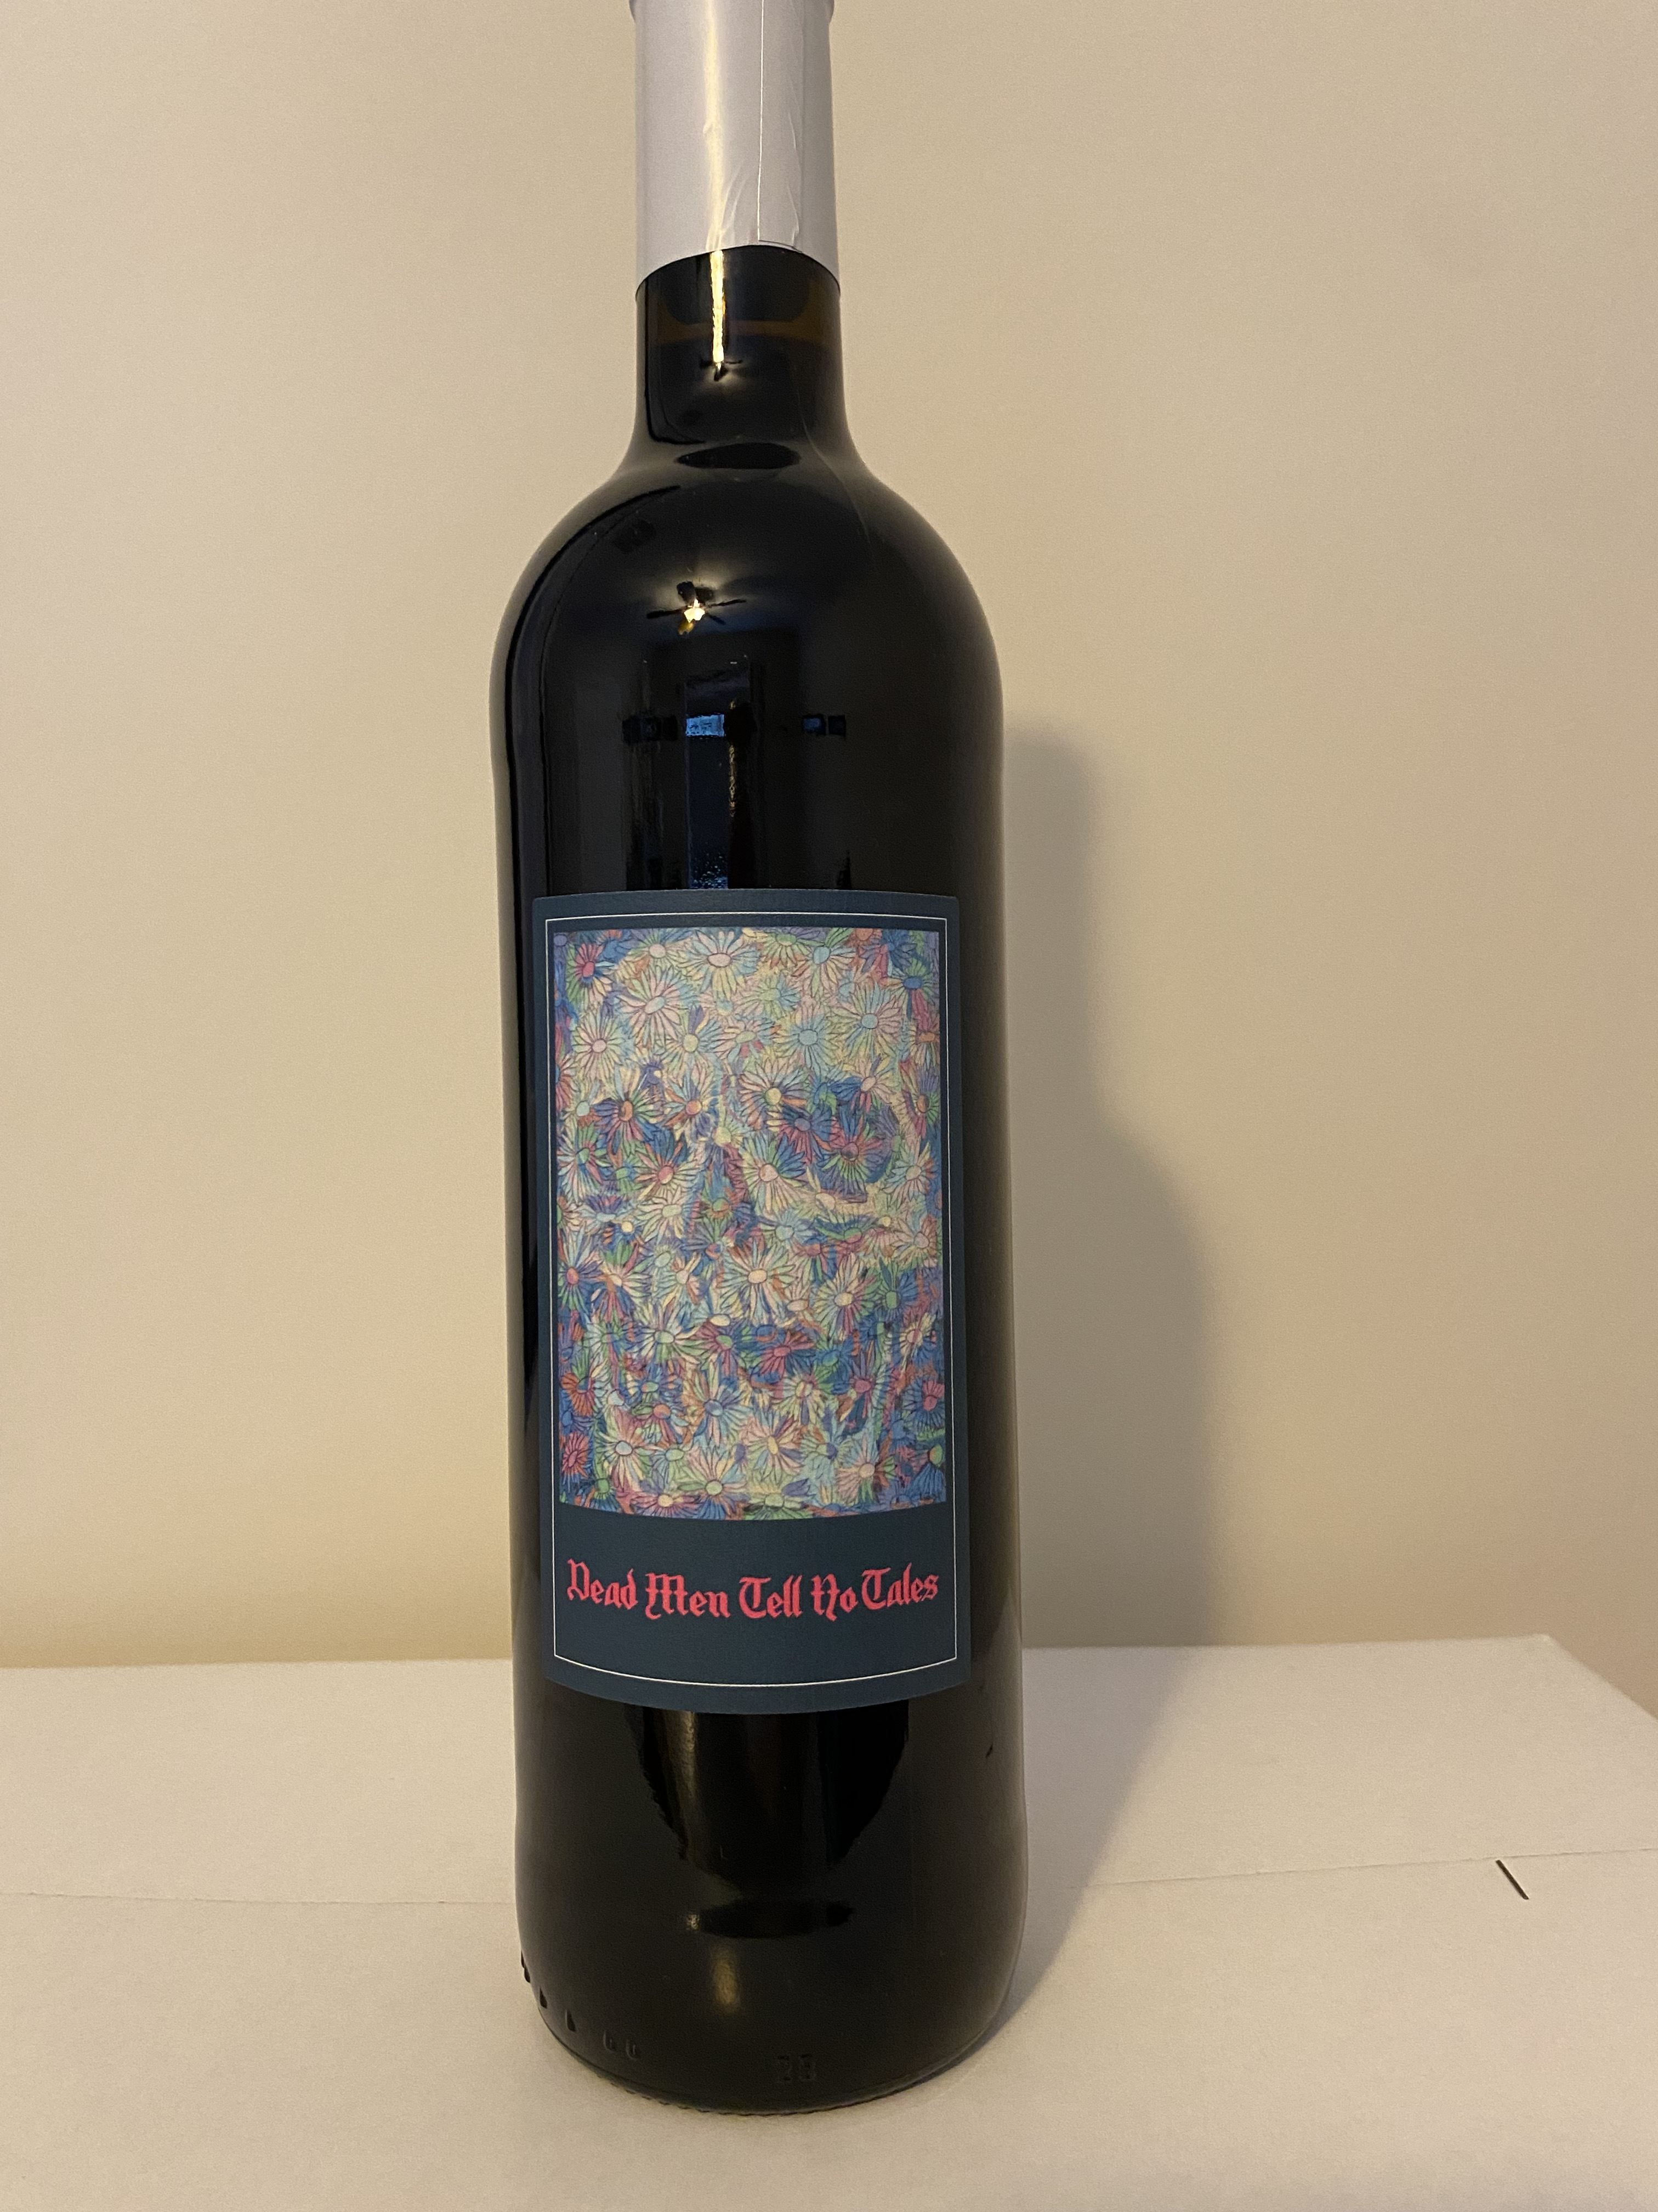
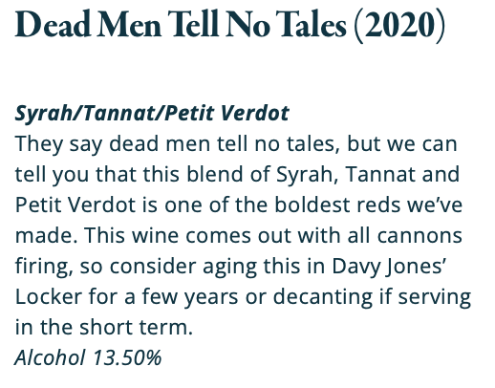
Big and bold, Tannat and Petit Verdot always bring too much tannin and alcohol to the party, so blending and further bottle aging help wines like this.

Slide 33

Notes:
Any questions?

Slide 34

** Wild Flowers
1 - Wild Pony White
2 - Triangle
3 - Pearl
4 - Morton
5 - Shipwreck
6 – Dead Men don’t Tell Tales
Notes:
Lets Vote! Favorite White, Favorite Red, Favorite overall

Slide 35

1 – Wild Pony White
2 – Triangle
3 – Pearl
4 – Morton
5 - Shipwreck
6 - Dead Men Tell No Tales

Slide 36
1 – Wild Pony White - $20
2 – Triangle
3 – Pearl
4 – Morton
5 - Shipwreck
6 - Dead Men Tell No Tales

Slide 37
1 – Wild Pony White - $20
2 – Triangle
3 – Pearl
4 – Morton
5 - Shipwreck
6 - Dead Men Tell No Tales

Slide 38
1 – Wild Pony White - $20
2 – Triangle - $30
3 – Pearl
4 – Morton
5 - Shipwreck
6 - Dead Men Tell No Tales

Slide 39
1 – Wild Pony White - $20
2 – Triangle - $30
3 – Pearl - $30
4 – Morton
5 - Shipwreck
6 - Dead Men Tell No Tales

Slide 40
1 – Wild Pony White - $20
2 – Triangle - $30
3 – Pearl - $30
4 – Morton - $20
5 - Shipwreck
6 - Dead Men Tell No Tales

Slide 41
1 – Wild Pony White - $20
2 – Triangle - $30
3 – Pearl - $30
4 – Morton - $20
5 - Shipwreck - $30
6 - Dead Men Tell No Tales

Slide 42
1 – Wild Pony White - $20
2 – Triangle - $30
3 – Pearl - $30
4 – Morton - $20
5 - Shipwreck - $30
6 - Dead Men Tell No Tales - $40

Slide 43
** Wild Flowers - $25 (6/10/2023)
1 – Wild Pony White - $20
2 – Triangle - $30
3 – Pearl - $30
4 – Morton - $20
5 - Shipwreck - $30
6 - Dead Men Tell No Tales - $40

Slide 44

Notes:
BONUS!!!!!!

Slide 45

Next Meeting - Card Bourdeaux – 7/14 - Stricklands

