Slide 1

KGWS WINE SOCIETY
MARCH MEETING
OPEN SPOTS :
June and August for Wine presentations
A lot of spots open for food
New Members!
Dues
Password

Slide 2
King George Wine Society www.kgwinesociety.com
2/10/2023
Average Attendees
2018 | 29
2019 | 29
2020 | 15
2021 | 17
2022 | 21
2023 | 31
Bylaws/Standing Rules up for discussion
RSVP – (Except for illness, If you RSVP’d, expected to pay)
If cost will be over $30 average/bottle, need membership approval (vote) the meeting before
Limit 3 bottles per wine, 6 wines (or under $540 total, without vote)
RSVP’s including guests are not guaranteed space
Budget has been strained; suggested options:
Change Tasting Size (2oz to 1.5oz)
Increase Tasting Fee ($15 to $20)
Reduce Free Tastings:
  Presenter: 1
  Food Preparer: 2 (2 to 1)
Meeting Income
Income: | Tasting Fee
Attendees: | $15 | $20
20 | $205 | $290
25 | $280 | $390
30 | $355 | $490
35 | $430 | $590
(3 free tastings ($45), food ($50)
# | Total | Pour Size (oz) |  | Bottle $ | Wines
Bottles | oz | 1.5 | 2 | $30 | 6
1 | 25.4 | 16.9 | 12.7 | 30 | $180
2 | 50.7 | 33.8 | 25.4 | 60 | $360
3 | 76.1 | 50.7 | 38.0 | 90 | $540
4 | 101.4 | 67.6 | 50.7 | 120 | $720

Slide 3
King George Wine Society www.kgwinesociety.com
Change pouring size (2oz 1.5/1.7oz)
Increase tasting fee ($15 $20)
Food Preparer - Reduce Free Tastings:
  Wine Presenter: 1
  Food Preparer: 2 (2 to 1)
  Possibly re-word by-law?
  If tasting fees are raised that adds to the reimbursement value

Slide 4


Slide 5


Why “Wines from India?”

Slide 6


Slide 7
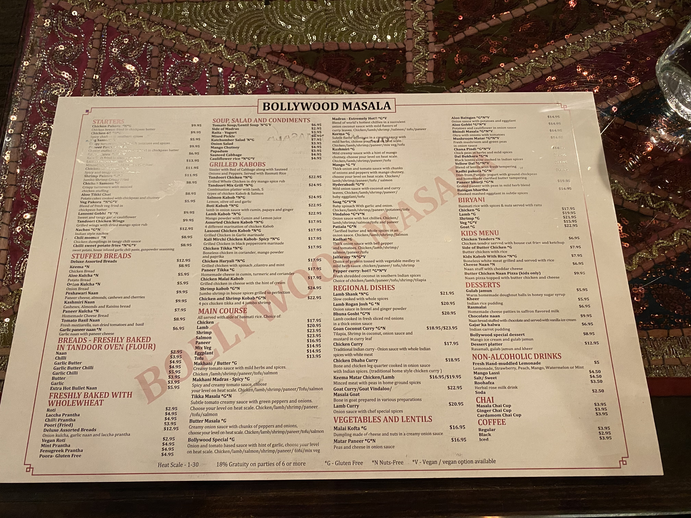
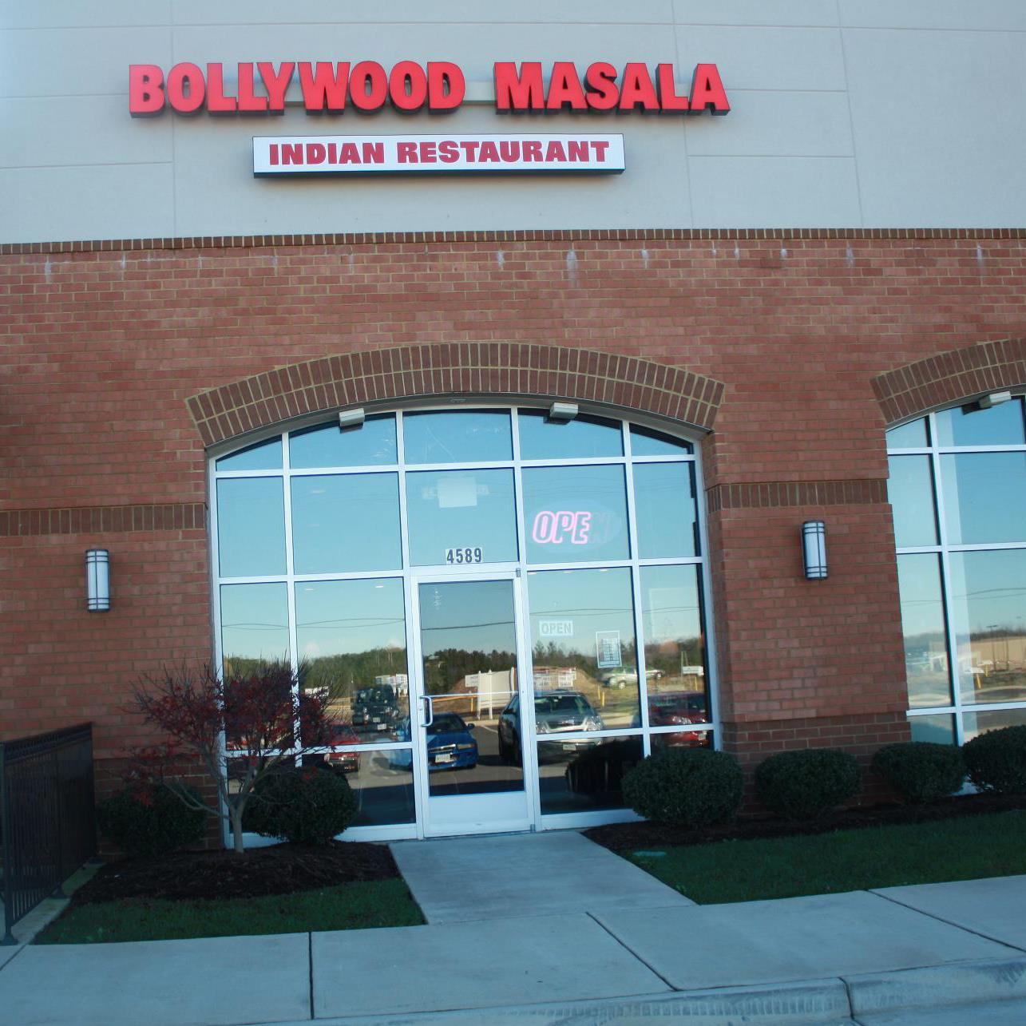
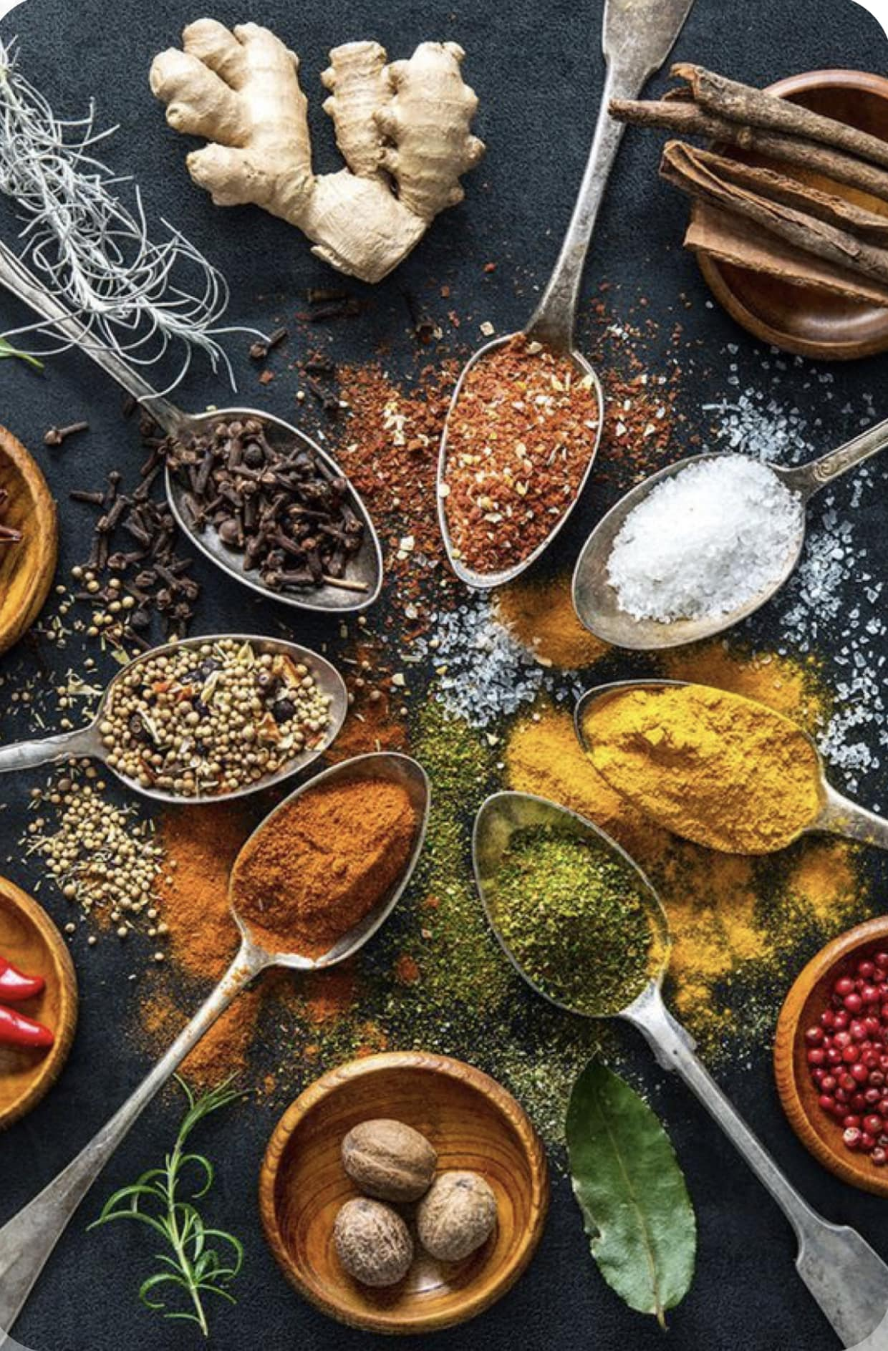

Slide 8
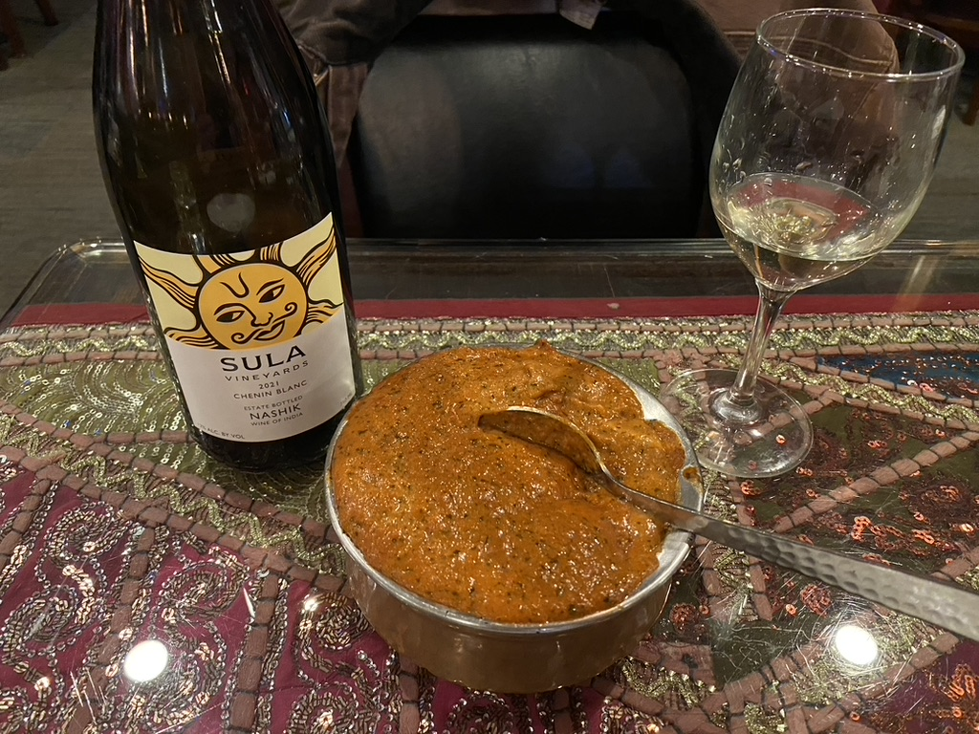
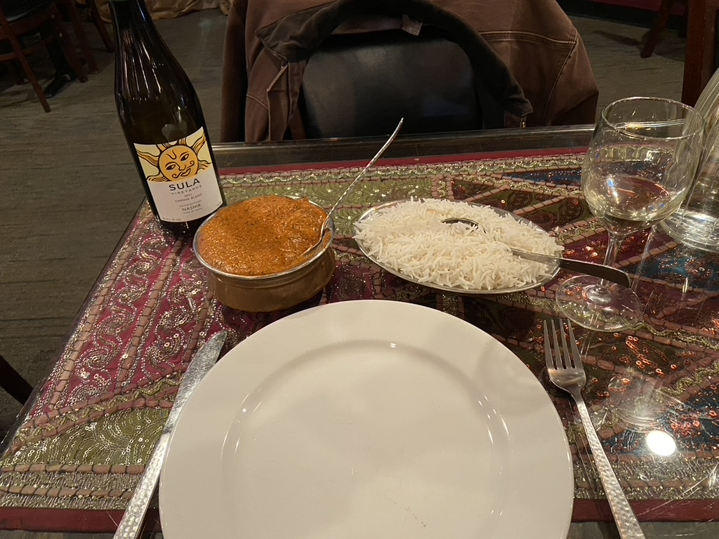
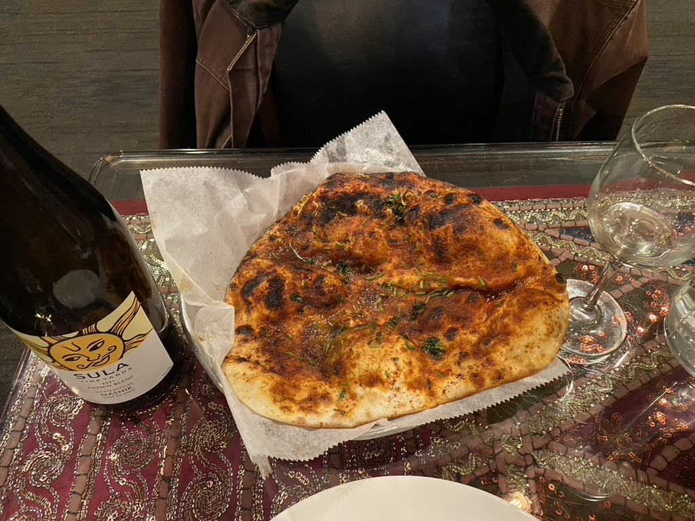

Slide 9


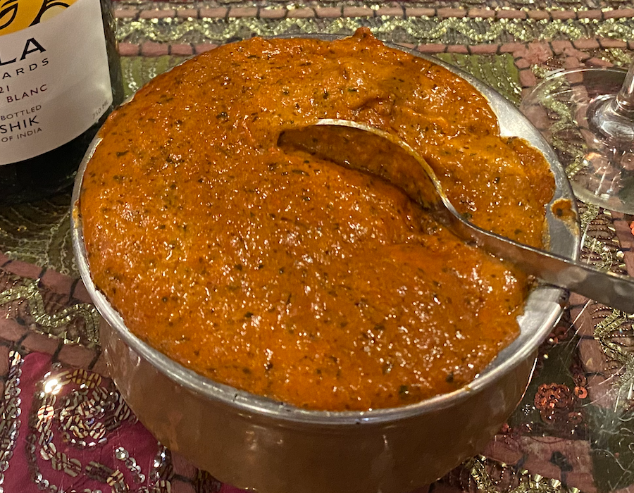
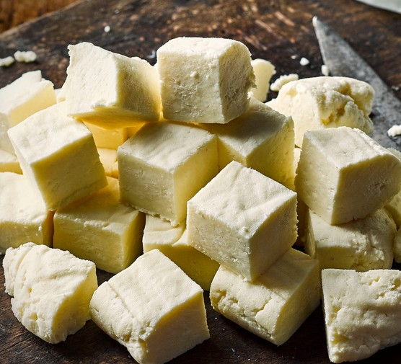
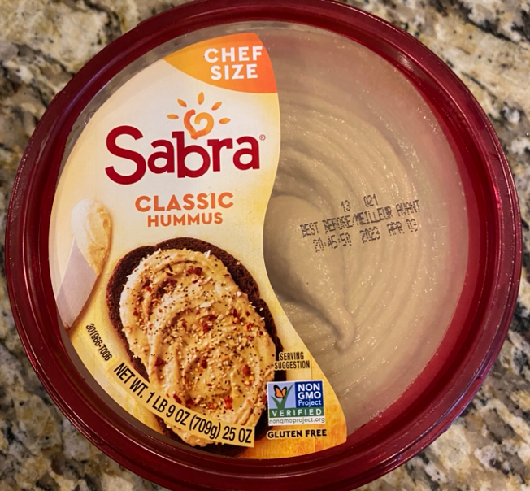
Speaking of food

Slide 10
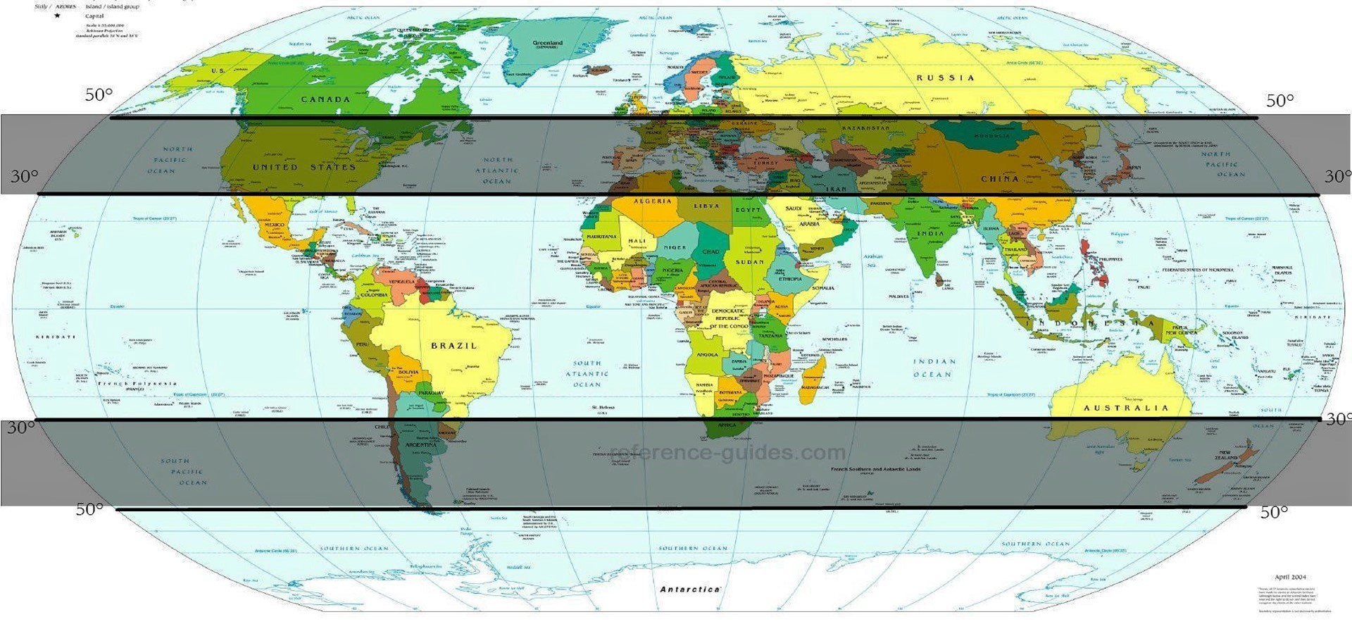
Where?
Nashik, India

Slide 11
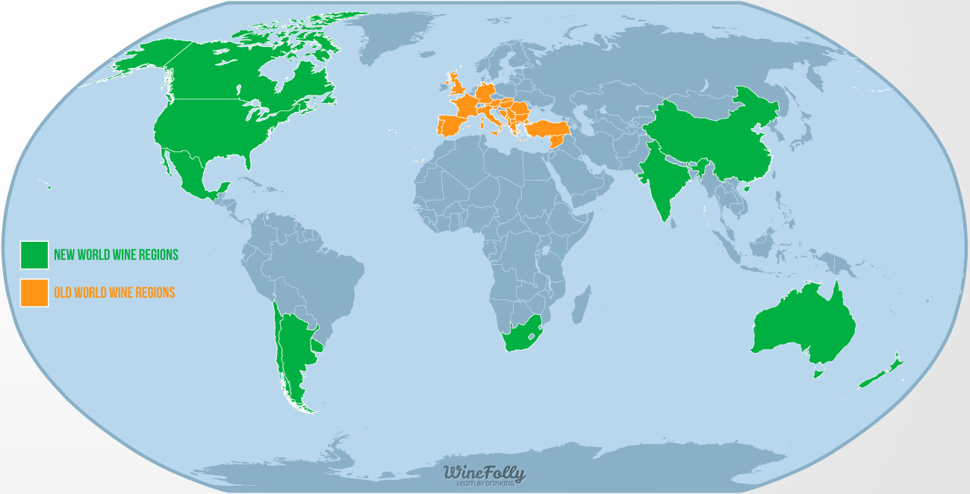

Slide 12
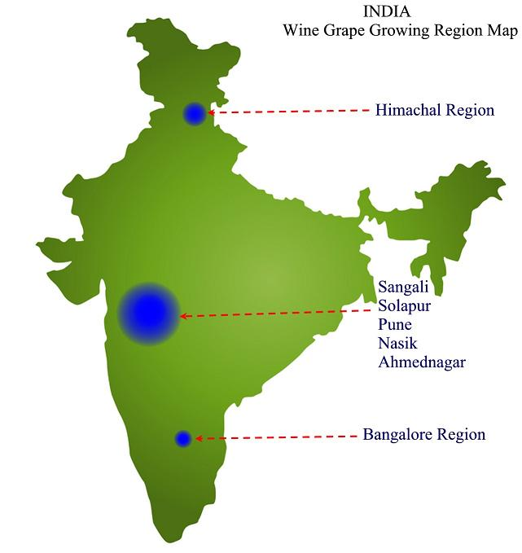
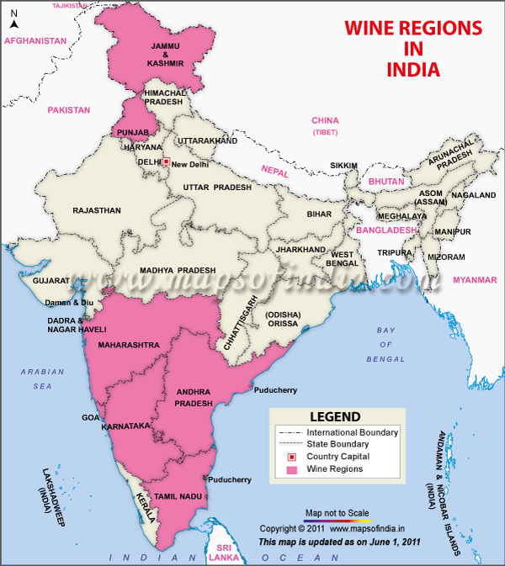

Slide 13
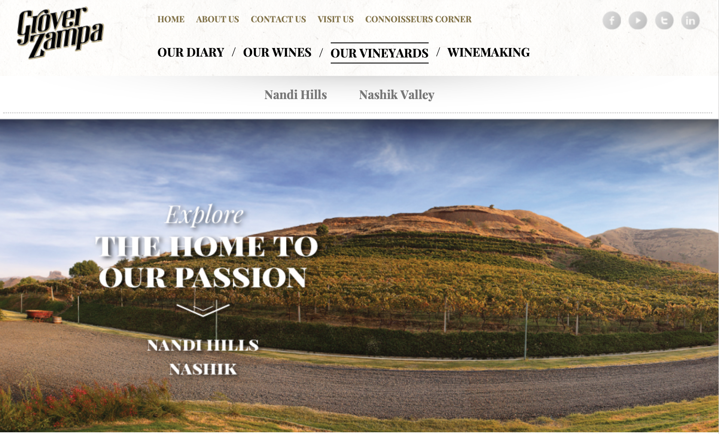
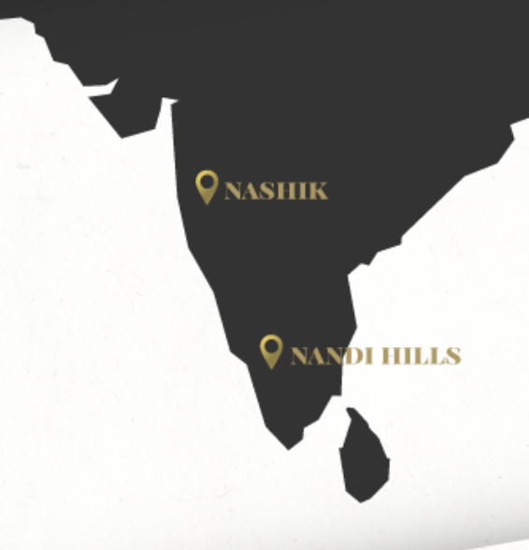

Slide 14

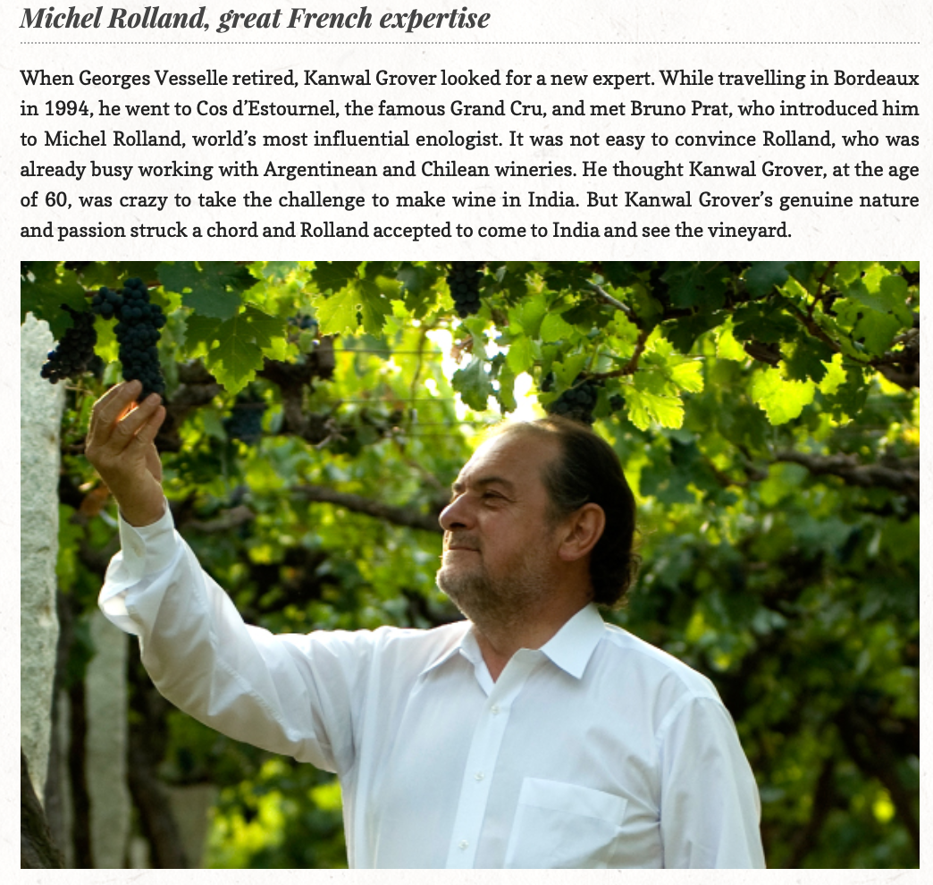
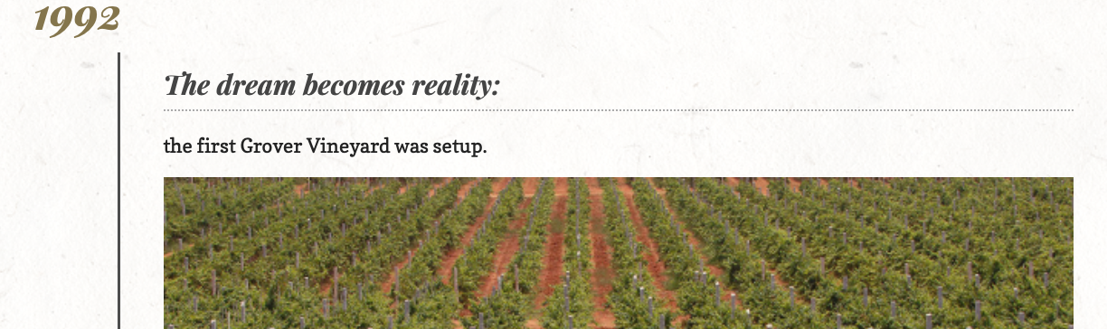
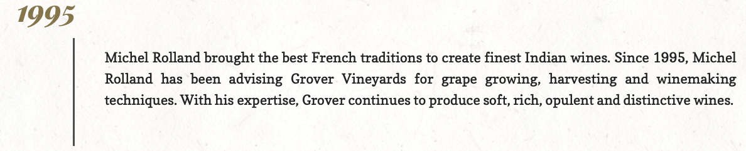

Slide 15

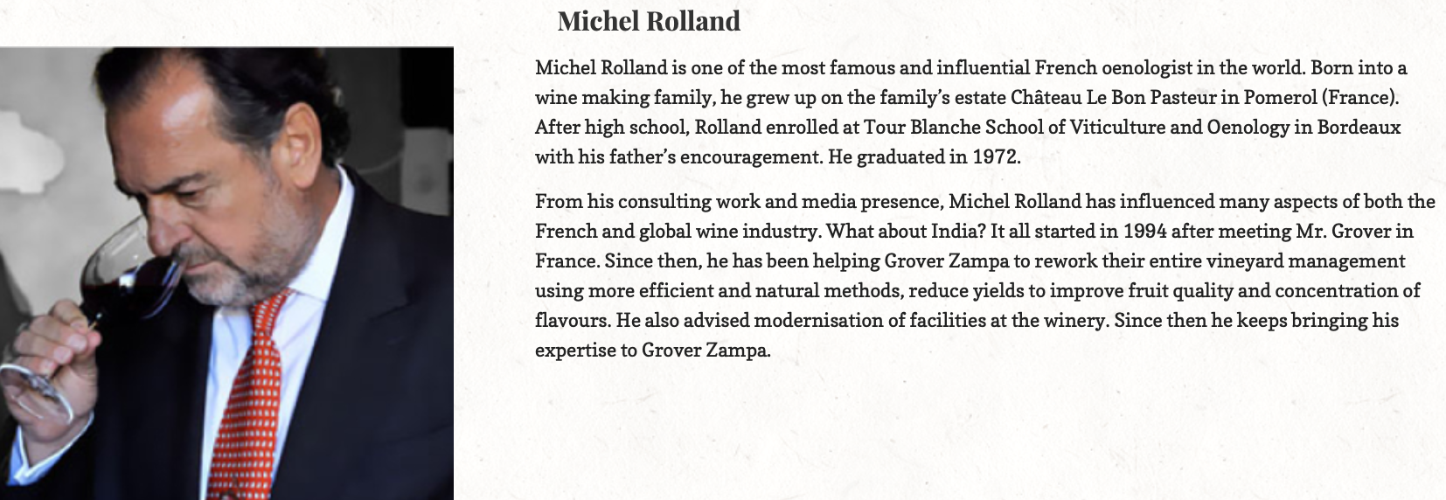
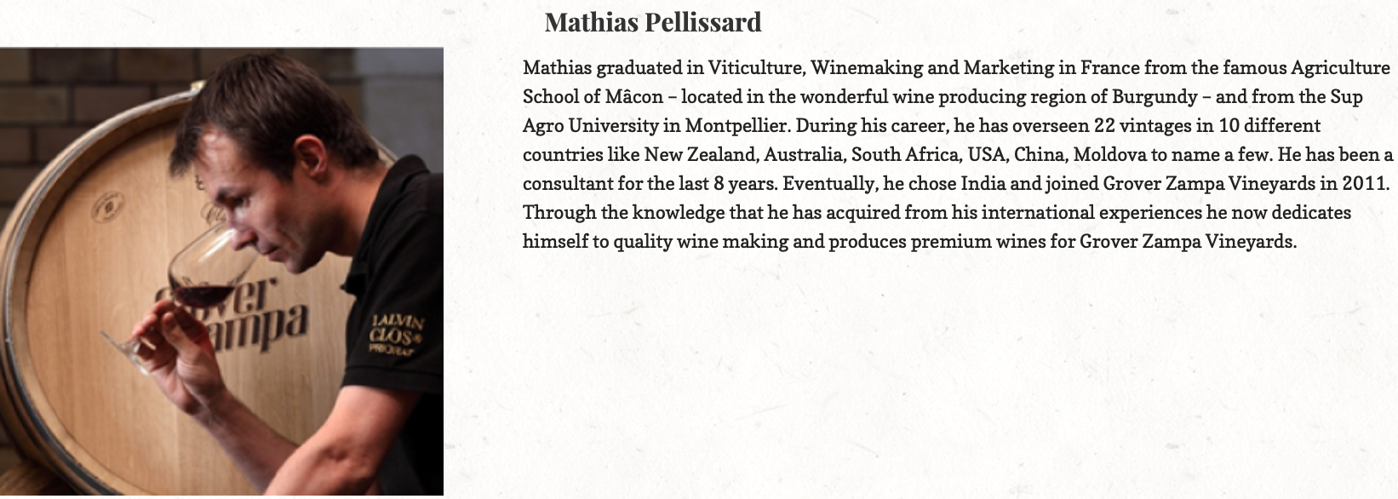

Slide 17

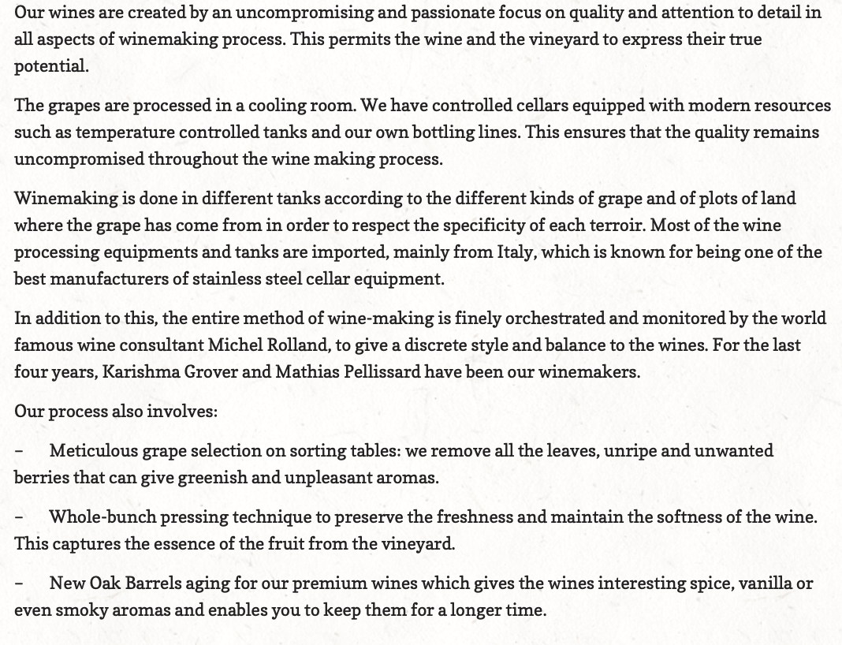

Slide 18
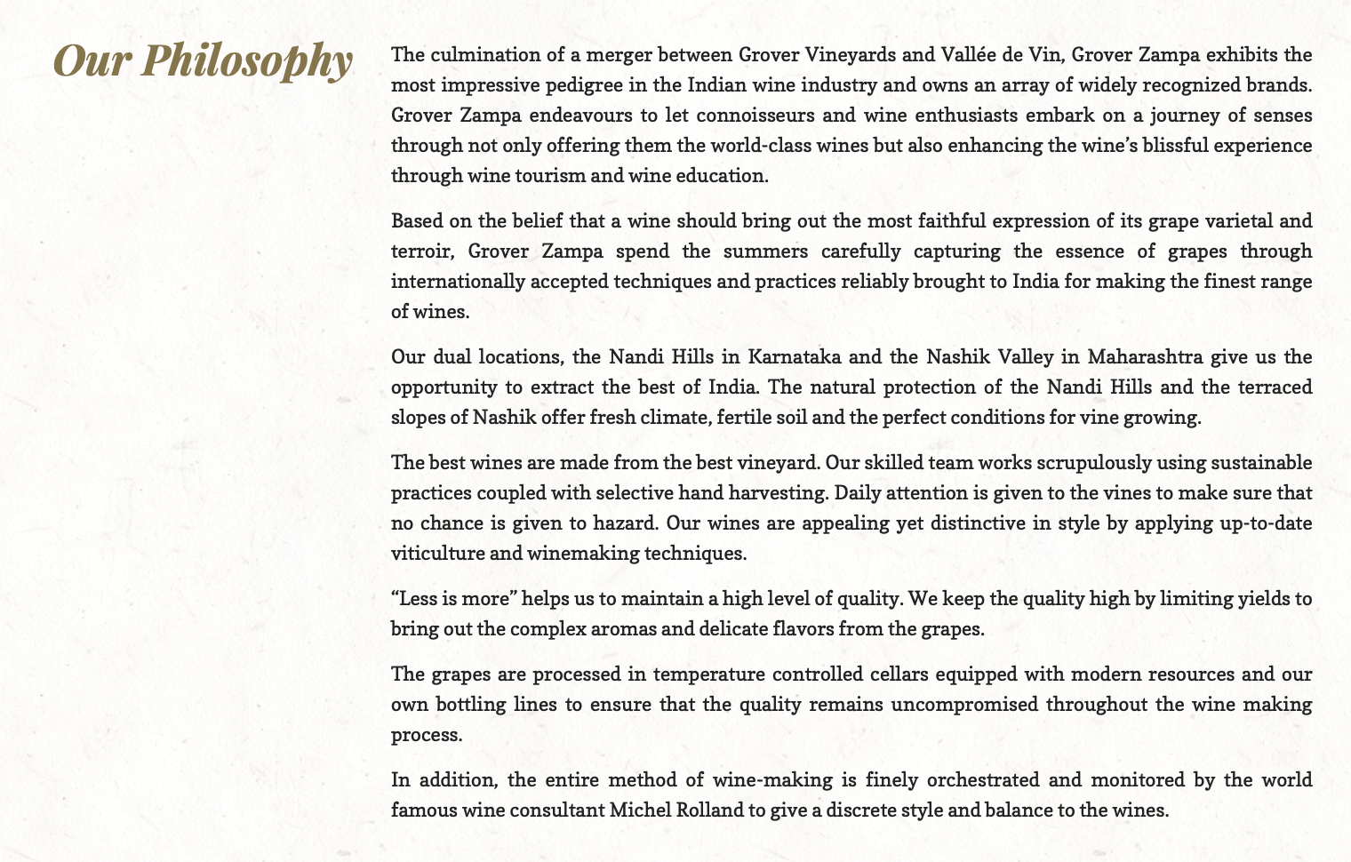

Slide 19
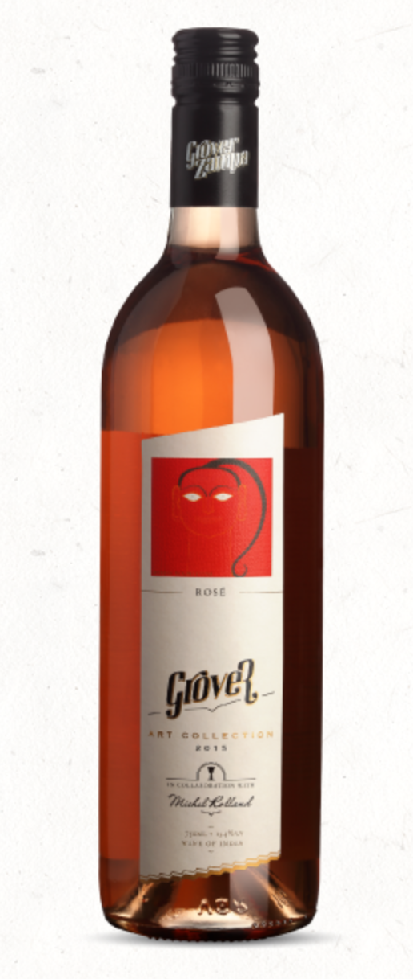
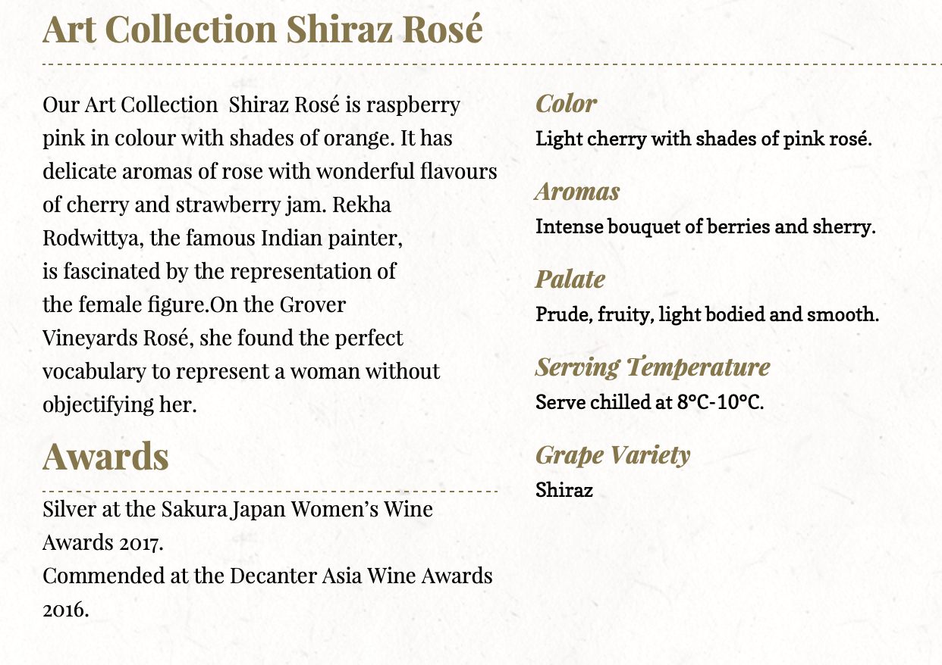
Rose Art Collection 2021

Slide 20
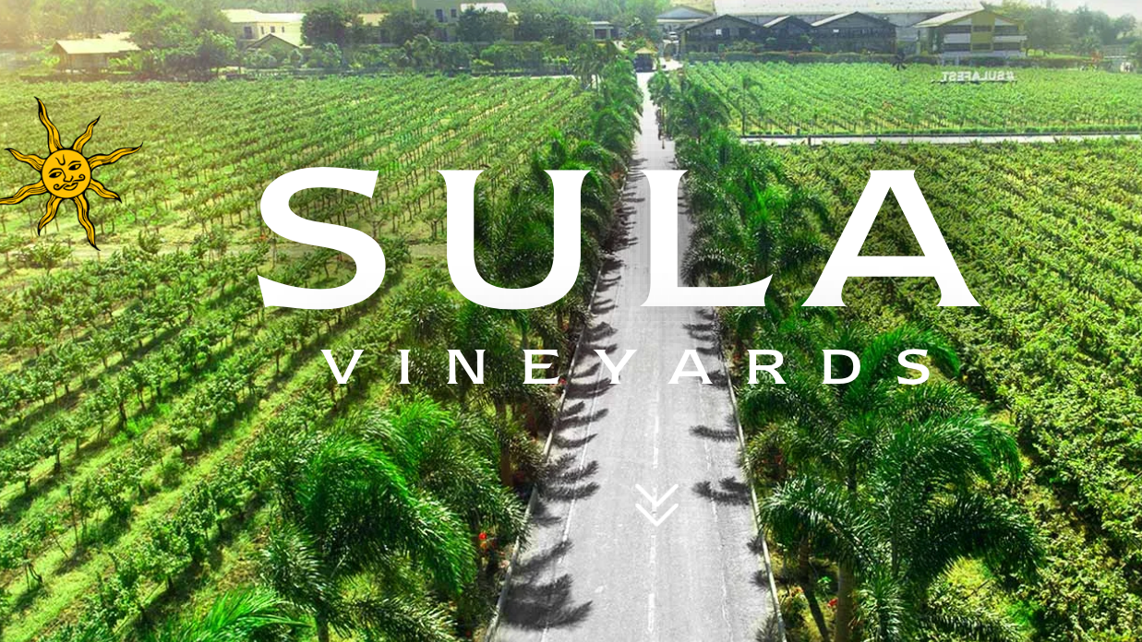

Slide 21
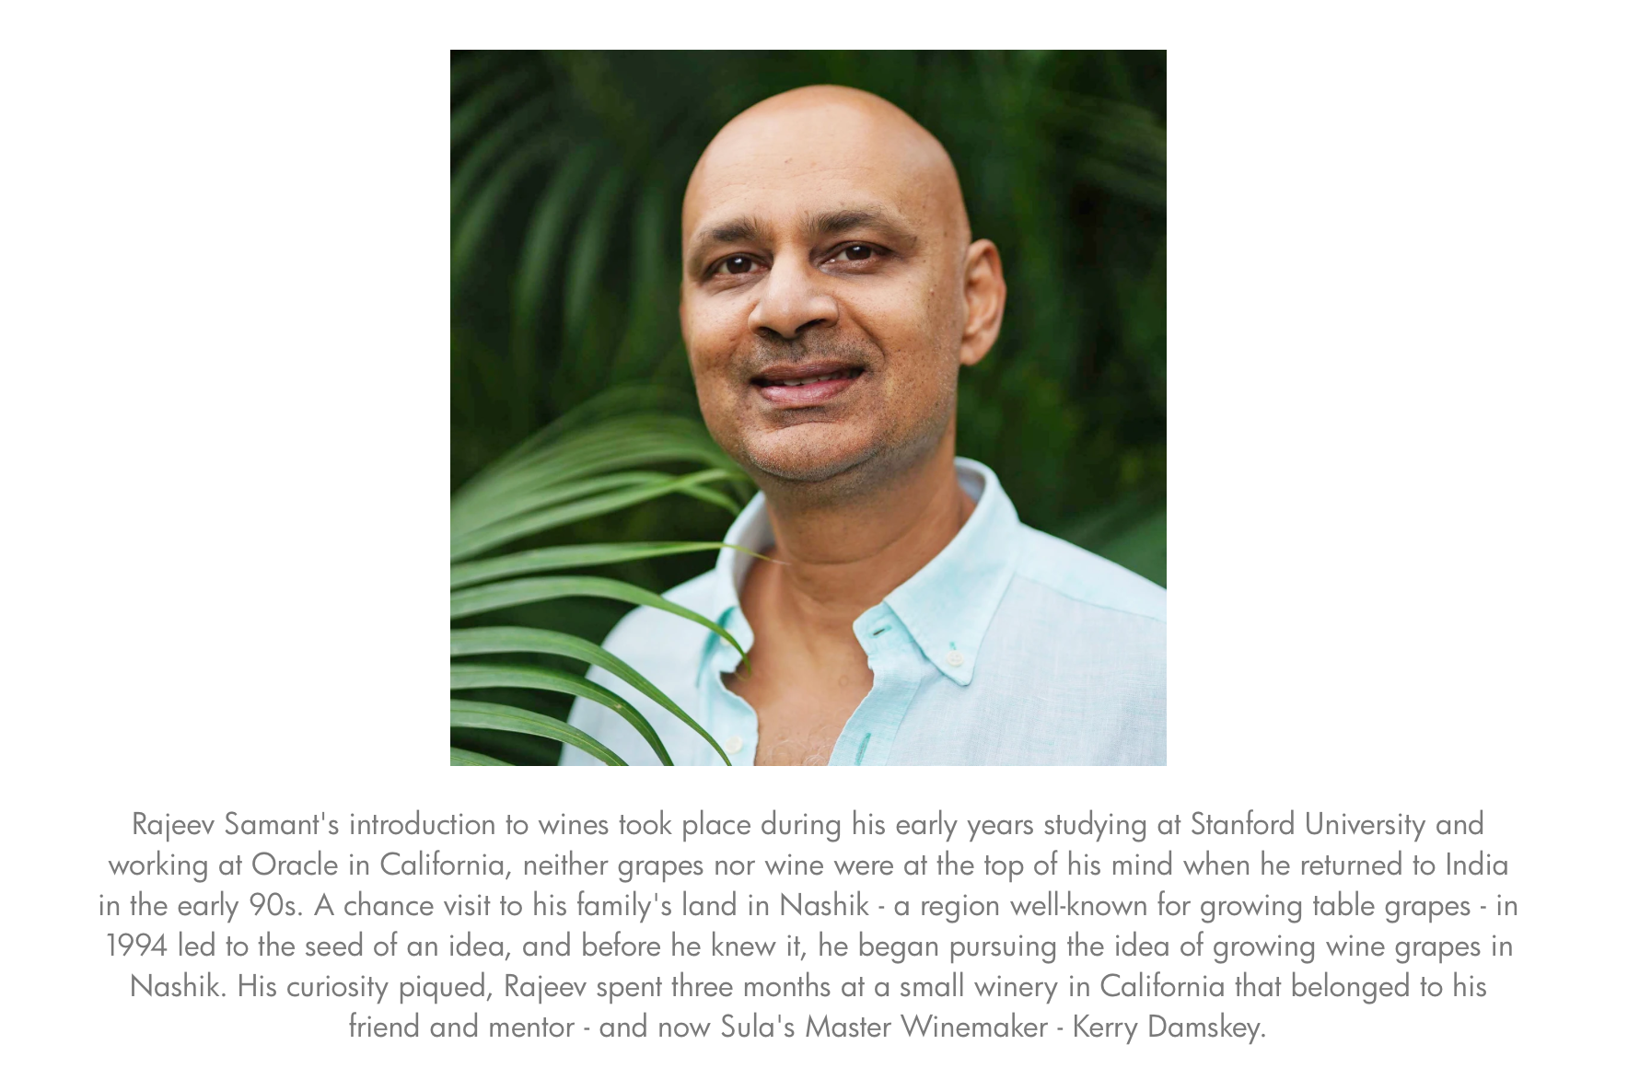

Slide 22
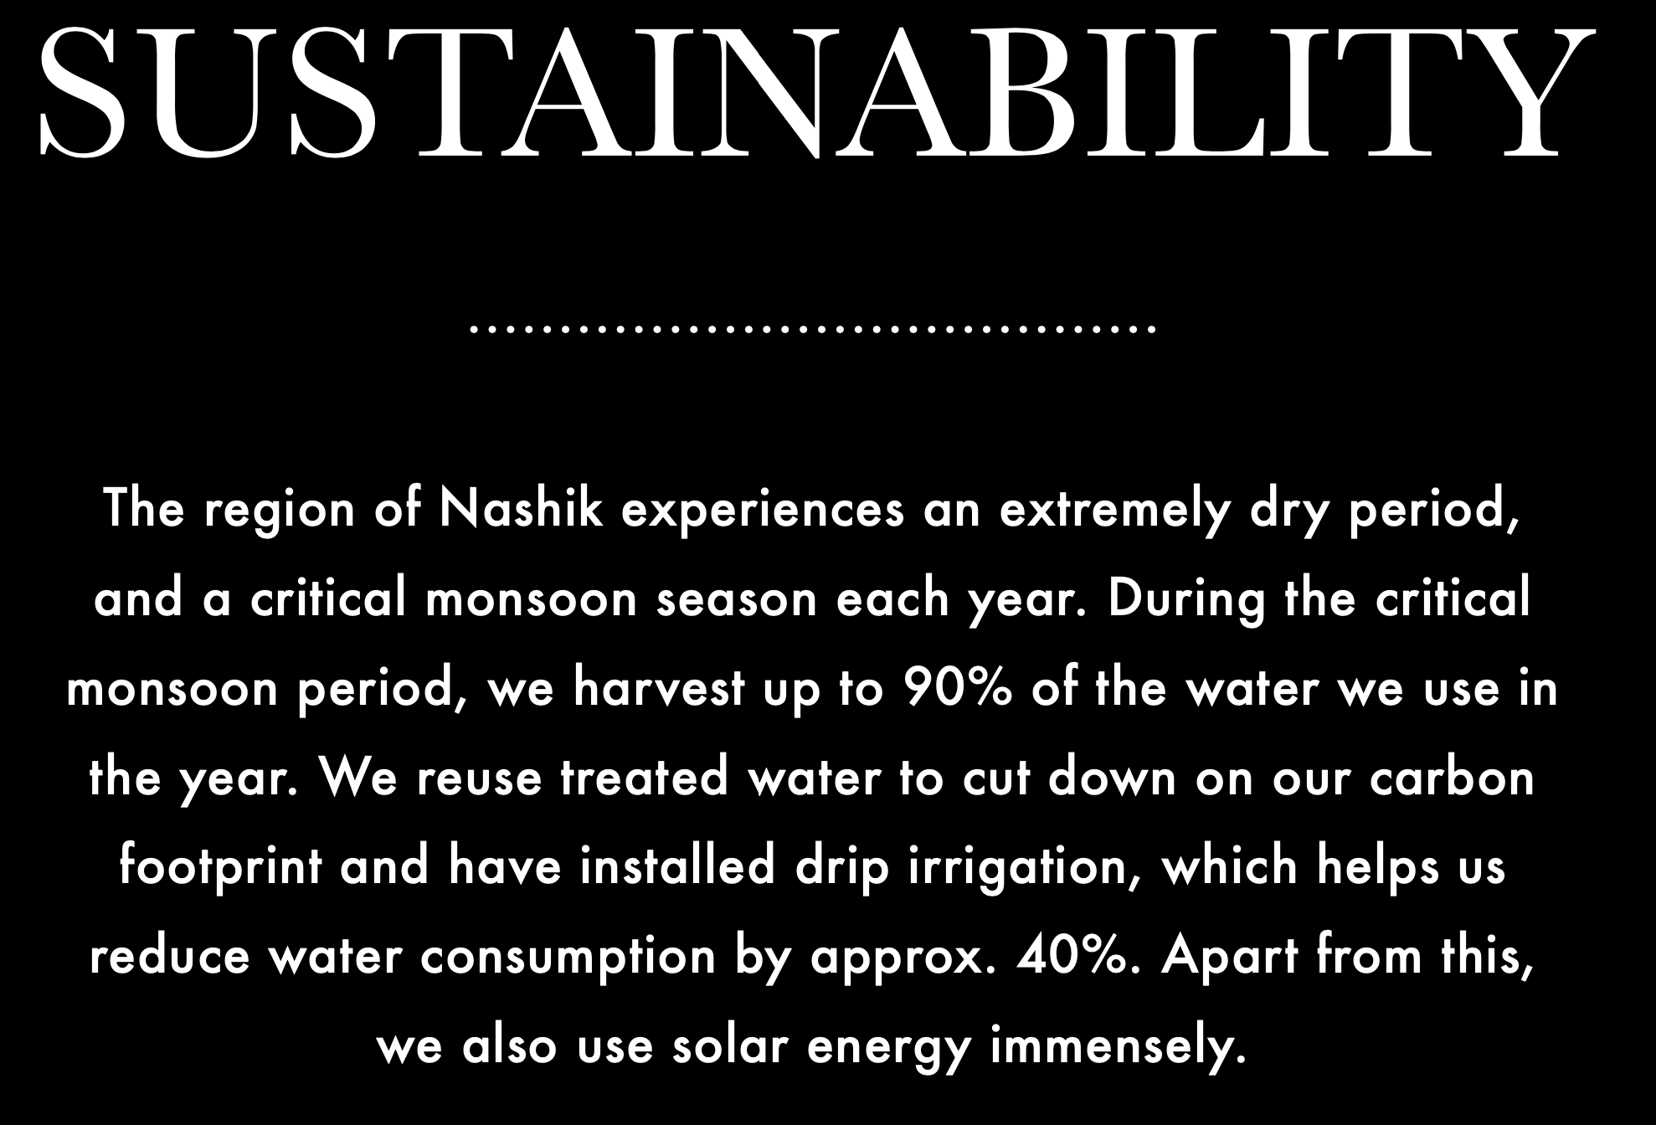
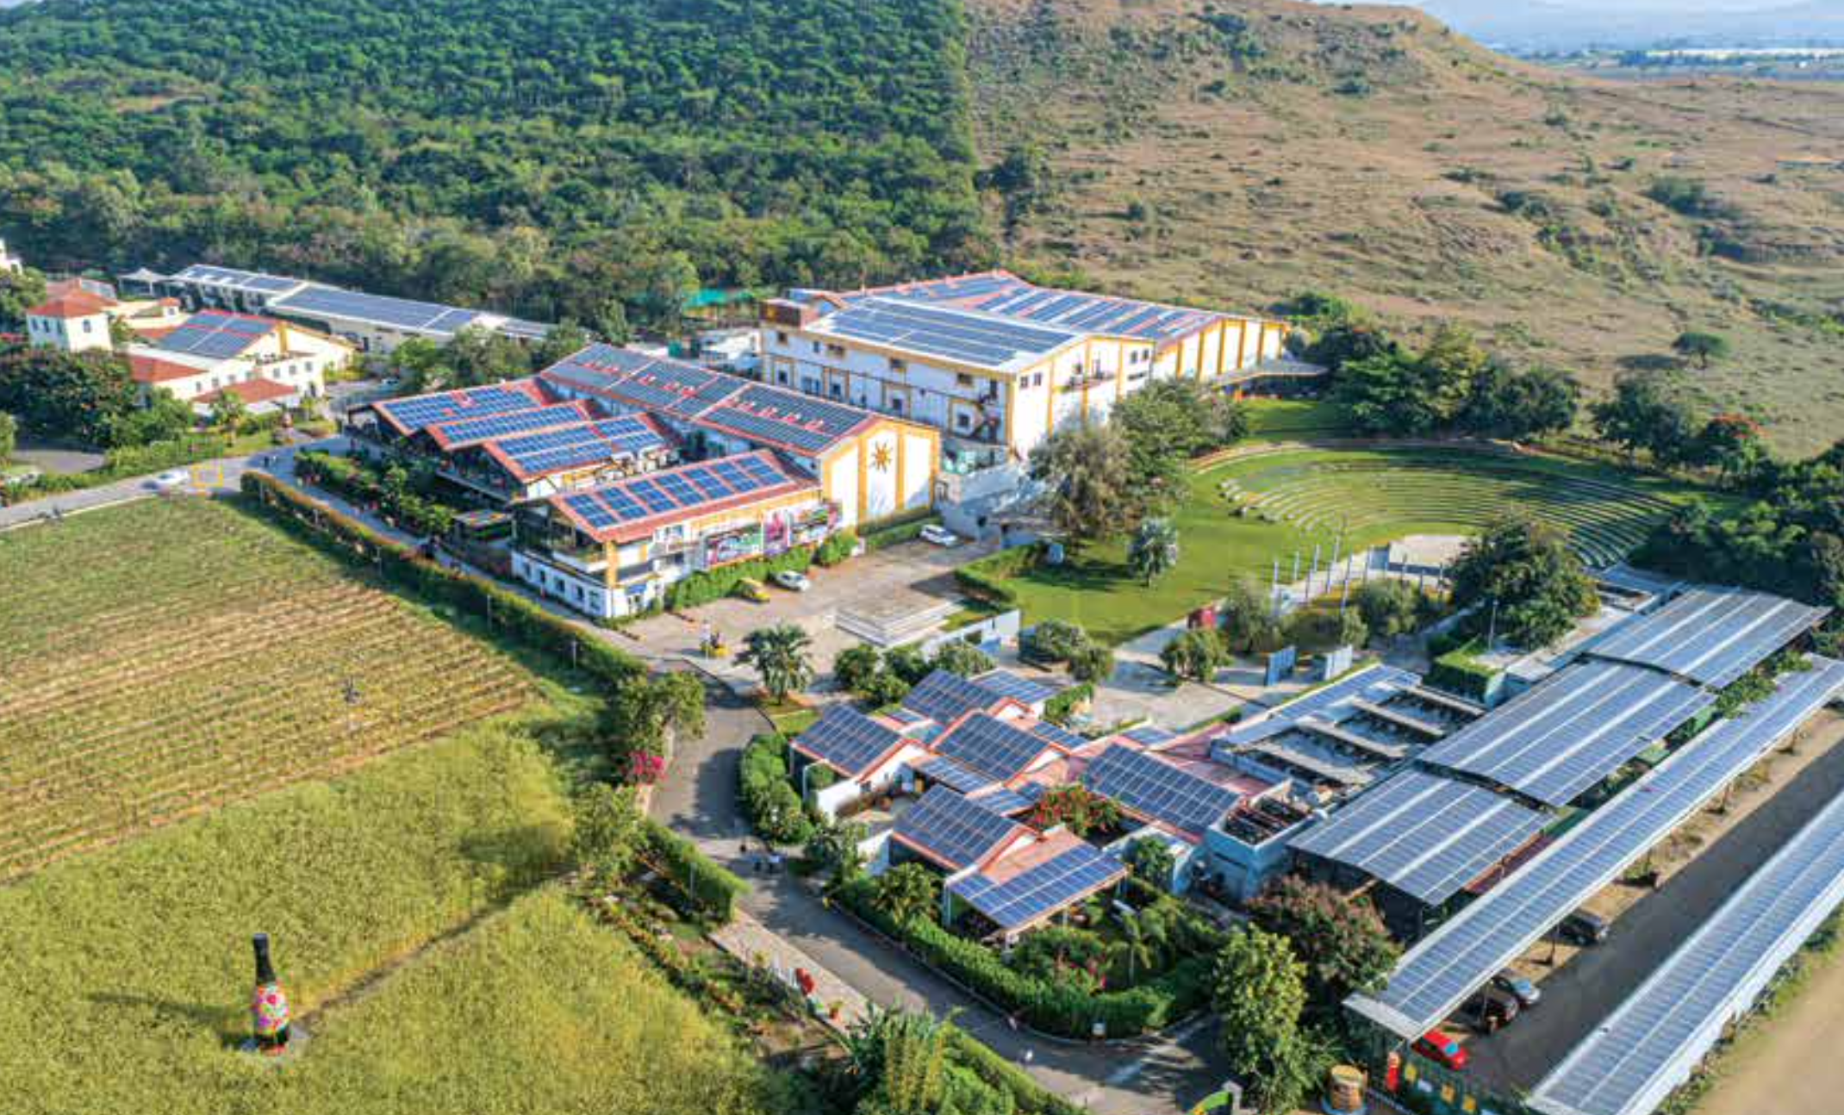
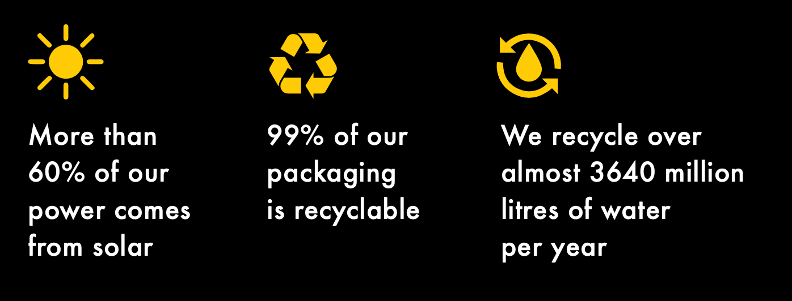

Slide 23
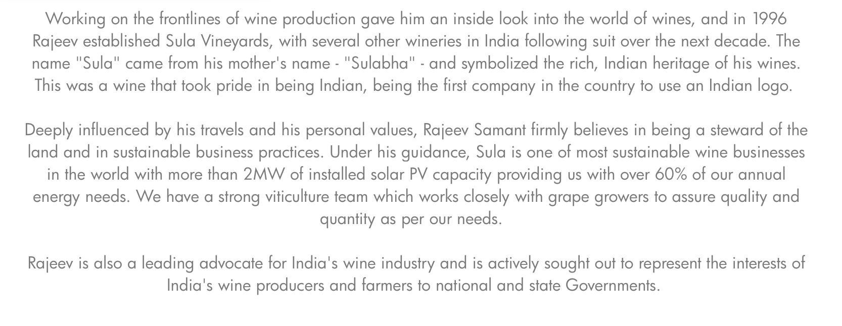

Slide 24
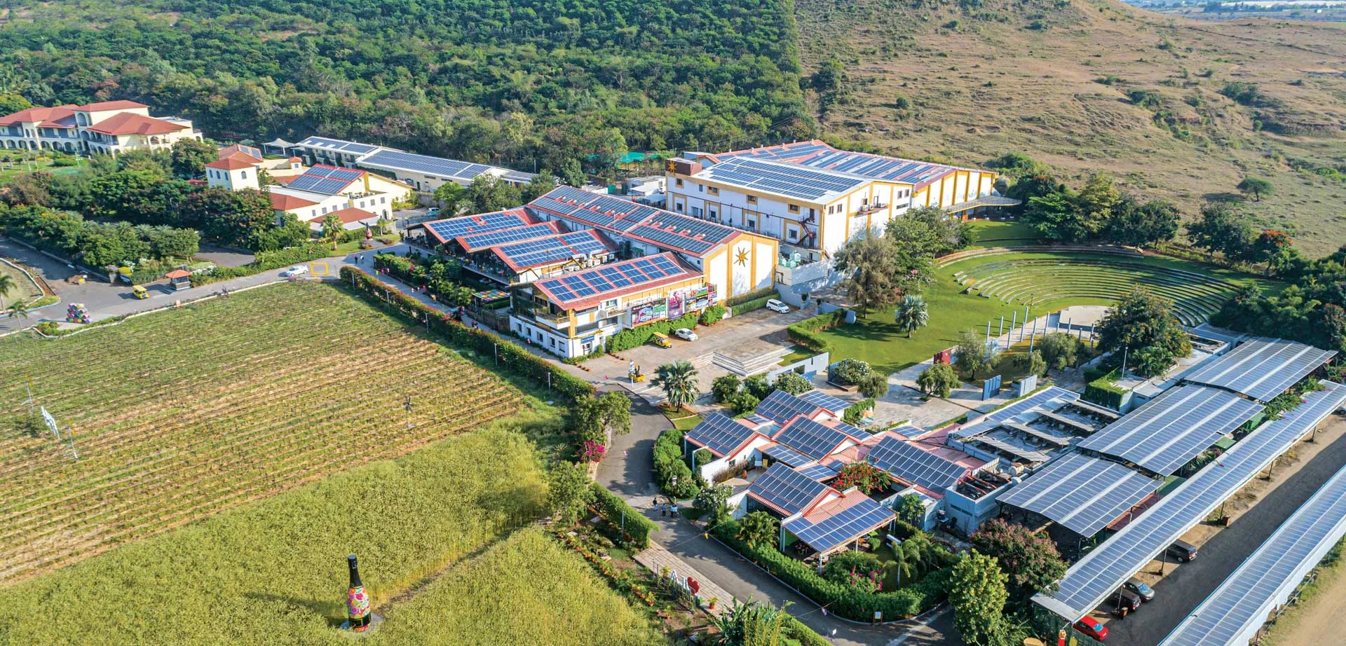

Slide 25
Terroir/Climate
Because of its location, India is not an easy place for large-scale viticulture. With latitudes ranging from 10 to 35 degrees north, the climate can be harsh and the tropical conditions mean that vines have to cope with a short growing season in addition to extreme heat and an unforgiving monsoon. Typical summer temperatures on the plains can reach more than 116F (47C) and rainfall can be intermittent. The climatic extremes are also exacerbated by high levels of humidity rising from the Arabian Sea and the Indian Ocean. Additionally, Indian wine producers must protect their vines from conditions such as sunburn, fungal diseases and over-ripeness.
Altitude plays the most significant role in site selection, as elevation ensures cooler growing conditions and also protects the vines from strong winds if they are planted in sheltered spots. The altitude in some of the prime growing areas reaches 3000ft (900m). A varied range of nutrient-rich soil types, ranging from well-drained sandy variants to complex metamorphic formations produced by the weathering of rock, lends character to Indian wines.
The majority of India's wine regions are concentrated in the south-western part of the country, primarily in the state of Maharashtra but also in Karnataka. The slopes of the Sahayadri mountain range which forms the 'Western Ghats' have been identified as the most suitable place for viticulture, due to high altitudes and a correspondingly mild macroclimate. Some of the most well-known wine-producing areas in Maharashtra include Nashik, Sangli, Sholapur, Satara, Ahmednagar and Pune. In the state of Karnataka, the best sites are situated on the foothills of the Nandi Hills on the outskirts of Bangalore. Other notable grape-growing areas are found in the states of Himachal Pradesh, Tamil Nadu, Punjab, and Jammu & Kashmir. A few areas in the north-east are also attracting attention due to their high location and cooler climates.
Since the beginning of the current renaissance in its wine industry, India has adopted a modern approach to production, both in its vineyards and wineries. Most commercial producers use phylloxera-resistant grafted vines imported from abroad. Contemporary vineyard practices, ranging from top-class soil and canopy management to a wide range of trellising methods, are used to combat the climatic extremes and control high yields caused by the fertile soils (it is not uncommon to find yields of 900hL/50 tons per hectare). Bordeaux's Michel Rolland is the consultant winemaker for Grover Vineyards – a well-known winery based near Bangalore.
India's low level of wine production contrasts with its total grape output of around 1.7m tons per year; the majority is used for table grapes and raisins, with only about 10% going to the production of wine. An even lower proportion comes from high-quality international varieties, although Cabernet Sauvignon, Shiraz, Merlot and Zinfandel for reds and Chardonnay, Chenin Blanc, Clairette and Sauvignon Blanc for whites are all grown. Thompson Seedless and Sultana vines produce the majority of India's grapes, with other notable varieties including Isabella (local name: Bangalore Blue) and Muscat Hamburg (local name: Gulabi).
Wine styles range from heavy and alcoholic fortified wines to quality still wines and sparkling wines made by the traditional method.

Slide 26
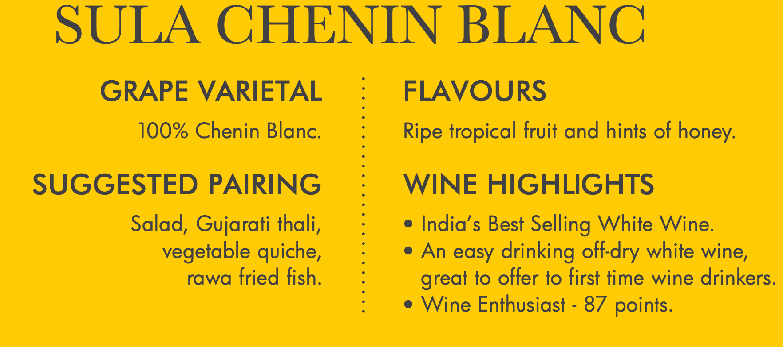
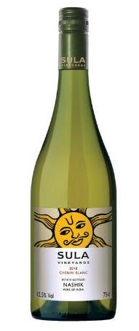
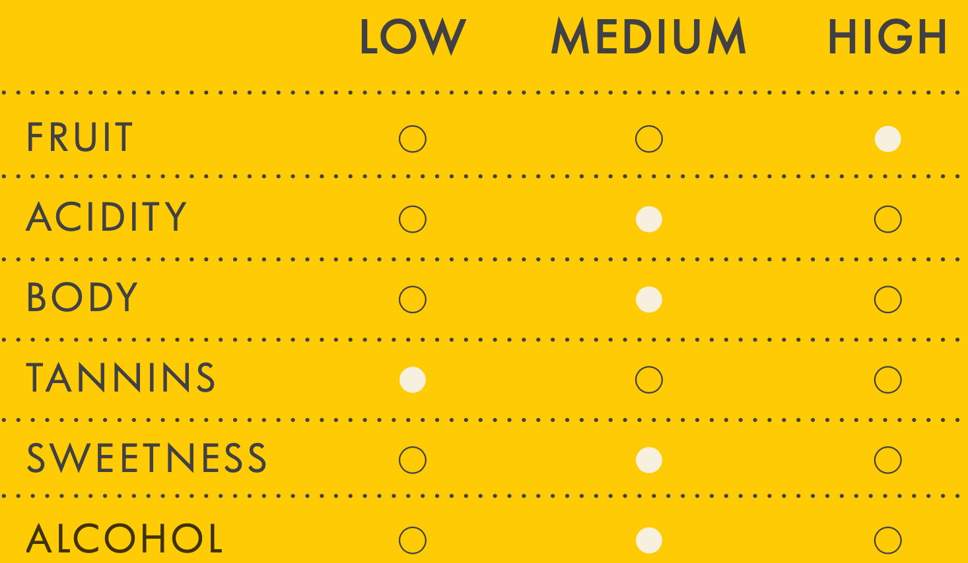

Slide 27
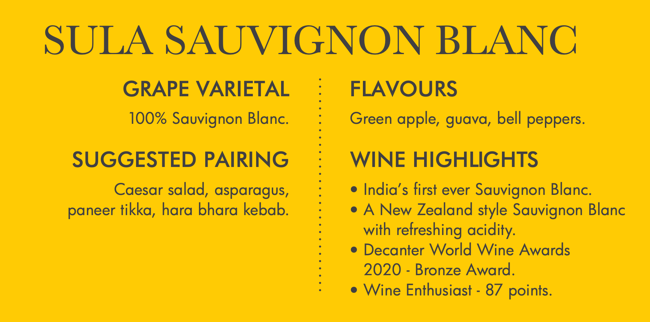
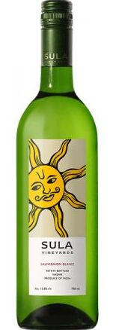
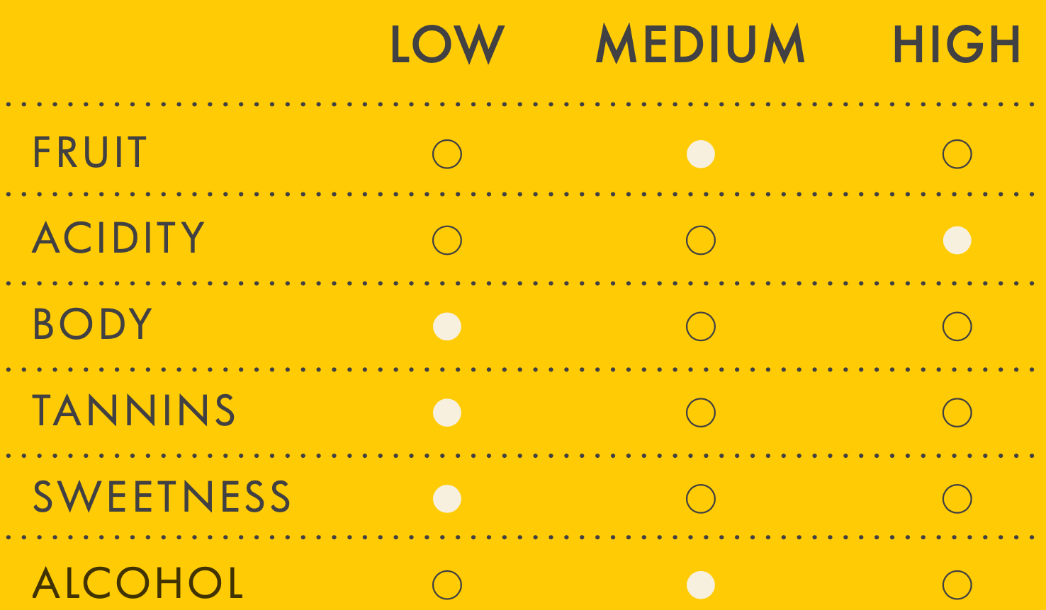

Slide 28
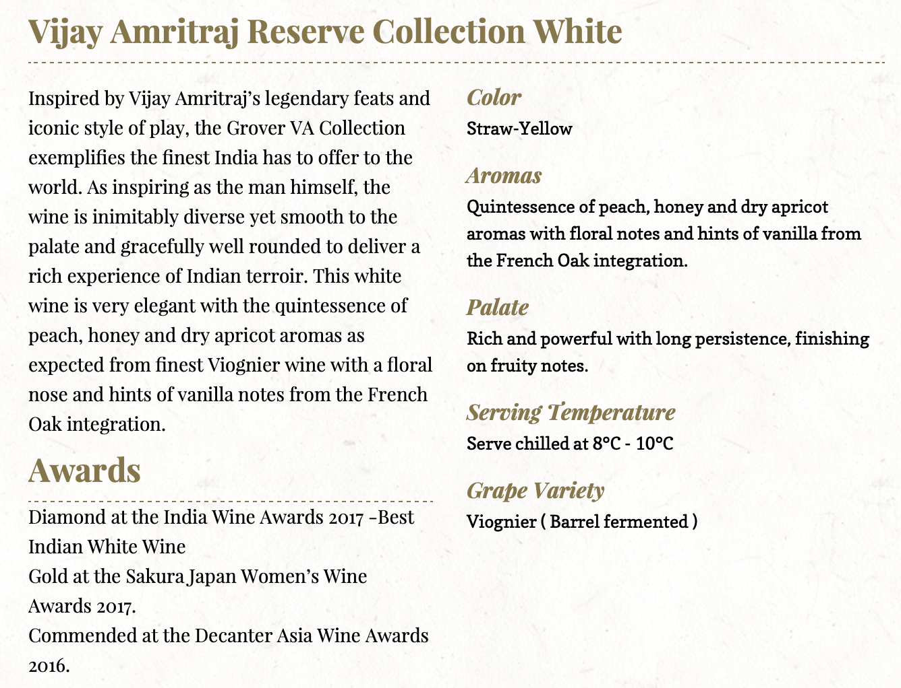
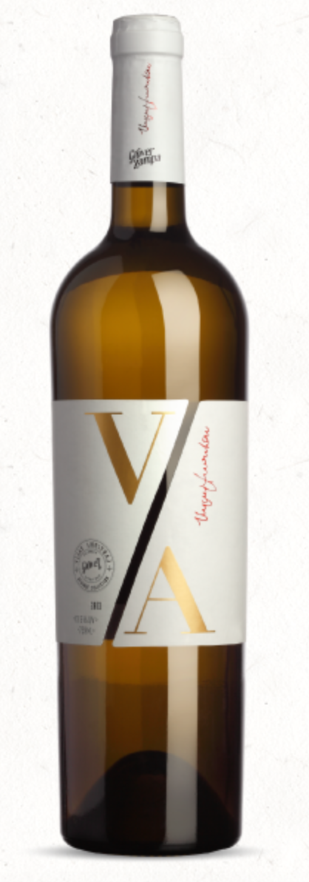
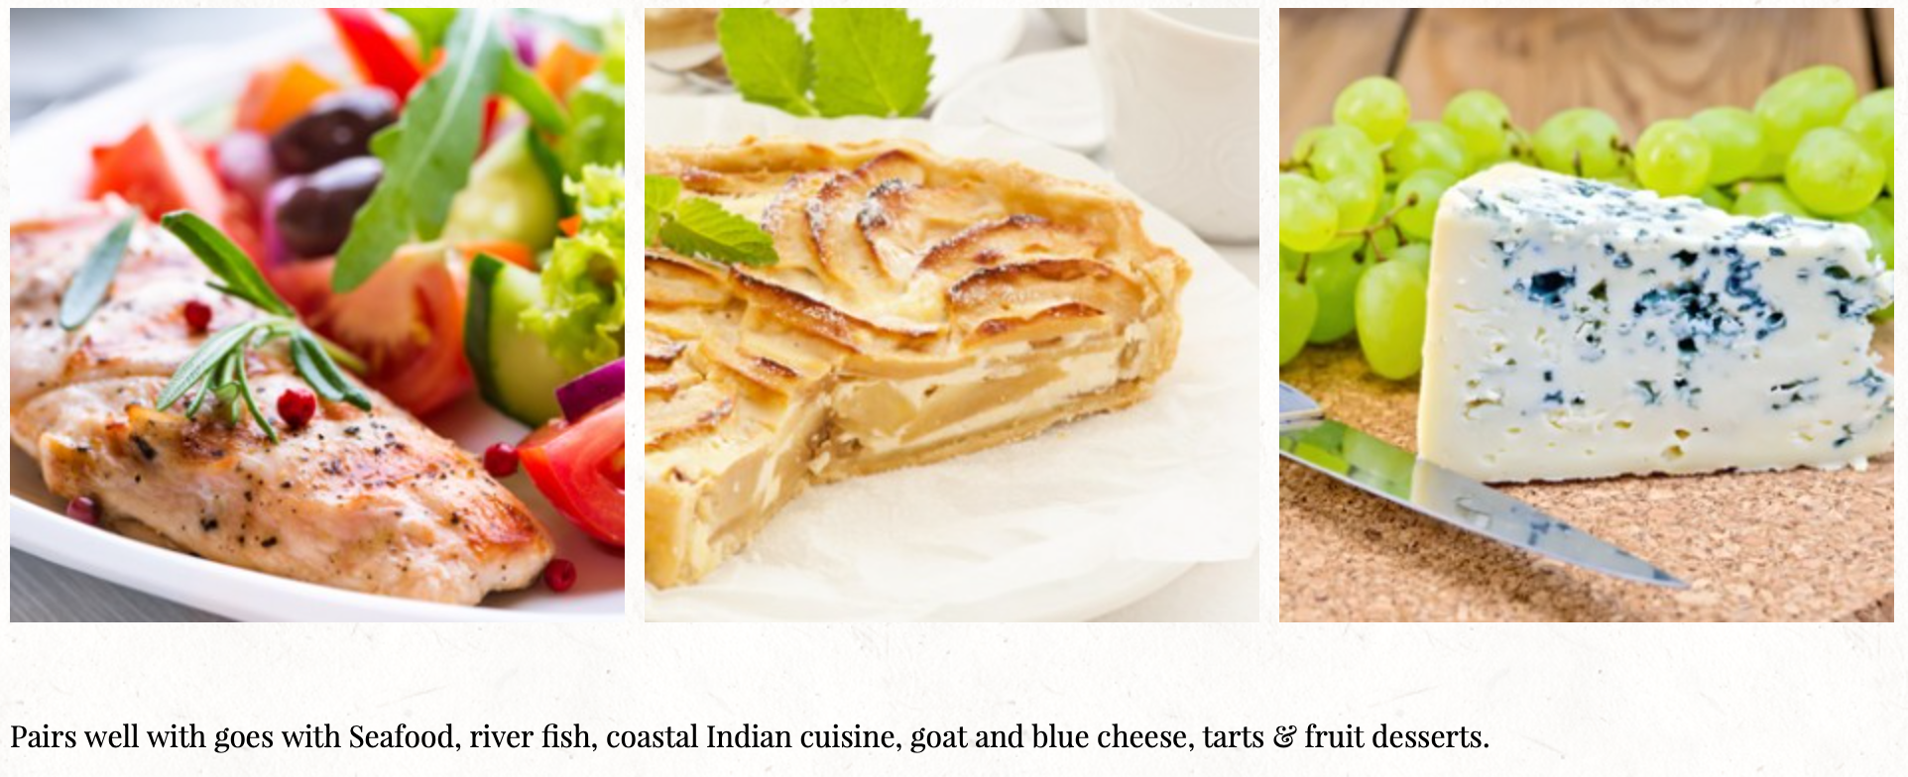

Slide 29
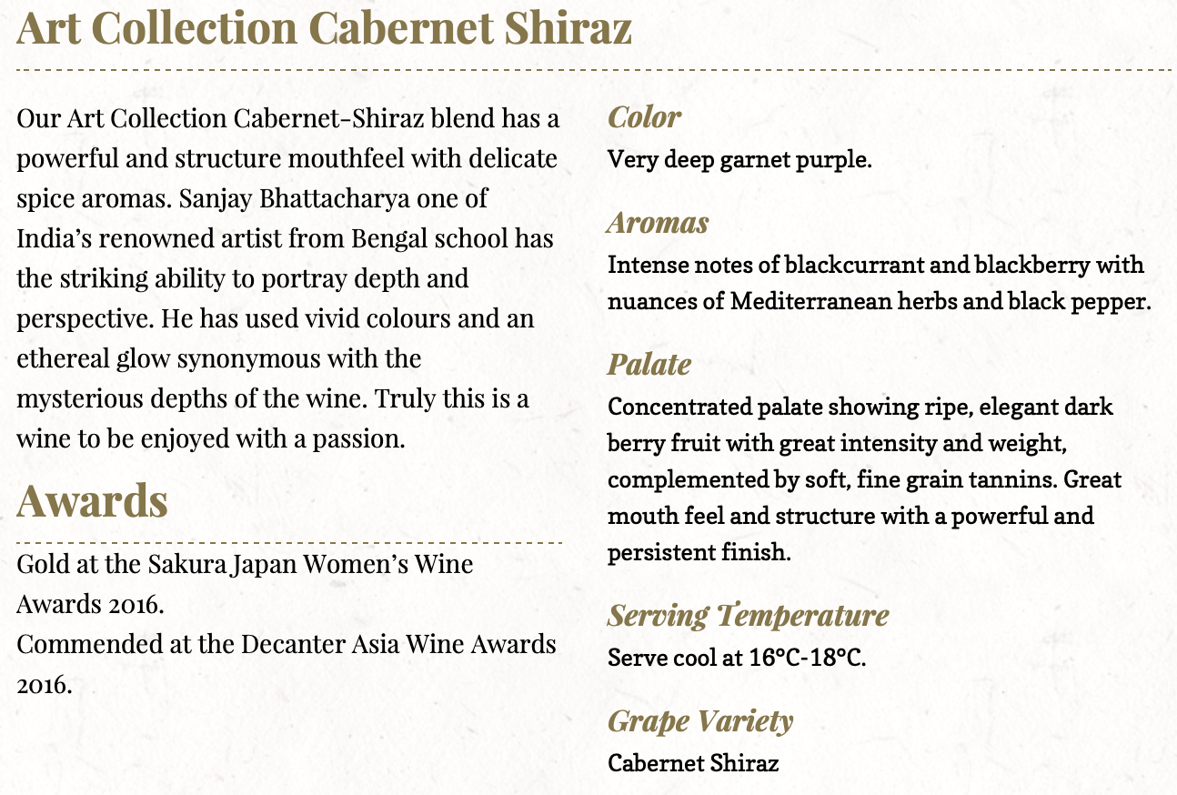
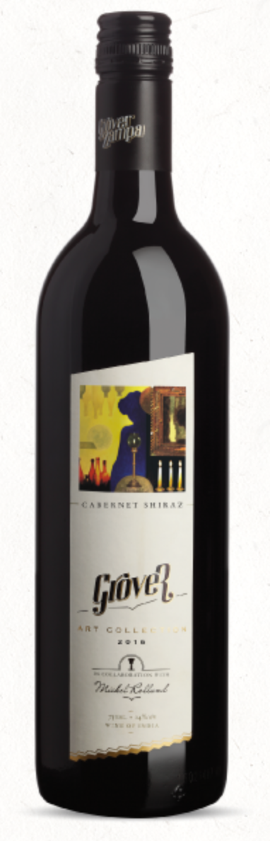
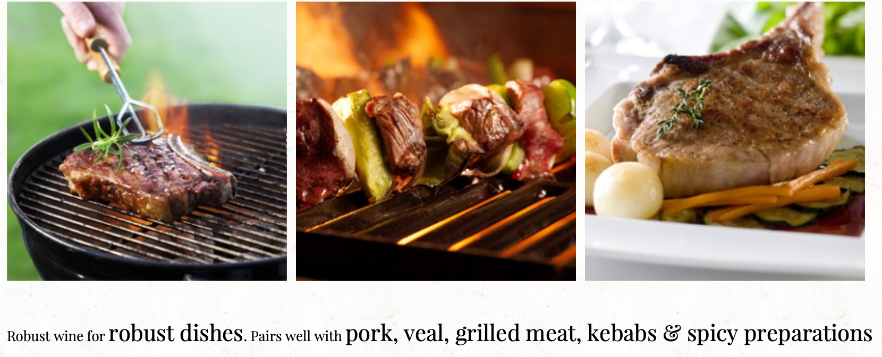

Slide 30
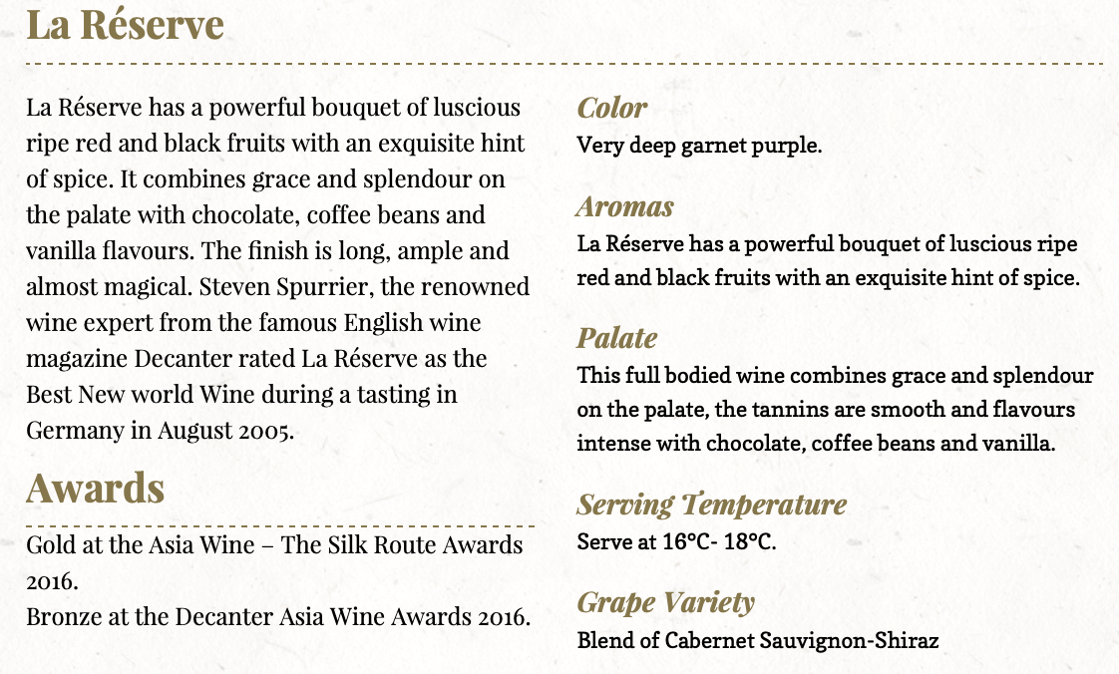
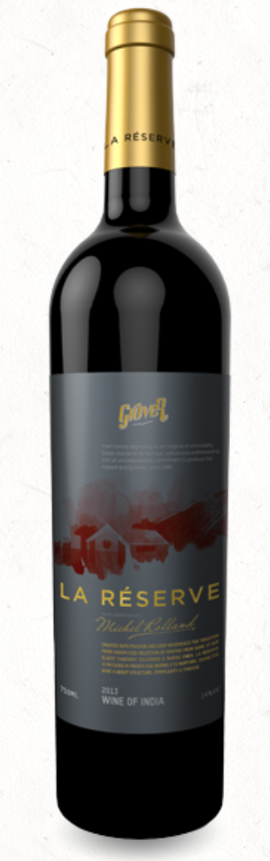
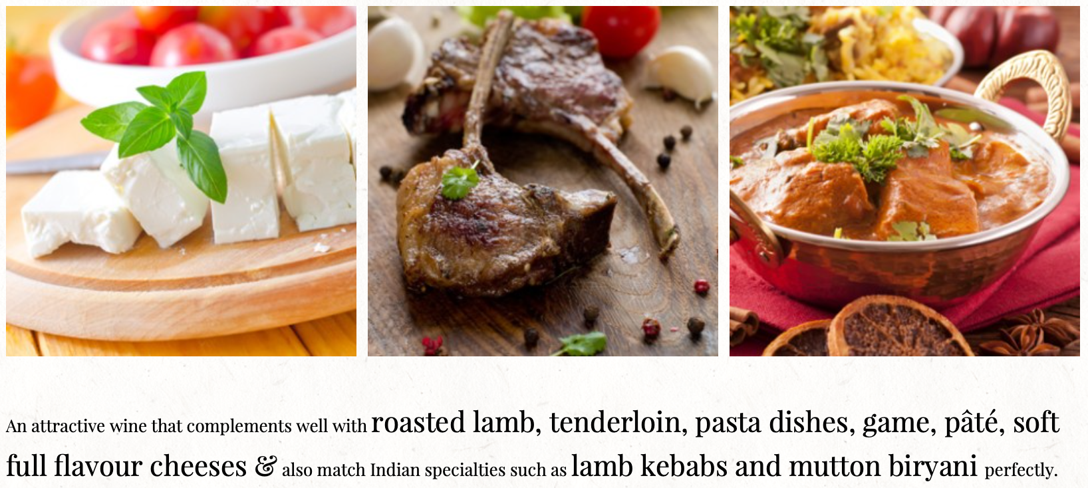

Slide 31

Notes:
Any questions?

Slide 32
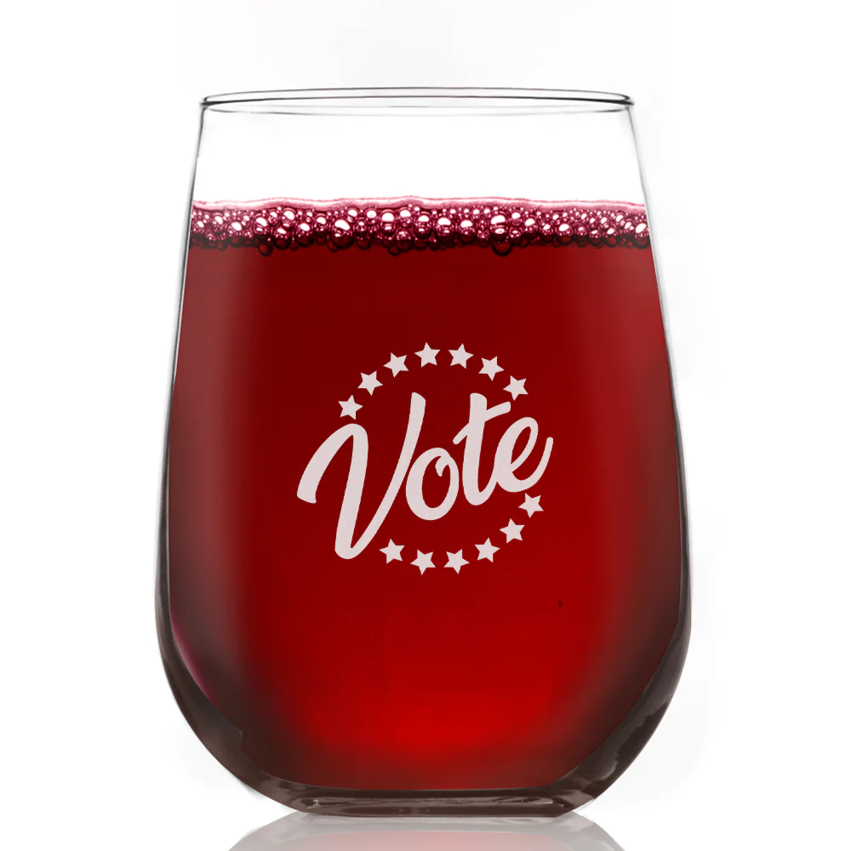
1 - Grover Rose 2021
2 - Sula Chenin Blanc 2022
3 - Sula Sauvignon Blanc 2022
4 - Grover White Viognier 2019
5 - Sula Shiraz 2020/2016
6 - Grover Cabernet Shiraz 2020
7 - Grover Red Cab & Shiraz 2018
Notes:
Lets Vote! Favorite White, Favorite Red, Favorite overall

Slide 33

1 - Grover Rose 2021 $20.99
2 - Sula Chenin Blanc 2022
3 - Sula Sauvignon Blanc 2022
4 - Grover White Viognier 2019
5 - Sula Shiraz 2020/2016
6 - Grover Cabernet Shiraz 2020
7 - Grover Red Cab & Shiraz 2018

Slide 34
1 - Grover Rose 2021 $20.99
2 - Sula Chenin Blanc 2022 $15.99
3 - Sula Sauvignon Blanc 2022
4 - Grover White Viognier 2019
5 - Sula Shiraz 2020/2016
6 - Grover Cabernet Shiraz 2020
7 - Grover Red Cab & Shiraz 2018

Slide 35
1 - Grover Rose 2021 $20.99
2 - Sula Chenin Blanc 2022 $15.99
3 - Sula Sauvignon Blanc 2022 $15.99
4 - Grover White Viognier 2019
5 - Sula Shiraz 2020/2016
6 - Grover Cabernet Shiraz 2020
7 - Grover Red Cab & Shiraz 2018

Slide 36
1 - Grover Rose 2021 $20.99
2 - Sula Chenin Blanc 2022 $15.99
3 - Sula Sauvignon Blanc 2022 $15.99
4 - Grover White Viognier 2019 $33.99
5 - Sula Shiraz 2020/2016 $20
6 - Grover Cabernet Shiraz 2020
7 - Grover Red Cab & Shiraz 2018

Slide 37
1 - Grover Rose 2021 $20.99
2 - Sula Chenin Blanc 2022 $15.99
3 - Sula Sauvignon Blanc 2022 $15.59
4 - Grover White Viognier 2019 $33.99
5 - Sula Shiraz 2020/2016 $20 ($33.71)
6 - Grover Cabernet Shiraz 2020
7 - Grover Red Cab & Shiraz 2018

Slide 38
1 - Grover Rose 2021 $20.99
2 - Sula Chenin Blanc 2022 $15.99
3 - Sula Sauvignon Blanc 2022 $15.99
4 - Grover White Viognier 2019 $33.99
5 - Sula Shiraz 2020/2016 $20 ($33.71)
6 - Grover Cabernet Shiraz 2020 $20.99
7 - Grover Red Cab & Shiraz 2018

Slide 39
1 - Grover Rose 2021 $20.99
2 - Sula Chenin Blanc 2022 $15.99
3 - Sula Sauvignon Blanc 2022 $15.99
4 - Grover White Viognier 2019 $33.99
5 - Sula Shiraz 2020/2016 $20 ($33.71)
6 - Grover Cabernet Shiraz 2020 $20.99
7 - Grover Red Cab & Shiraz 2018 $24.99

Slide 40

Notes:
BONUS!!!!!!

Slide 41
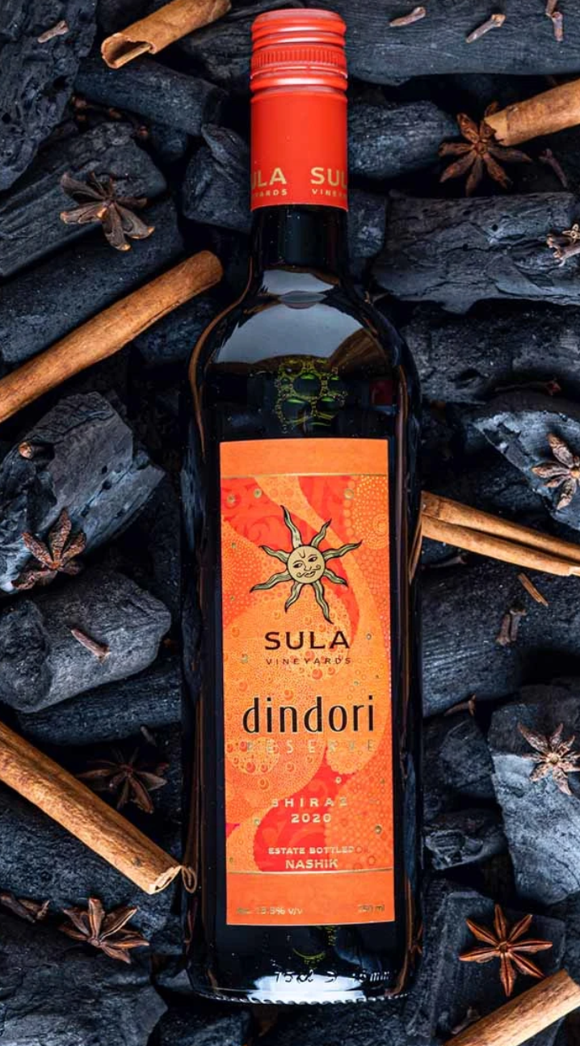

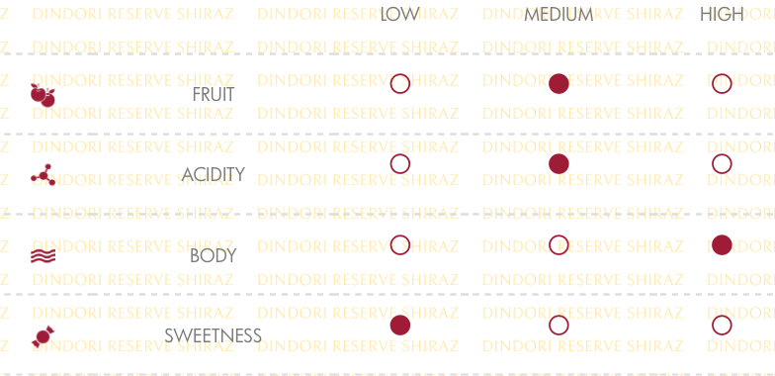

Slide 42
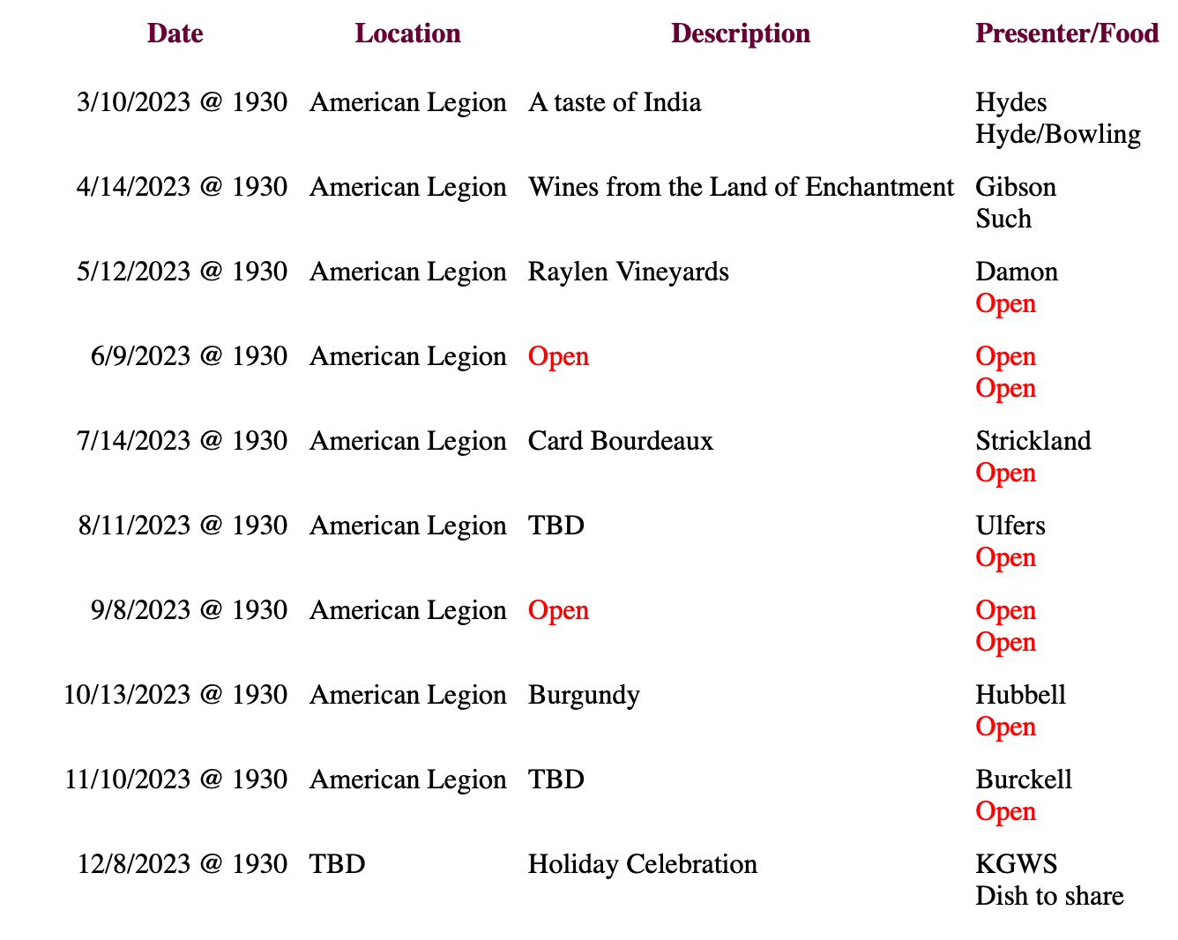


Slide 44
King George Wine Society www.kgwinesociety.com
2/10/2023
Average Attendees
2018 | 29
2019 | 29
2020 | 15
2021 | 17
2022 | 21
2023 | 31
Bylaws/Standing Rules up for discussion
RSVP – (Except for illness, If you RSVP’d, expected to pay)
If cost will be over $30 average/bottle, need membership approval (vote) the meeting before
Limit 3 bottles per wine, 6 wines (or under $540 total, without vote)
RSVP’s including guests are not guaranteed space
Budget has been strained; suggested options:
Change Tasting Size (2oz to 1.5oz)
Increase Tasting Fee ($15 to $20)
Reduce Free Tastings:
  Presenter: 1
  Food Preparer: 2 (2 to 1)
Meeting Income
Income: | Tasting Fee
Attendees: | $15 | $20
20 | $205 | $290
25 | $280 | $390
30 | $355 | $490
35 | $430 | $590
(3 free tastings ($45), food ($50)
# | Total | Pour Size (oz) |  | Bottle $ | Wines
Bottles | oz | 1.5 | 2 | $30 | 6
1 | 25.4 | 16.9 | 12.7 | 30 | $180
2 | 50.7 | 33.8 | 25.4 | 60 | $360
3 | 76.1 | 50.7 | 38.0 | 90 | $540
4 | 101.4 | 67.6 | 50.7 | 120 | $720

Slide 45

Why “Wines from India?”

