Slide 1
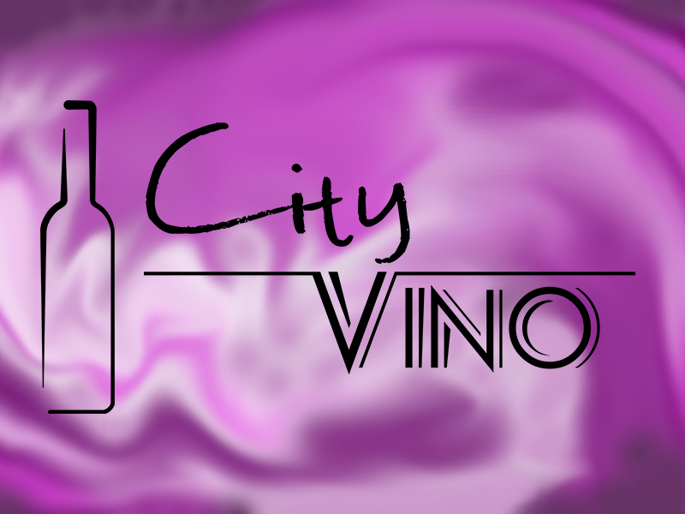

Slide 2
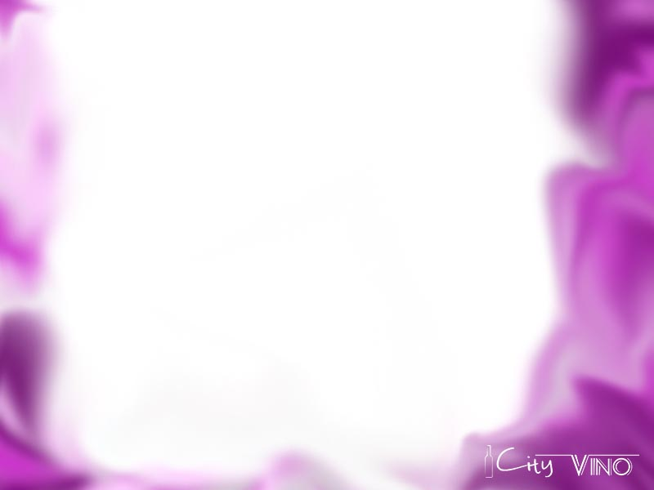
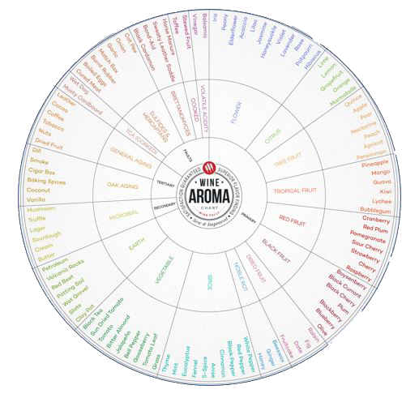
How do the professional know what they are drinking?
See
Swirl
Smell
Sip
Notes:
See
Notice the color and intensity
Is the wine clear or hazy?
Swirl
Gently swirl the wine around in the glass to release aromas
Smell
What aromas do you smell?
Are they light or intense?
Sip
What flavors do you taste?
Does the wine feel light or heavy?
What sort of textures do you feel?
How much does it make your mouth water?
How long to the flavors linger?
Aroma Wheel
Primary v. Secondary v. Tertiary

Slide 3
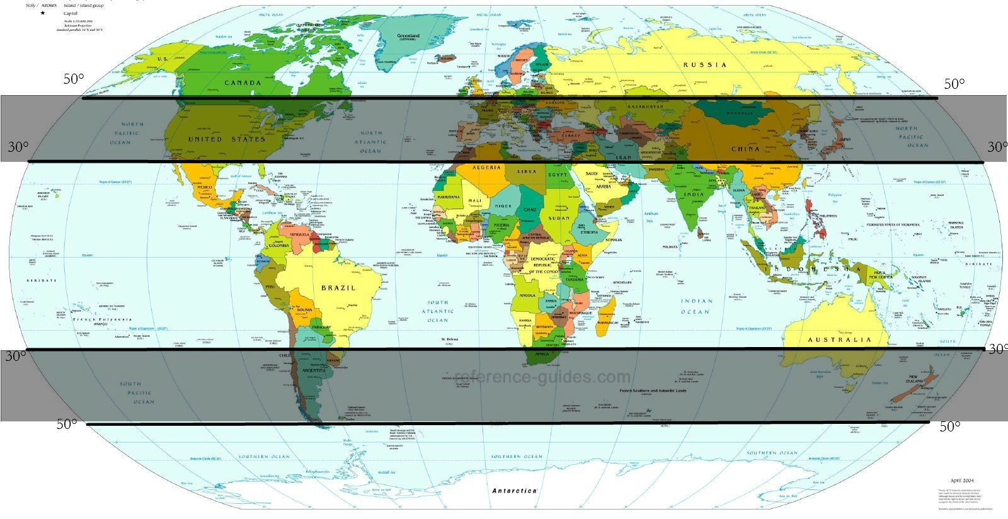
Notes:
Europeans Vitis vinifera vines were planted over the colonial era
Didn’t always immediately thrive in new territories→ lacked the resistance to insect pest thus stayed rudimentary
Competitive fine wines would not emerge for centuries in most places
Old world vs. New world warmer climate, different soils, different rain/ irrigations,
differences in winemaking choices abide by old world rules?
Old world classic tend to be lighter and milder leaner and more earthy→ companion for food and to age
New world tends to be bolder, heavier, more ripe, fruiter→ built to drink on its own now

Slide 4
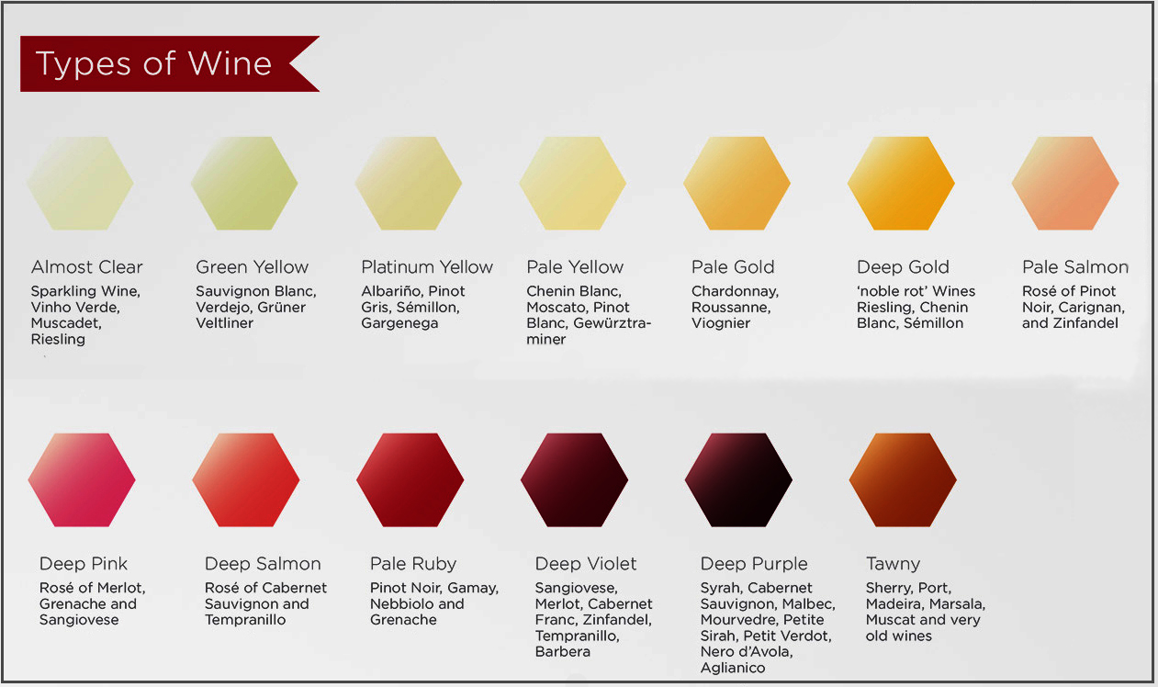
See the Colors of wine
Notes:
dfgsfg

Slide 5
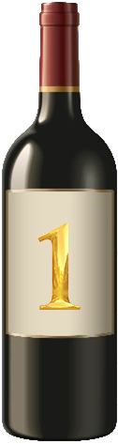
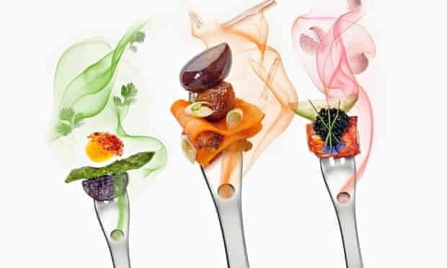
Smell the Aromas
Flowers, Green Fruits, Citrus Fruit, Stone Fruit, Tropical, Herbaceous, Herbal, Pungent Spices, or Other?
Notes:
dfgsfg

Slide 6
Tasting notes: Clear, pale lemon in color. Very expressive wine. Aromas of peony, iris, apple, pear, peach, citrus. Juicy flavors include pear, orange peel, limoncello cream, persimmons, honeysuckle, green apple. The wine has a “unctuous” texture (slightly weighty, lush, with some viscosity, oily almost). Medium acidity, over all medium body. Even for all the complexities, it has a medium finish.
Food Pairing: Aperitif or tapas, or tapenade, grilled seafood, fruit salsas, food with hints of spice, cream, or fatty sauces.
Notes:
dfgsfg

Slide 7
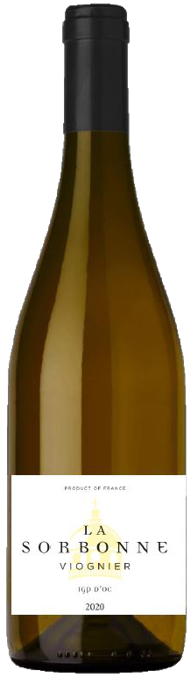
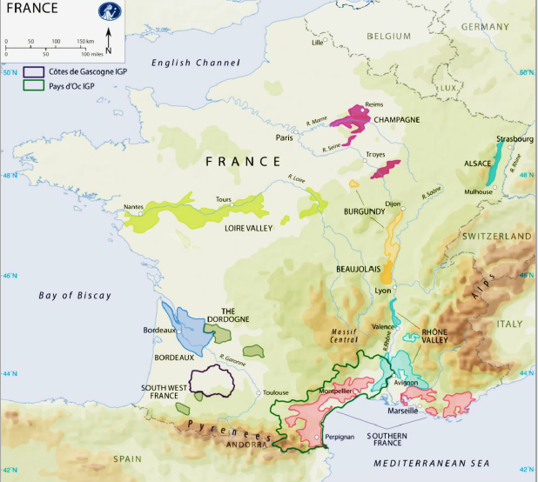
La Sorbonne Viognier Pay d'Oc France 2020
Notes:
ffff

Slide 8
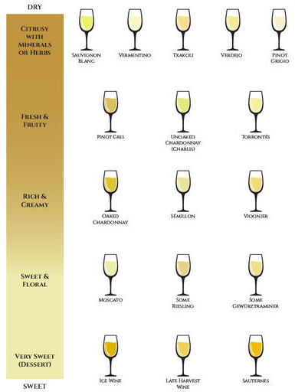
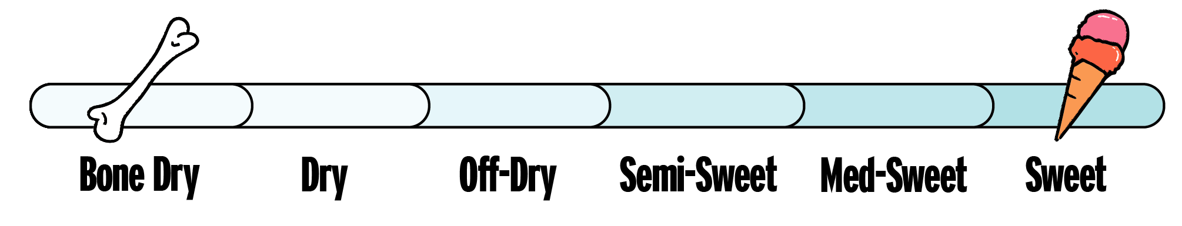
Sweetness or Fruitiness?
Notes:
dfgsfg

Slide 9
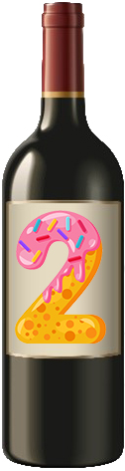
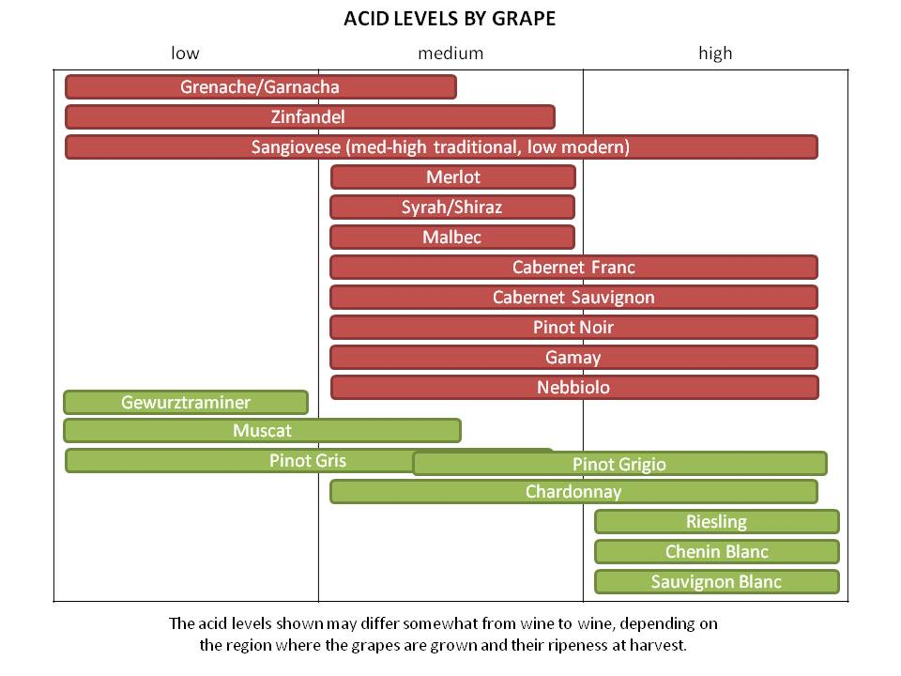
Acidity
Notes:
dfgsfg

Slide 10
Tasting notes: Green Yellow in color. Orange blossom, peach, and white fruit aromas. Full of nuance starting with honeysuckle, chalk, vibrant minerality, ripe citrus and fruit flavors. Off dry, medium plus acidity with a long full finish. Easy to drink.
Food Pairing: Mixed salads, mussels, seasoned or homemade terrines, 'Flammenküche', tarts flambées, or traditional Alsatian main courses.
Notes:
dfgsfg

Slide 11
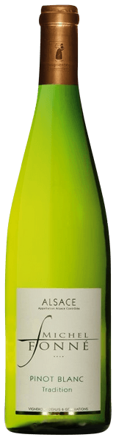
Michel Fonne Pinot Blanc Alsace France 2018
Notes:
ffff

Slide 12
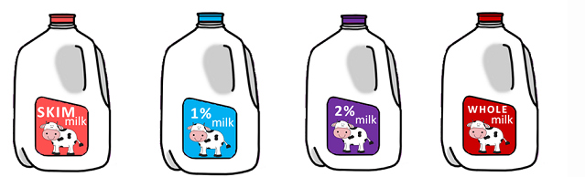
Describing Body
Notes:
dfgsfg

Slide 13
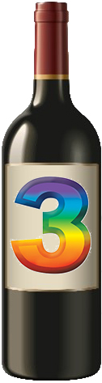
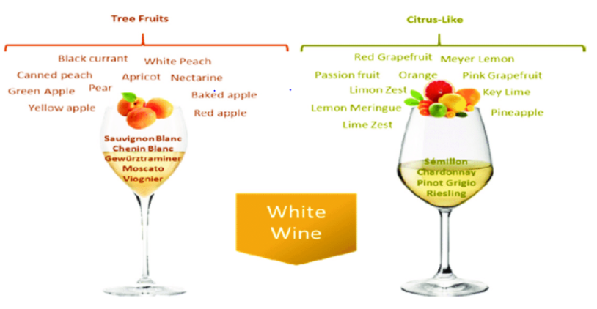
White Wine flavors
Flowers, Herbaceous, Herbal, Pungent Spices, or Other- Minerals, Salty?
Notes:
dfgsfg

Slide 14
Tasting notes: Pale gold in color. Fruity aromas of citrus, green apple, honeysuckle. Tropical notes with bright lemon-lime citrus, dried pineapple, apples and soft oak nuances. Full bodied wine with notes of butter, oak, and cream. It has lively acidity which straddles tones of butter and minerality. Long finish.
Food Pairing: Fish pâtés, fish, chicken or vegetable terrines, risotto with spring vegetables and creamy vegetable soups
Notes:
dfgsfg

Slide 15
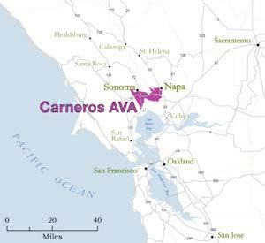
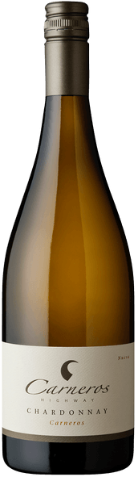
Highway 12 Carneros Highway Chardonnay Carneros California 2020
Notes:
ffff

Slide 16
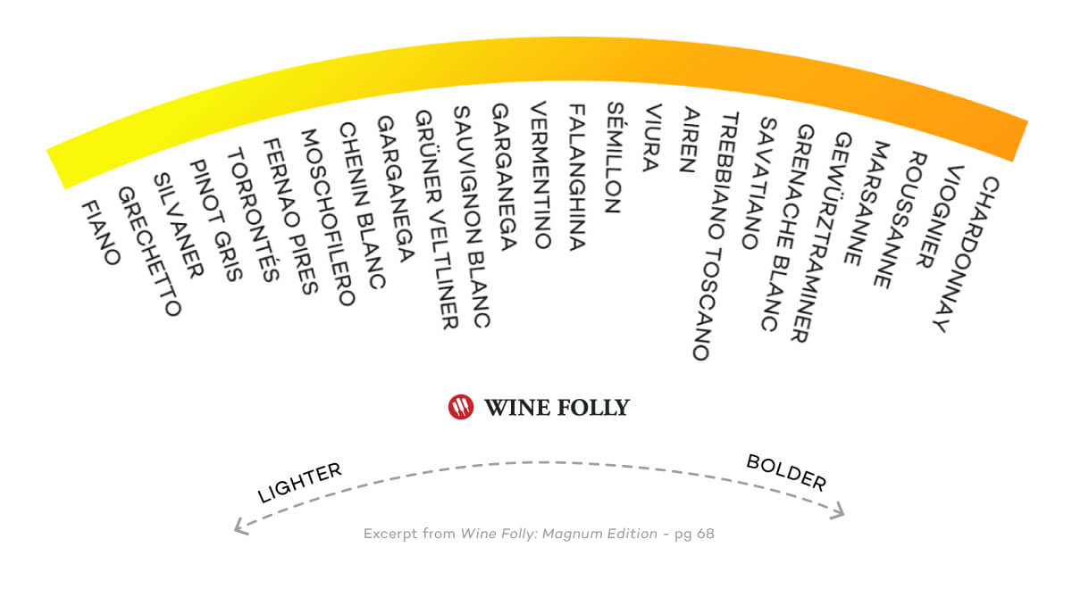
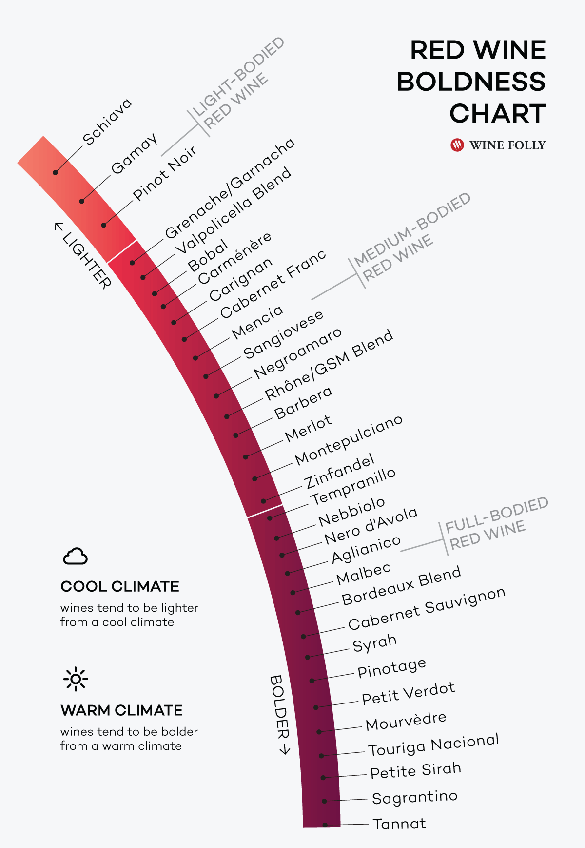
Intensity, concentration, and complexity
Notes:
dfgsfg

Slide 17
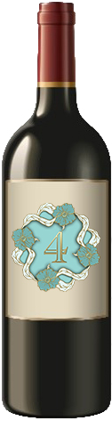
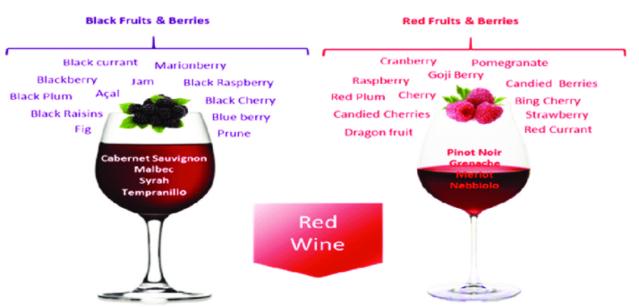
Red Wine flavors
Flowers, Herbaceous, Herbal, Pungent Spices, or Other?
Notes:
dfgsfg

Slide 18
Tasting notes: Pale to medium ruby tinges. Energetic aromas of bright cherry, raspberry, fresh cut rose, hibiscuses, red cherry, with lighter tones of oak, tobacco, cola. The plate brings with juicy plum, boysenberry, sour cherry, earth, savory, vanilla, cinnamon, blueberry, black cherry, earth, mushroom, and hints of crème brulée. Refreshing acidty, gentle medium, chalky tannins, medium minus body. Light complexity with some evolving in the glass and a medium finish.
Food Pairing: Lentil curry, wild mushroom and burrata bruschetta, squash, fennel-garlic pork roast, stuffed eggplant, vegan enchiladas, crispy skin goose, smoky glazed ham, grilled squid and torpedo onions with sorrel, stir-fried five spice port with lettuce cups, grilled quail, caramelized onions with goat cheese.
Notes:
dfgsfg

Slide 19
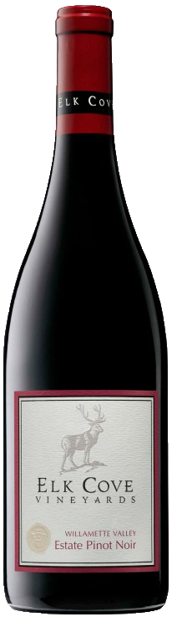
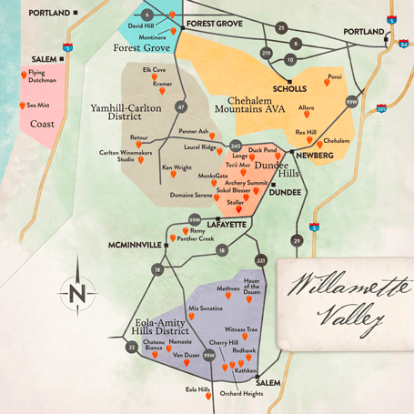
Elk Cove Vineyards Pinot Noir Willamette Valley Oregon 2021
Notes:
ffff

Slide 20
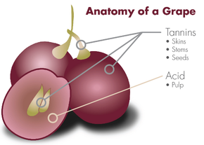
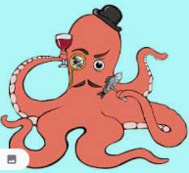
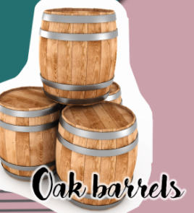
Describing tannin
Notes:
dfgsfg

Slide 21
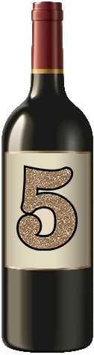
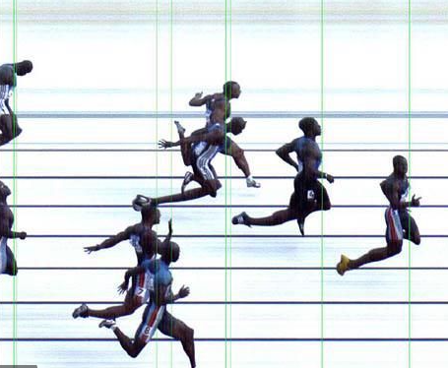
Describing Finish
Notes:
dfgsfg

Slide 22
Tasting notes: Rich ruby in color. Aromas of red cherry, blackberry, blueberry, bramble, earth, herbal, rosemary, sage, and eucalyptus. The flavors expand into black plum, stone, jammy raspberry, fig, molasses, earth, and leather. This is a dry, high acid, high tannin full bodied wine with concentration of favors and a healthy finish.
Food Pairing: roasted peppers, eggplant, and fish, semi-aged cheese, flavorful grilled meat and roasted dishes.
Notes:
dfgsfg

Slide 23
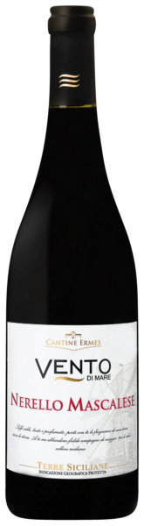
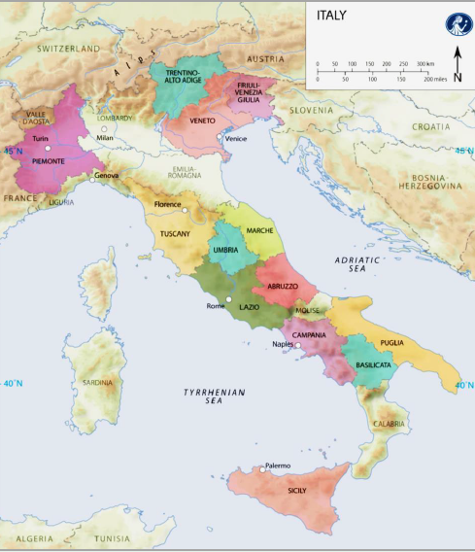
Vento di Mare Nerello Mascalese Terre Siciliane IGP Italy 2019
Notes:
ffff

Slide 24
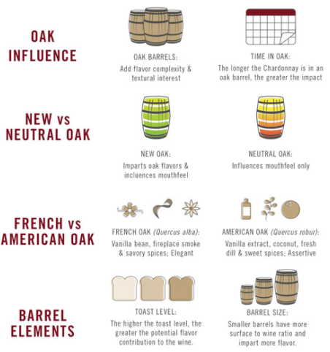
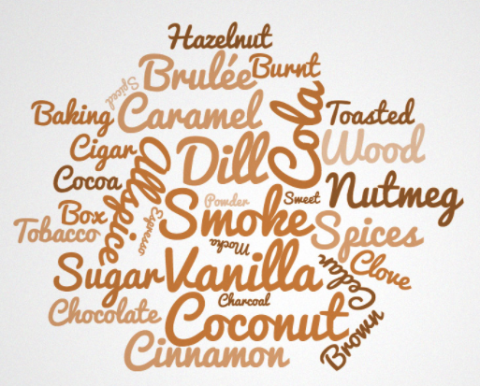
Oak Aging flavors
Notes:
dfgsfg

Slide 25
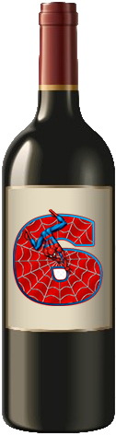
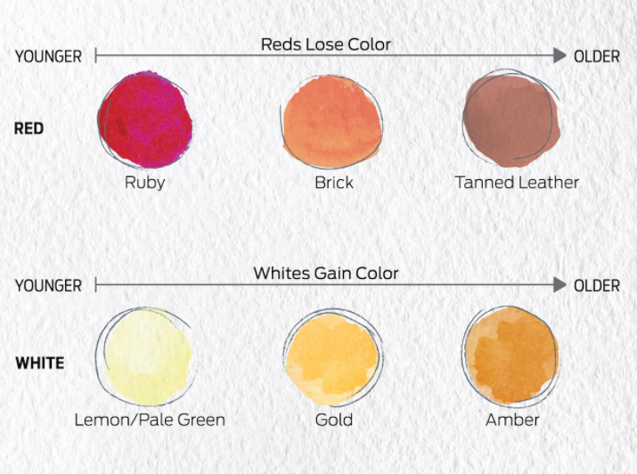
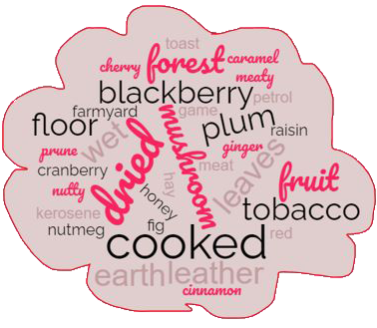
bottle aging
Notes:
dfgsfg

Slide 26
Tasting notes: Deeply garnet in color. Intense aromas of violets and potpourri, blackberry, black plum, black cherry, leather, blueberry, leather, oak, tobacco, earth, and slate. The palate is dominated by blue and black fruit. Further expressed is black cherry, leather, black pepper, dried herbs. Secondarily leather, mineral, graphite, smoke, tobacco, vanilla, chocolate, and coffee. This is a dry wine with medium plus acidty which lifts all the brooding flavors. Muscular tannins result in a full body wine with a long finish. There are layers of complexities that evolve in the glass over time.
Food Pairing: BBQ grilled, beef ribs, duck breast, grilled lamb chops, capon stuffed with morel mushrooms, Bluefin or Red Tuna tartare with ginger, beef in orange sauce, Asian style beef, sausage with lentils.
Notes:
dfgsfg

Slide 27
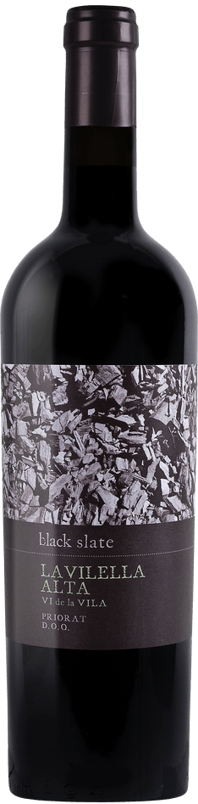
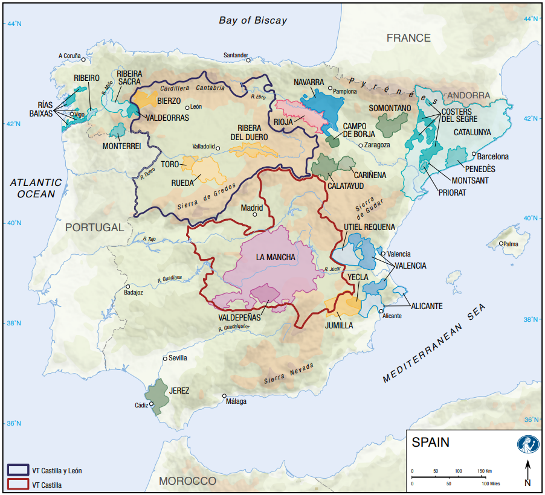
Bodegas Mas Alta Black Slate La Vilella Alta Priorat Spain 2019
Notes:
ffff

Slide 28
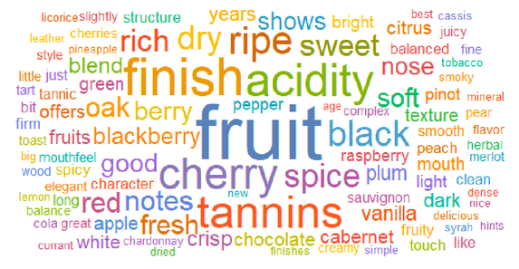
Notes:
dfgsfg

Slide 29
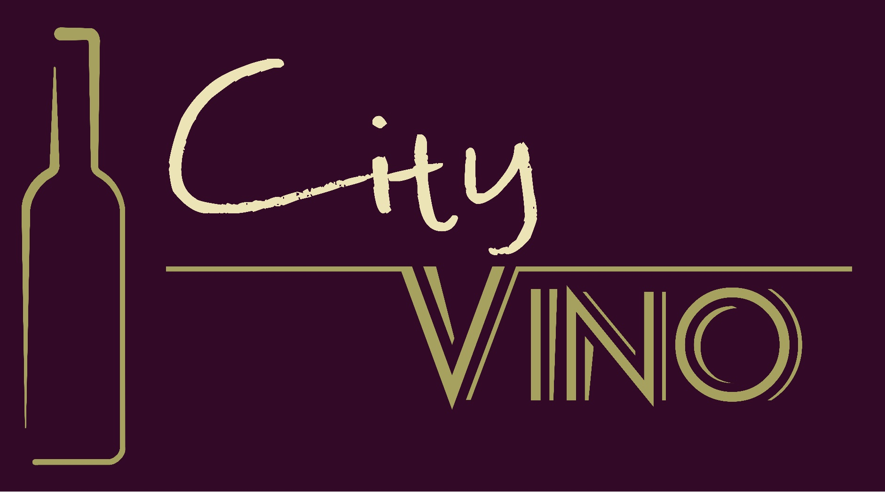
810 Caroline St, Suite 101 |Fredericksburg, VA 22401
Rita@city-vino.com
540.368.0400
Notes:
ggg

Slide 30
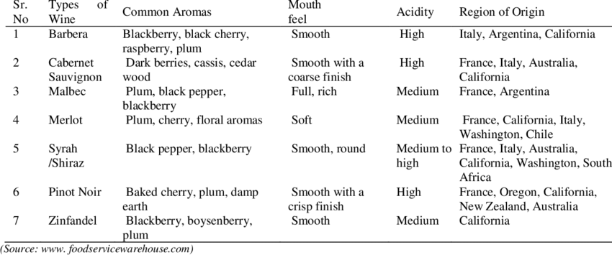
Knowing the characteristics of a varital to determine what is in your glass?

Slide 31
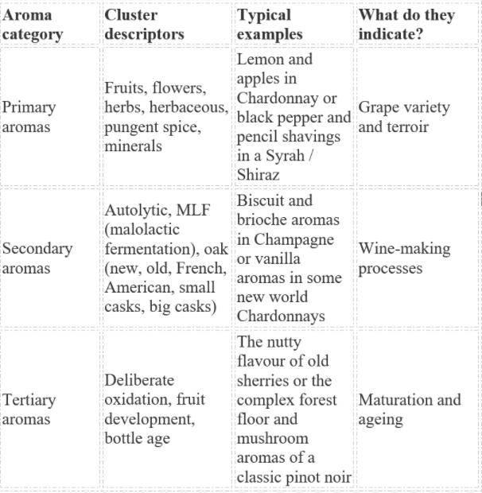
Knowing the characteristics of a varital to determine what is in your glass?

Slide 32
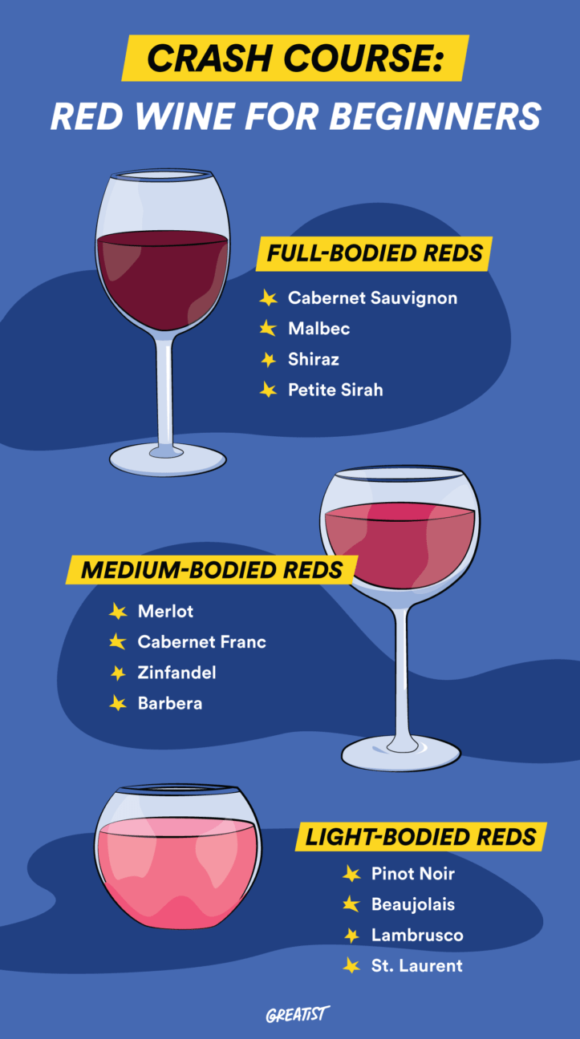
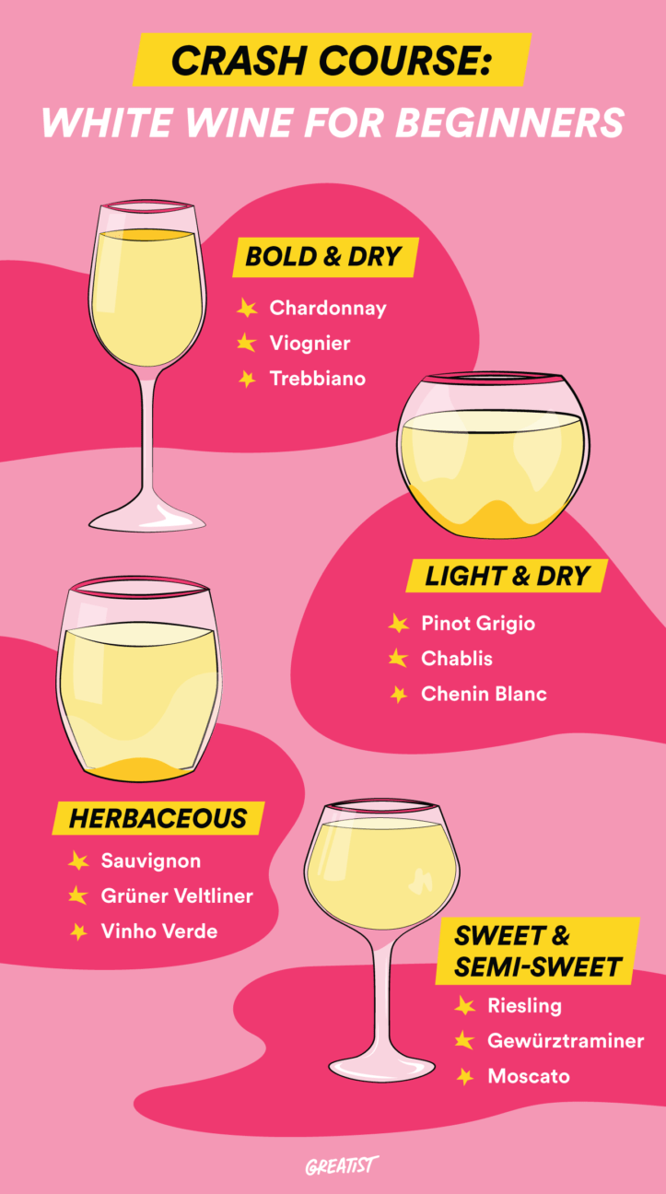
Knowing the characteristics of a varital to determine what is in your glass?

