Slide 1
Sicilian Wine
14 Jan 2022
King George Wine Society

Slide 2
Why
Educational Op prior to AWS National Tasting
Not in our archives
Ancestry ?

Slide 3
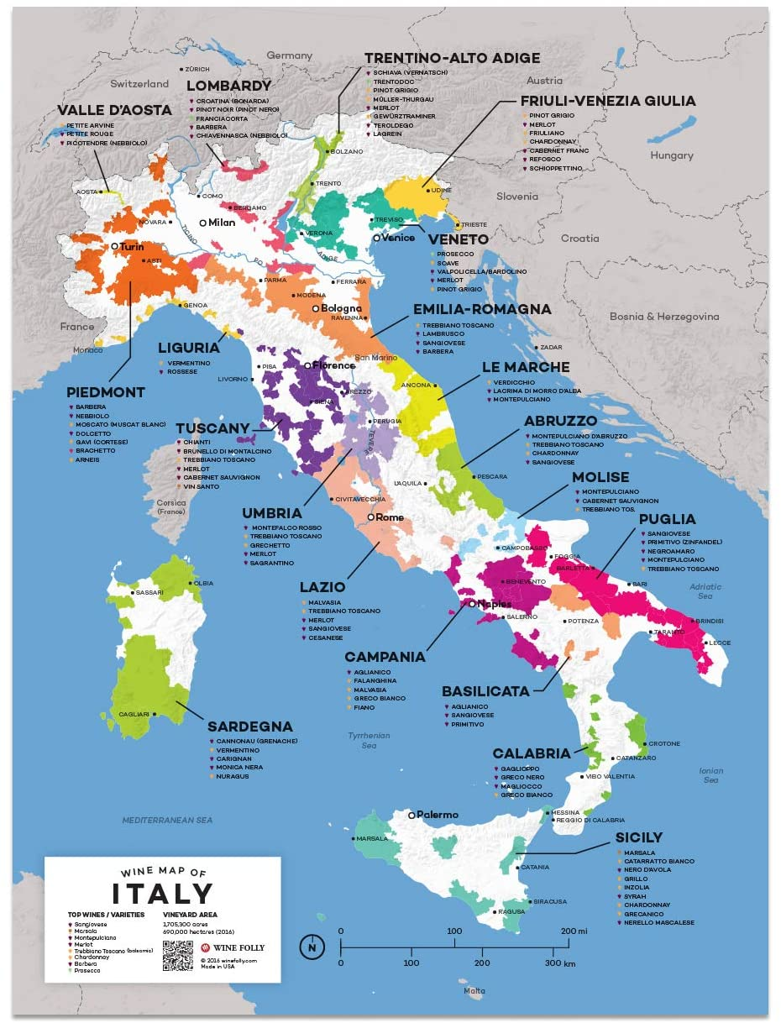
Where....................................

Slide 4
History
Is said wine preceded man on Sicily
Viticulture continuously spread and improved by succession of invaders
1700s: Marsala
1970s: “International” varieties added
1990: Move from Quantity to Quality
  Still lots of quantity

Slide 5
Viticulture
Wine & Olives biggest export
Mountains and hills, one volcano
Soil: Poor, but good for grapes, lots of rocks, lava, sand
Climate: hot summers, mild winters, low rain in summer, frosts rare

Slide 6
Indigenous Varietals
White
Red
Cartarrato
Carricante
Grillo
Inzolia/Ansonica
Amber
  Marsala (not tonight folks)
Frappato
Nerello Mascalase
Nero d’Avola
Nerello Cappuccio
Perricone

Slide 7
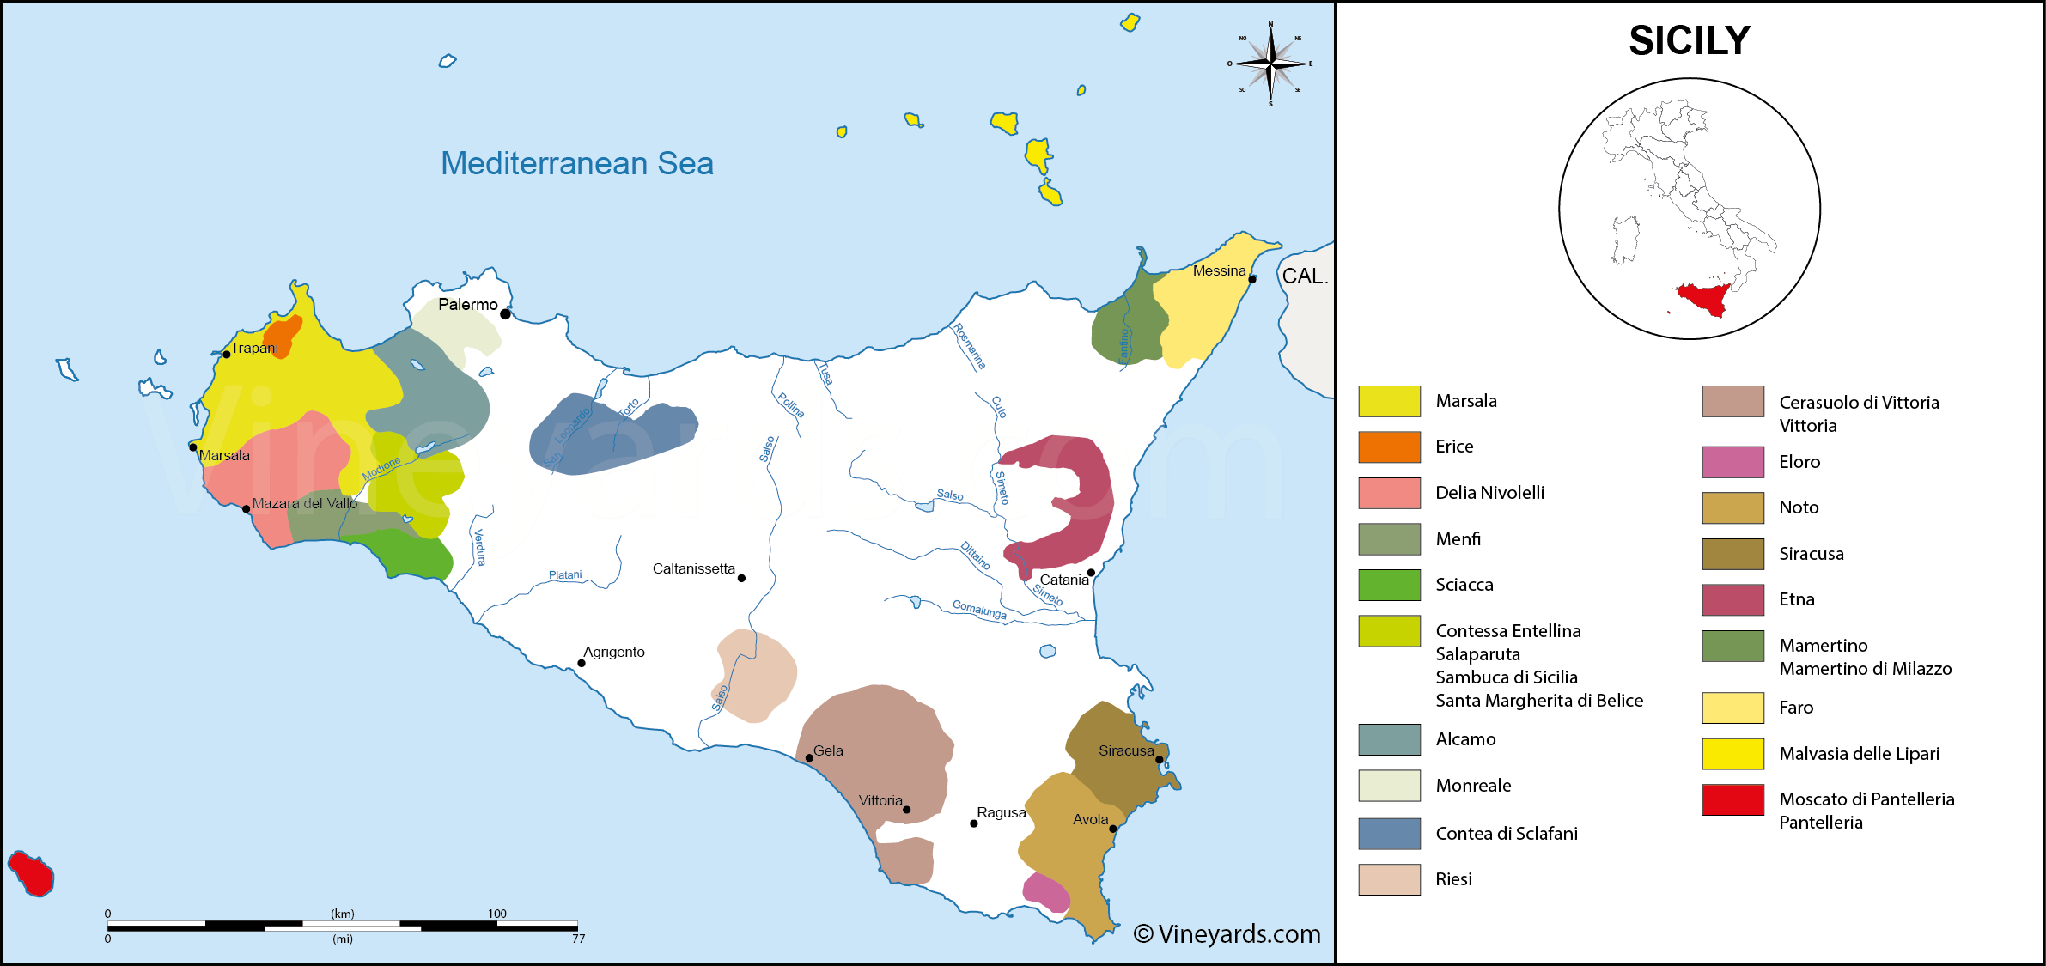
Sicily DOCs
#1
#4 #3
#6
#2 #5

Slide 8
Stop boring them with facts, and Pour Wine!

Slide 9
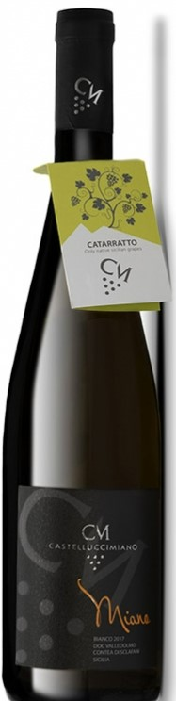
#1 Castellucci Miano Bianco 2020 DOC Valledolmo Contea Di Sclafani Sicilia
100% Catarratto ”ka-tar-rah-tow”
  Med body, low tannin, medium acidity
  1-3 year cellar
  lemon, apple, peach, floral, honey
Producer: Castellucci Miano, Valle Dolmo, central mountains, SE of Palermo
Vineyard: Madonie mountain slopes, 2500 ft, ~ 20 year vines, sand/clay/limestone soil, old style bush vines

Slide 10
#1 Castellucci Miano Bianco 2020 DOC Valledolmo Contea Di Sclafani Sicilia
100% Catarratto ”ka-tar-rah-tow”
  Med body, low tannin, medium acidity
  1-3 year cellar
  lemon, apple, peach, floral, honey
Producer: Castellucci Miano, Valle Dolmo, central mountains, SE of Palermo
Vineyard: Madonie mountain slopes, 2500 ft, ~ 20 year vines, sand/clay/limestone soil, old style bush vines
Brian & Jenni: Citrus, clean, crisp, tongue tingling, little aftertaste

Slide 11
Sicily DOCs
#1
#4 #3
#6
#2 #5

Slide 12
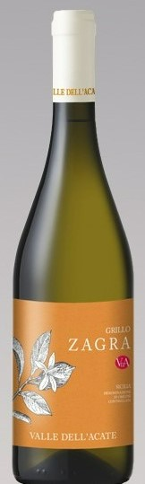
#2 Valle dell Acate Grillo Zagra 2019
DOC Sicilia
100% Grillo “gree-lo”
  Med body, low tannin, med-hi acidity, dry
  floral/herbal aroma, straw yellow
  grapefruit, citrus, thyme, mineral
  Fuller, funkier Pinot Grigio
Producer: Valle dell Acate, SE Sicily, Contrada Biddine Sopranae, Sottana
  Zagra = white blossom
Vineyard: Yellow soil, sandy-clay light soil

Slide 13
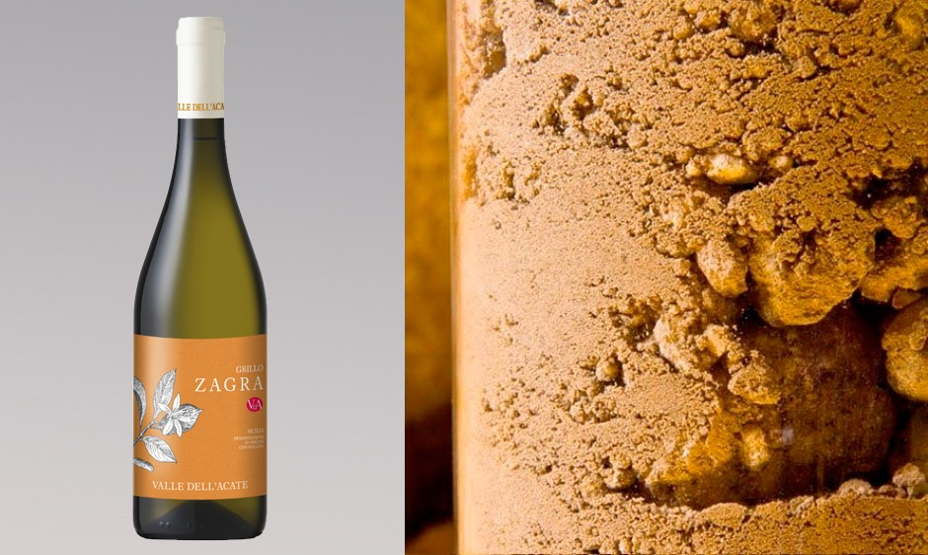
#2 Valle dell Acate Grillo Zagra 2019
DOC Sicilia
100% Grillo “gree-lo”
  Med body, low tannin, med-hi acidity, dry
  floral/herbal aroma, straw yellow
  grapefruit, citrus, thyme, mineral
  Funkier Pinot Grigio
Producer: Valle dell Acate, SE Sicily, Contrada Biddine Sopranae, Sottana
  Zagra = white blossom
Vineyard: Yellow soil, sandy-clay light soil
Brian & Jenni: Dry, minerally, fuller Pinot Grigio

Slide 14
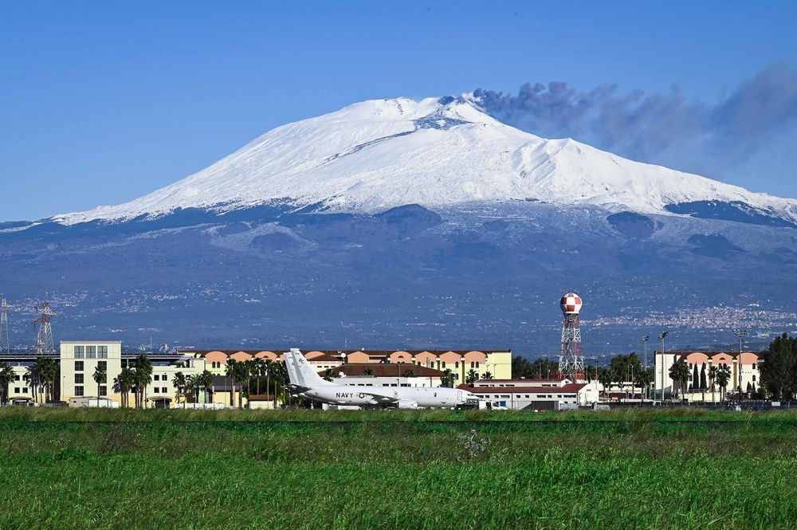
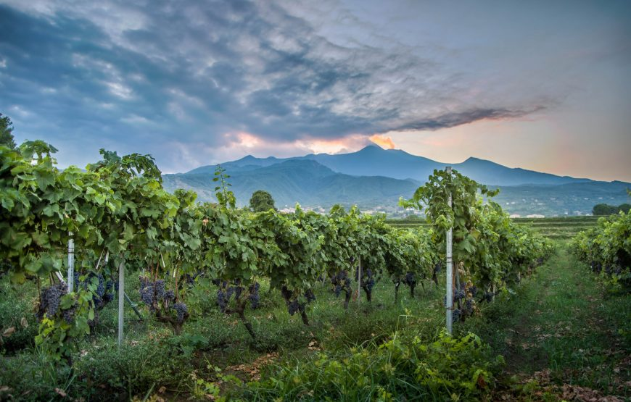
Mt Etna
11,000 ft active volcano on east coast
1669 most destructive eruption
Many since but mostly summit (big boom little lava flow vs flank (lava spills) eruptions.

Slide 15
Sicily DOCs
#1
#4 #3
#6
#2 #5

Slide 16

#3 Alta Mora Etna Bianco 2018
DOC Etna Bianco
100% Carricante “Kar-ree-kan-tae”
  Historically known for high yields
  Unique to Mt Etna
  Bright yellow, citrus, apple, white flower,
  spicy, rich, slate, herbal finish, acidic
  Sauvignon Blanc like
Producer: Cusumano Bros, 2013
  20 deg C fermentaion in SS tanks
  On lees for 4 months
Vineyard: N slopes Mt Etna at 4000 ft

Slide 17
#3 Alta Mora Etna Bianco 2018
DOC Etna Bianco
100% Carricante “Kar-ree-kan-tae”
  Historically known for high yields
  Unique to Mt Etna
  Bright yellow, citrus, apple, white flower,
  spicy, rich, slate, herbal finish, acidic
  Sauvignon Blanc like
Producer: Cusumano Bros, 2013
Vineyard: N slopes Mt Etna at 4000 ft
Brian & Jenni: Complex, citrus floral nose, grassy, mineral, tongue tickler, lingers

Slide 18
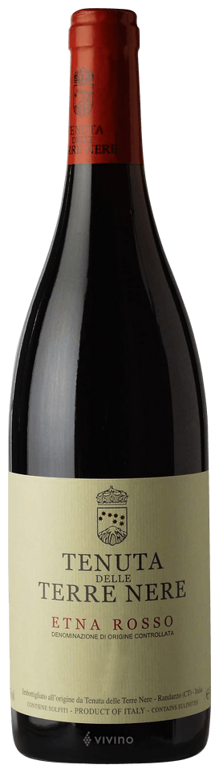
#4 Tenuta delle Terre Nere, Etna Rosso
DOC 2019
95% Nerello Mascalese, 5% Nerello Cappuccio
  “nair-rello mask-ah-lay-zay, cap-poo-cho”
  medium body/tannin/acidic
  Red fruit, floral, dried herbs, earthy
  Pinot Noir like with more body
  Cappuccio adds acidity & aroma
  One year French oak
Producer: Tenuta delle Terre Nere, Randazzo
  several levels of Etna Rosso
  66 acres in production
Vineyard: N slopes Mt Etna at 4000 ft, younger vines 5-50 yrs

Slide 19
#4 Tenuta delle Terre Nere, Etna Rosso
DOC 2019
95% Nerello Mascalese, 5% Nerello Cappuccio
  “nair-rello mask-ah-lay-zay, cap-poo-cho”
  medium body/tannin/acidic
  Red fruit, floral, dried herbs, earthy
  Pinot Noir like
  Cappuccio adds acidity & aroma
  One year French oak
Producer: Tenuta delle Terre Nere, Randazzo
  several levels of Etna Rosso
  66 acres in production
Vineyard: N slopes Mt Etna at 4000 ft, younger vines 5-50 yrs
Brian & Jenni: Cherry chocolate nose, not fruity, tannin, long mineral finish

Slide 20
Sicily DOCs
#1
#4 #3
#6
#2 #5

Slide 21
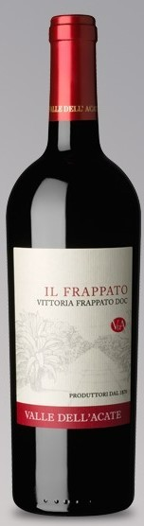
#5 Valle dell ‘Acate Il Frappato 2019, DOC Vittoria Frappato Sicilia
100% Frappato “fra-pat-tow”
  Clear ruby red, dry red berries, floral
  Medium light body & acidity, low tannin
  1-3 year cellar
Producer: Same as the Grillo
Vineyard: 300 ft hills, black soil white pebbles

Slide 22
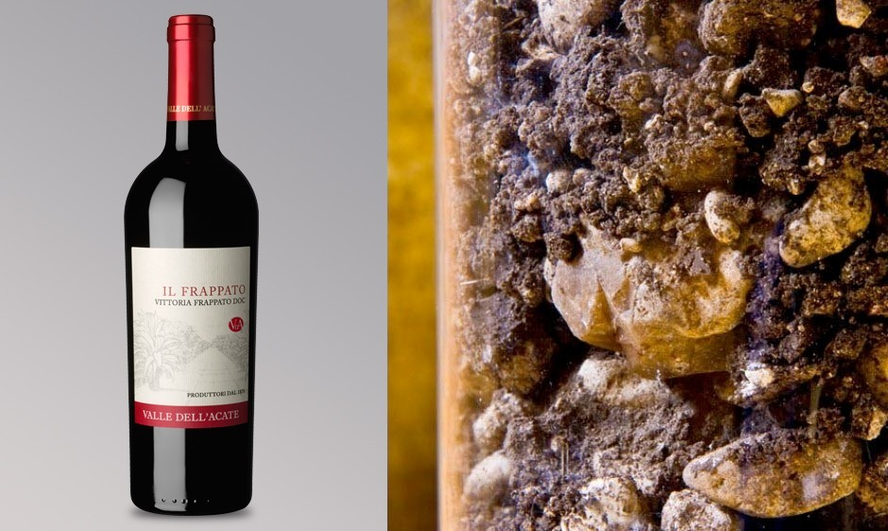
#5 Valle dell ‘Acate Il Frappato 2019, DOC Vittoria Frappato Sicilia
100% Frappato “fra-pat-tow”
  Clear ruby red, dry red berries, floral
  Medium light body & acidity, low tannin
  1-3 year cellar
Producer: Same as the Grillo
Vineyard: 300 ft hills, black soil white pebbles
Brian & Jenni: POMEGRANATE, cherry, nice fruit/acidity balance, mouthfeel

Slide 23
Ancestry

Slide 24
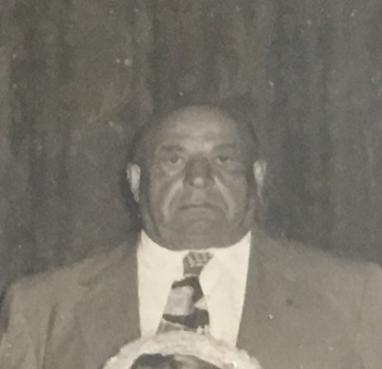

My Great Grandfather
Attilio Conceto Trojano

Slide 25
Ortona dei Marsi

Slide 26
Sicily DOCs
#1
#4 #3
#6
#2 #5

Slide 27
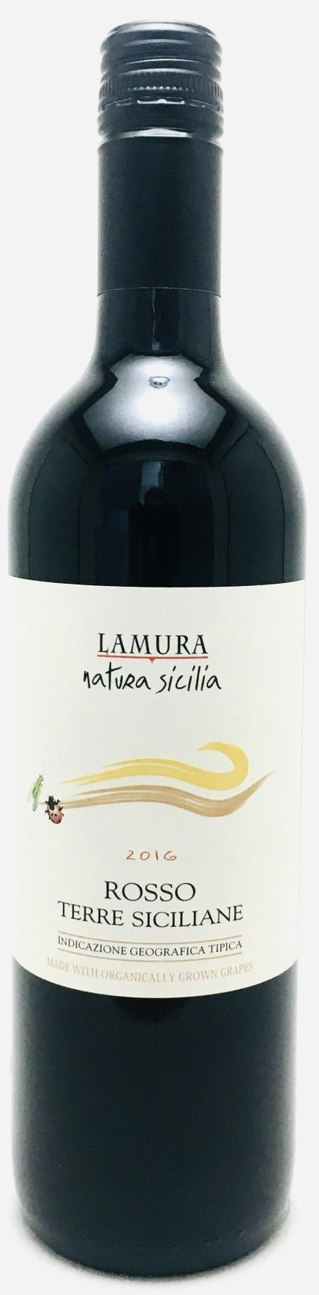
#6 Lamura Rosso 2015
Terre Siciliane IGT
Grape: 100% Nero D’Avola “nair-oh davo la"
  Biggest indigenous red, loves the dry heat
  Plum, pepper full fruit & body
  Shiraz like
Producer: Casagirelli, Trento 1966
  Source grapes from all over Italy
  Lamura is the Sicilian line
Vineyard: Valle del Belice, hilly western Sicily
  Family owned, organic

Slide 28
#6 Lamura Rosso 2015
Terre Siciliane IGT
Grape: 100% Nero D’Avola “nair-oh davo la"
  Biggest indigenous red, loves the dry heat
  Plum, pepper full fruit & body
  Shiraz like
Producer: Casagirelli, Trento 1966
  Family owned, organic
  Source grapes from all over Italy
  Lamura is the Sicilian line
Vineyard: Valle del Belice, hilly western Sicily
Brian & Jenni: tbd

Slide 29
Scoring
#1 Castellucci Miano Cataratto
#2 Valle dell Acate Grillo
#3 Alta Mora Carricante
#4 Tenuta delle Terre Nere Nerello Mascalase
#5 Valle dell Acate Frappato
#6 Lamura Nero D’Avola

Slide 30
NOT YET!!

Slide 31
Retail Prices
#1 Castellucci Miano Cataratto $22.99
#2 Valle dell Acate Grillo $24.99
#3 Alta Mora Carrcante $34.99
#4 Tenuta Nerello Mascalase $28.99
#5 Valle dell Acate Frappato $25.99
#6 Lamura Nero D’Avola $14.99

