Slide 1
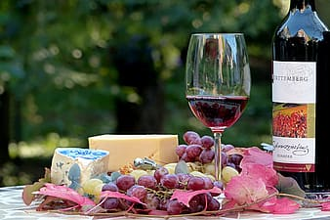

Slide 2
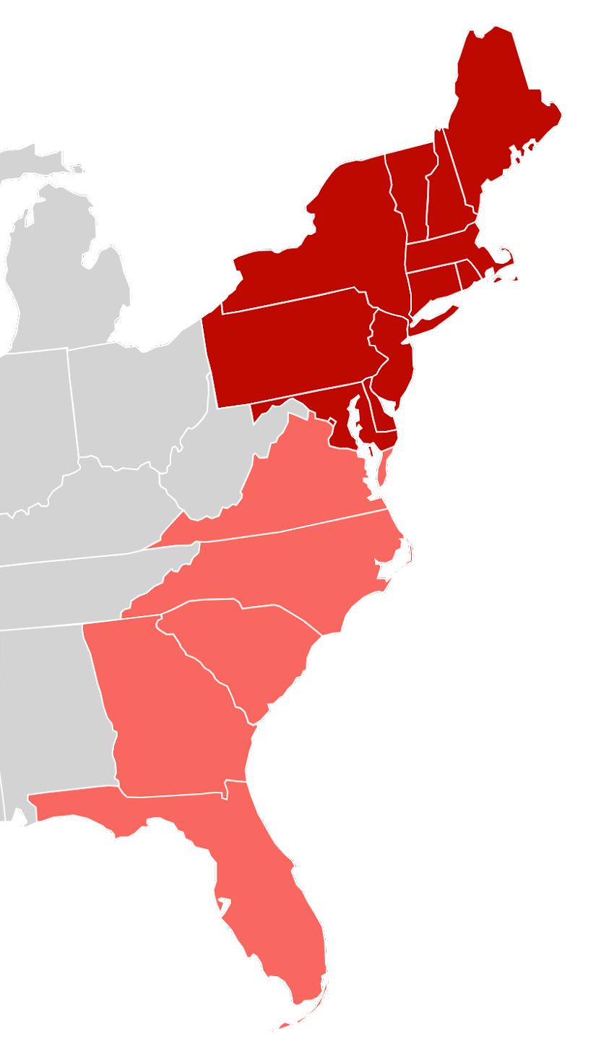
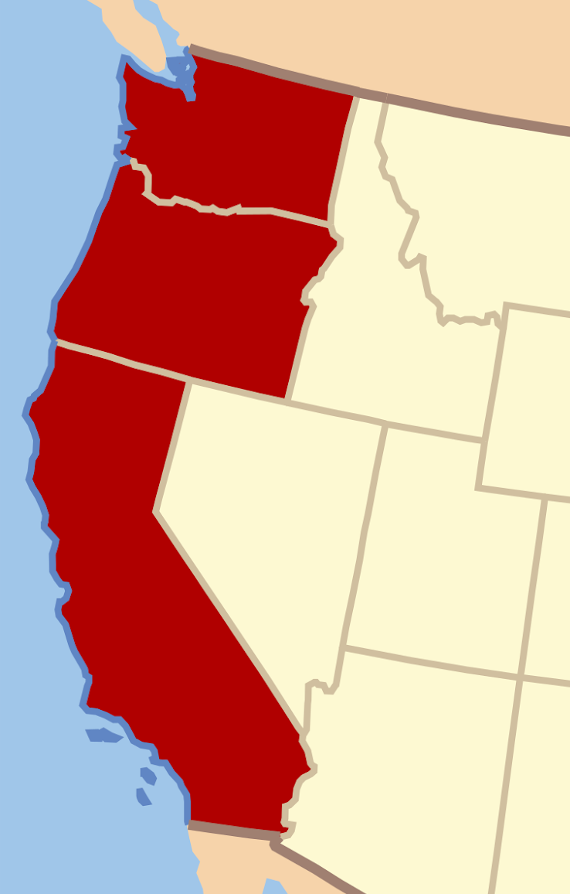
East Coast
VS.
West Coast

Slide 3



Slide 4

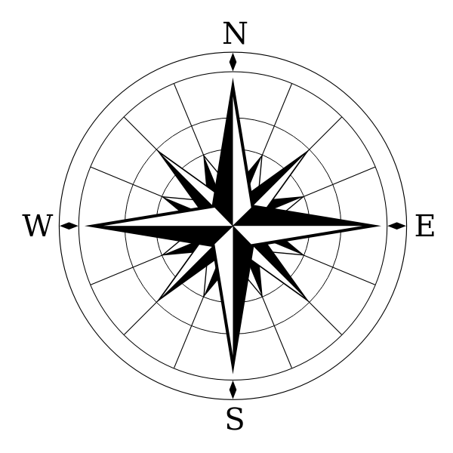
Step 1: Ask a question.
Would the same varietal grape taste distinctively different from different sides of the US?
Step 2: Form a hypothesis.
Step 3: Make a prediction.
We are of the opinion that the same varietal will taste very different, based on the numerous factors that affect the taste of the wine.

Slide 5
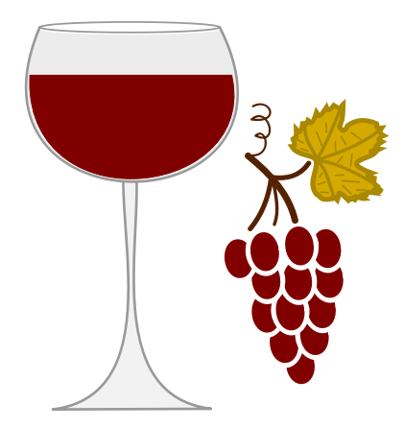
What are the factors that influence the taste of wine?
THE OBVIOUS :
The type of grape determines largely the flavour, colour, sugar, acidity and the levels of tannin in the wine.

Slide 6
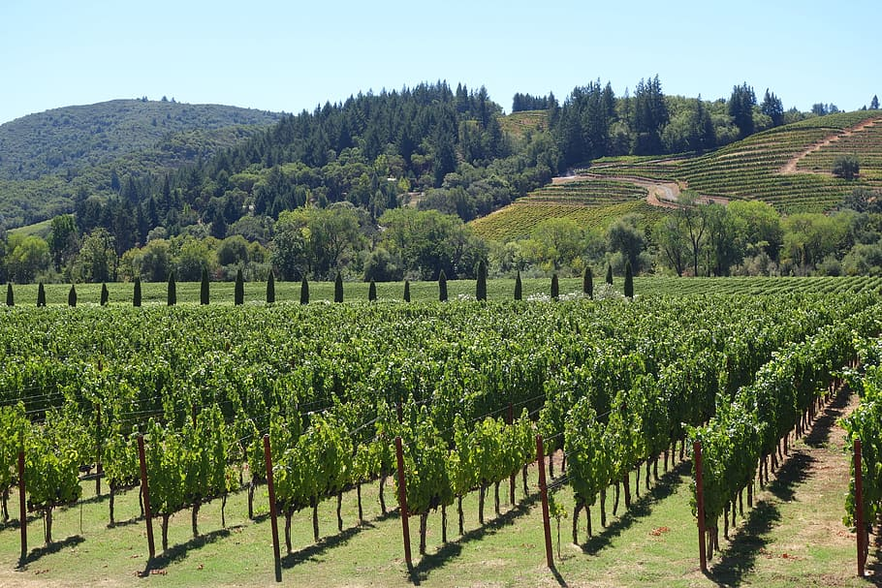
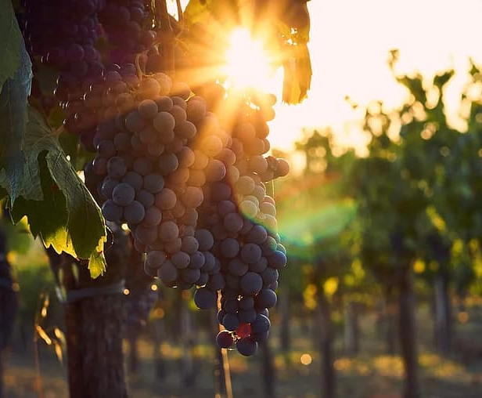
The Other Factors That Contribute to Wine Quality:
The terroir of wine has a clear-cut
influence on the wine...
* Climate (weather) and Soil
Temperatures and
the amount of Sunlight. ...
Winemaking Practices. ...

Slide 7

Step 4
Perform Tests or Experiments.
This is where you come in…..

Slide 8
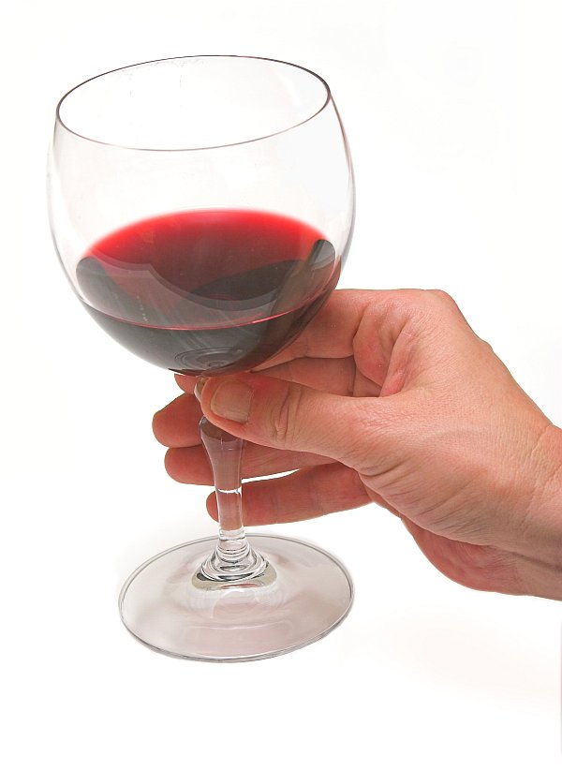
During our experiment(s):
Our “constant” will be the grape varietals. As well as the winemaking practices. As well as all of you, our tasters.
Our “variable” is that the wines are grown and processed/produced on opposite coasts.
Blind Tastings for each pair of wines. Try keeping them in the order we pour them for you. I will ask our “question” for each round and reveal which coast is which wine at the end of each pair. We will also be voting for our preferred of each round.

Slide 9
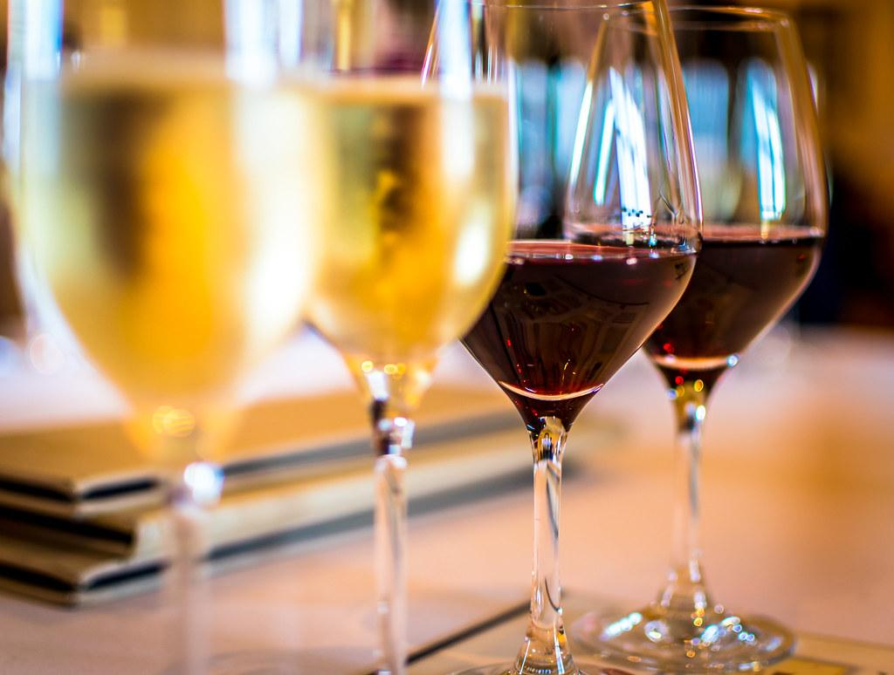
Now for the wines:
First pair will be Chardonnay
Second pair will be Barbera
Third pair will be a Pinot Noir
Our Bonus wine will not be part of our experiment but it will be poured with the last pair.

Slide 10
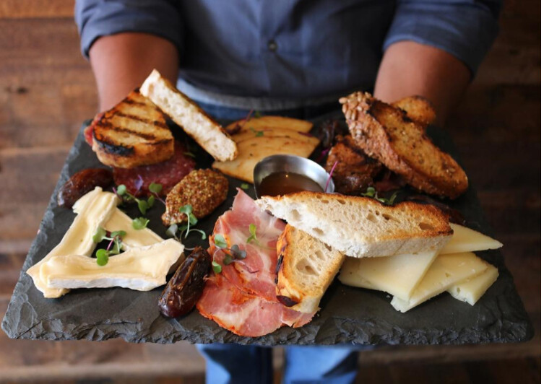
Our Food for this evening.
Chardonnay : Turkey, creamy pasta salad, Gouda Cheese
Barbera and Pinot Noir Both had the pairing suggestion of Hearty beef stew, blue cheese and hard cheddars. Make sure you save some of those for both rounds. Of course a little bread is always in order.

Slide 11

Chardonnay
Both of our Chardonnay wines were grown at the Vineyards and both were done in 100% stainless steel. No Barrel time for either of them. (un-oaked)
We will pause for you to try your first pair and make your vote as to which you think is East Coast and which is West Coast.
Do you notice a significant difference in these 2 wines?

Slide 12
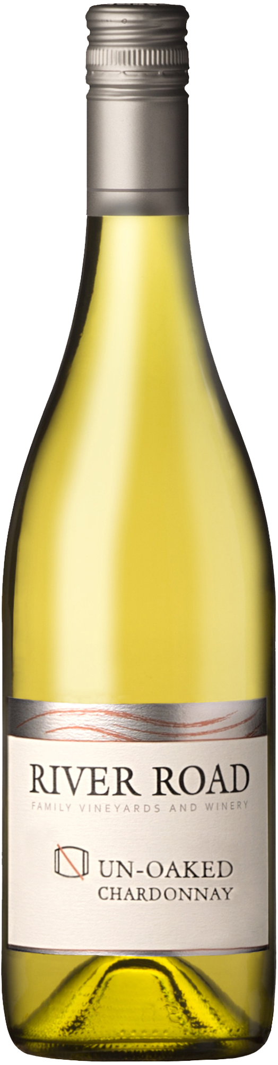
Chardonnay #1 -
West Coast - California
RIVER ROAD FAMILY VINEYARD AND WINERY
Based in the heart of California’s Russian River Valley
Sonoma County

Slide 13
It's fitting that the Russian River Valley appellation lies at the geographical heart of Sonoma County. This is where some of wine country's best known and most beloved varietals really earned their reputation. This is the appellation that set the standard for California, and perhaps New World, Pinot Noir and Chardonnay, while remaining home to sought-after old vine Zinfandel.
Top Grapes
By wide margins, Chardonnay, Pinot Noir and Zinfandel top the charts in this AVA, and in that order. Merlot, Cabernet Sauvignon, and Sauvignon Blanc are next in acreage, but the small amount of cool-climate Syrah produced here may get more attention among wine collectors. Pinot Gris and Gewürztraminer are also important.
In the growing season, warm daytime temperatures plummet when fog regularly intrudes from the Petaluma Gap to the south, and the Russian River to the west. The northern border marks the point where the fog frequently sticks around a while longer in the morning, while Alexander Valley is already heating up.In the late afternoon, a fog bank can often be seen hovering above the appellations border in the hills west of Sebastopol. (When attending a summer barbecue in the Russian River Valley, one is well advised to bring a sweater.)

Slide 14
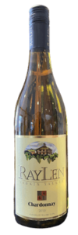
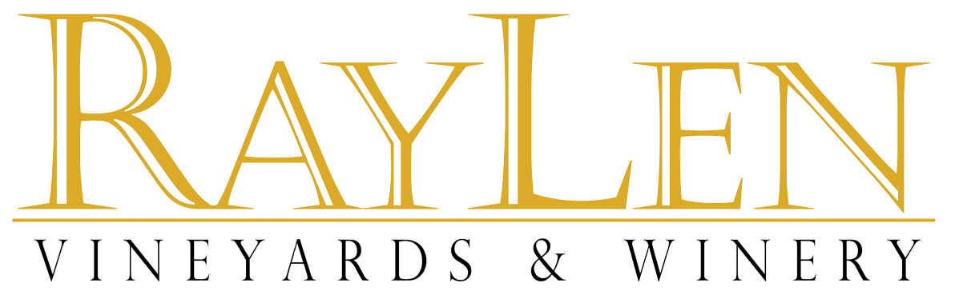
Chardonnay #2 -
East Coast North Carolina
We’re located in the Yadkin Valley AVA, of North Carolina’s Piedmont region. This means that the Yadkin Valley is an exceptional region for growing European wine grapes. RayLen Vineyards is a charter member of the AVA, joining in the early 2000s. RayLen Vineyards remains a leading pioneer of the Yadkin Valley with over 35,000 vines on our property today.

Slide 15
North Carolina is now home to 350 vineyards and more than 70 wineries in more than 30 counties. Statewide, the wine and grape industries account for more than 5,700 jobs. The crops vary across the state, with muscadine grapes typically harvested in the coastal and eastern regions, while vinifera (European varieties) and French-American hybrids are grown in the Piedmont, mountains, and much of the foothills area. But it’s no accident that winemakers have migrated to the Yadkin Valley. The French have a term, terroir, to describe soil, temperature, topography, weather, and how they all combine to define the essence of an area’s wine. “Here, the rolling hills aren’t too high, making for great drainage and exposure to the sun,” “It’s hot in the daytime and cools off at night. That difference of high and low temperatures gives grapes the opportunity to rest and concentrate their sugar to make great wine.”
“Sonoma of the South”
From Tobacco to Wine,
North Carolina’s
Yadkin Valley
has turned over a new leaf.
The Yadkin Valley became North Carolina’s first federally-approved AVA in 2003. Growing from soil that for decades saw primarily tobacco, the grapes of the Yadkin Valley are not limited to the native breeds Muscadine and Scuppernong. Viticulture and wine making research have helped apart many European varietals to this area’s climate and soil.

Slide 16
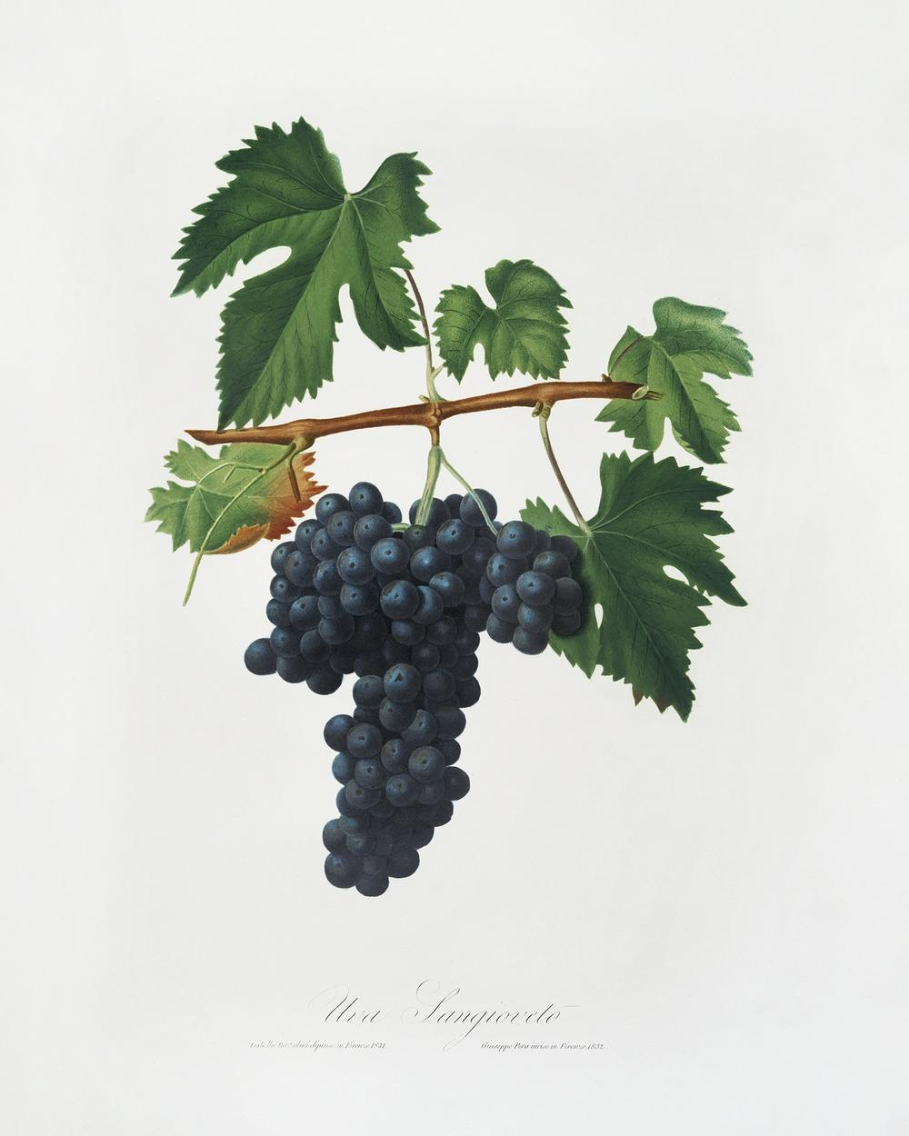
Barbera
I can’t say too much without giving it away, so I will just say the grapes were grown in the same state as the wine they produced. And were treated in the same manner.
We will pause for you to try your second pair and make your vote as to which you think is East Coast and which is West Coast.
Do you notice a significant difference in these 2 wines?

Slide 17
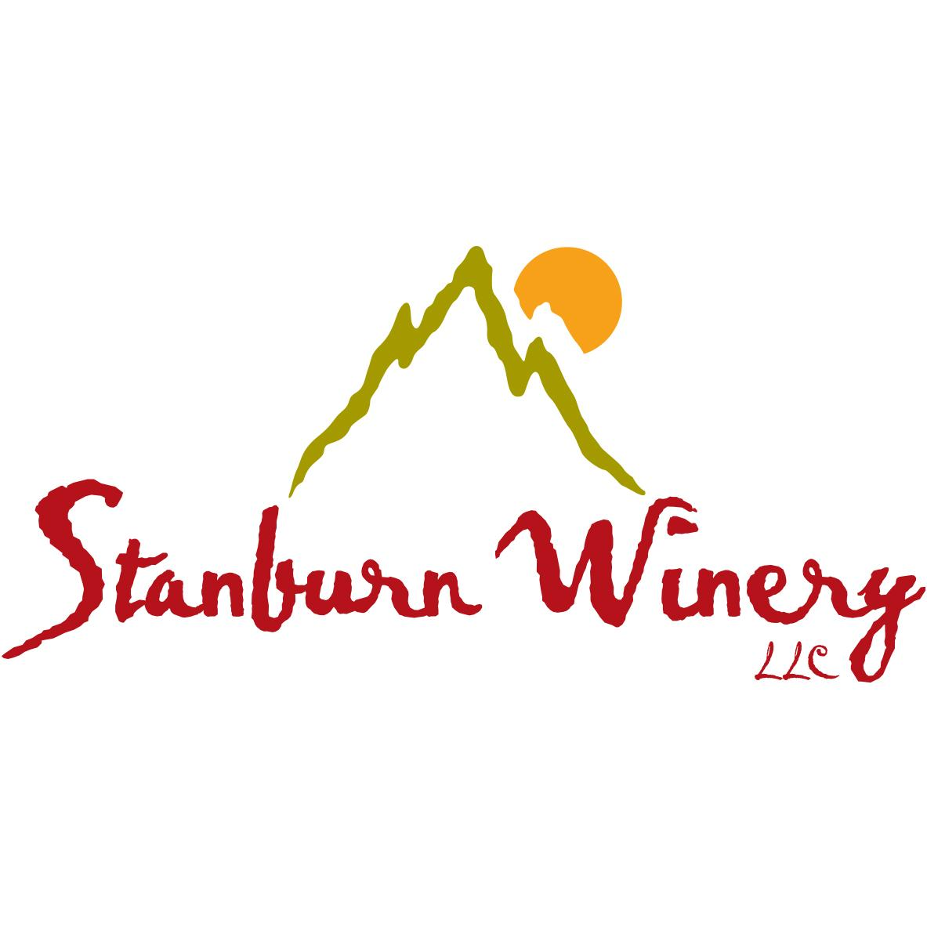

Barbera # 1 -
East Coast - Virginia (Stuart)
The winery name comes from both sides of the family, Stanley and Burnette. The family is a combination of these, so the name should be as well.

Slide 18
The Rocky Knob AVA
The Rocky Knob AVA is located in Floyd and Patrick counties on the eastern slopes of the Blue Ridge Mountains. The area is located on the eastern slopes of the Blue Ridge Mountains in southwestern Virginia near the towns of Woolwine and Meadows of Dan and astride the Blue Ridge Parkway. The soil is primarily loam and gravel and is well drained.
Stanburn Vineyard began with 2.5 acres of Chardonnay by planting approximately 1250 vines, and 4 acres of Cabernet Franc with about 2050 vines. In 2004, they planted 2.5 acres of Traminette with almost 1300 vines. In 2010, they planted Barbera to add another red variety into the field. The vineyard currently yields between 45-50 tons of grapes each year, depending on needs and Mother Nature. She can be fickle!
Interstate 81 bisects the Blue Ridge Wine Region, which runs south of Roanoke to the North Carolina border. The windy and picturesque mountainsides of southwest Virginia are home to a number of well-established wineries thanks to loamy and gravelly soil with good drainage and stunning elevations.

Slide 19
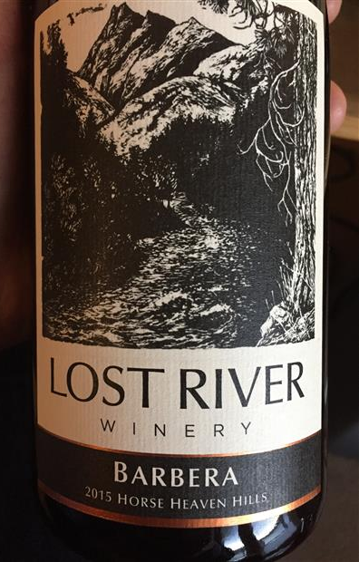
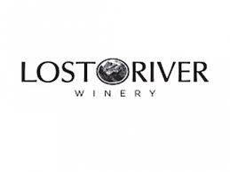
Barbera # 2 -
West Coast Washington State
The Lost River Winery is a boutique, family-owned winery started in 2002 the upper Methow Valley of Washington State by a family of Bellingham transplants. Their primary varietal wines include Pinot Gris, Barbera, Nebbiolo, Walla Walla Syrah, Cabernet Sauvignon, Merlot and Semillon.
It might be relevant to mention that this winery was just recently sold, but they say nothing is going to change as far as the wines.

Slide 20
While not one and the same the winery and the vineyard are both within the state of Washington. The vineyard is about 4 hours South (and just a bit East) of the winery.
The Wallula Gap is the prominent notch between the Horse Heaven Hills on the west and the foothills of the Blue Mountains on the east, through which the Columbia River flows. The Wallula Vineyard’s soils are composed of a mix of glacial marine sediments left by the ancient Missoula floods which were backed up by the narrow Wallula Gap.
“In the Horse Heaven Hills, you have very uniform soils over thousands and thousands of acres.” The soils are also well-drained, ideal for irrigated viticulture. “Our sites have even soil profiles with little slope that allow us to distribute water extremely evenly,” “This gives us incredible control and even vigor in all our vineyard blocks.”
The area also has persistent wind. the wind and proximity of the Columbia River reduce the risk of frosts and freezes. The result is a long, warm growing season, with cool nights that lock in acidity.

Slide 21
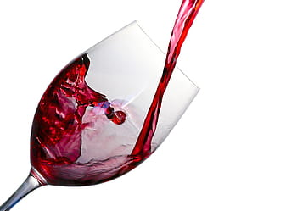
Pinot Noir
You will notice this pair is actually a trio. We would like you to simply try the first two for your votes, I promise you will get to try the last one.
We will pause for you to try your third pair and make your vote as to which coast.
Do you notice a significant difference in these 2 wines?

Slide 22
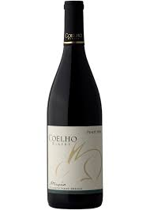
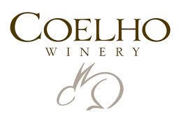
Pinot Noir #1 -
West Coast Oregon Willamette Valley
A bottle of wine is not simply a beverage. When you open a bottle, whether at a celebration or during a moment of quiet contemplation, it creates a unique moment forever tied to that bottle of wine. We invite you to create your own unique moments with us.

Slide 23
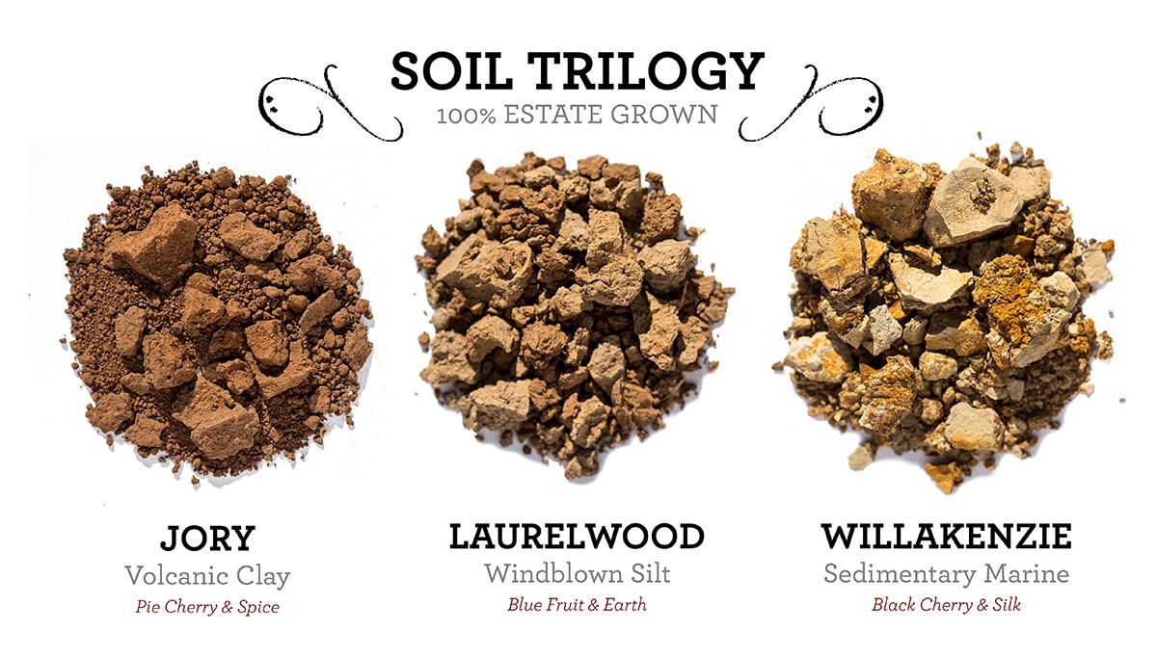
The Willamette Valley AVA is a fertile triangular region of more than 100 miles long and up to 60 miles wide. The Valley climate provides an elongated grape-growing season that is said to be ideal for Pinot Noir. Winter is typically cool, wet and mild. Spring is oftentimes rainy and summers are warm with cool evenings.
What type of soil is in the Willamette Valley?
The Willamette Valley's flagship dirt is Jory, the basalt-based volcanic soil found in most vineyard sites in the Dundee Hills (the most prominent sub-appellation in the valley). High in clay content and iron, Jory is reddish in color and nutrient-rich. "You could grow anything in volcanic soil,"
The soil name for the Willamette Silt is the Woodburn Series, named after a town in the valley. It is rich in nutrients, hence grows wine grapes very well. Their flavor, however, is less complex than that of grapes grown on the soils of the bedrock slopes.

Slide 24
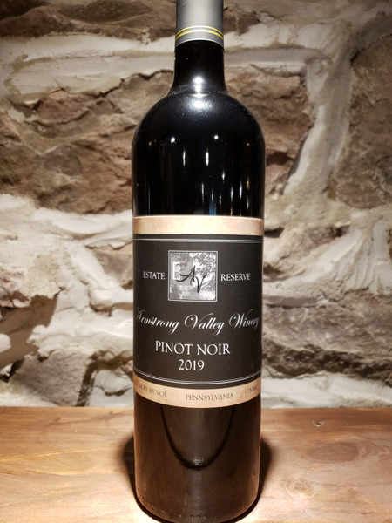
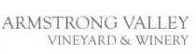
Pinot Noir #2 -
East Coast Pennsylvania (Halifax)
The dry red Pinot Noir, produced from our estate grown grapes, is oak aged in French barrels specifically designed for the Pinot Noir wine. This creates a wonderfully drinkable wine with light fruit overtones and a well-balanced palate.

Slide 25


Sitting between warmer Virginia and cooler New York, Pennsylvania is in a wine-growing “sweet spot.” The humid summers and cold winters are more like Europe than arid wine regions in California or Australia. This means that Pennsylvania can produce a wide-range of grape varieties, from cold-tolerant, hybrid grapes, like Marquette and La Crescent, to heat-loving vinifera (European grape) varieties, like Cabernet Franc and Merlot. Pennsylvania’s geology is ancient, diverse, and made up of well drained shale soils. Add this earth to the right slope, elevation, and direction, and you have the perfect formula for high-quality wines. The soil, climate, plants, and viticulture combine to produce wines that are unique to their surroundings The last part of the fine wine equation is the growers’ know-how. Careful cultivation and care of the vine from the day it’s planted helps to craft Pennsylvania’s special wines.
Pennsylvania’s moderate climate and rolling terrain provides some of the best growing conditions on the East Coast as nearly 300 wineries produce a delightful array of wine varieties. With over 14,000 acres of grapes, the state ranks 5th nationally in the production of wine, producing more than 2 million gallons annually.

Slide 26

NOW I would like you to try the third in this trio and we will vote on this one by itself.
Based on the other two Pinot Noir we tried which Coast do you think this wine is from?
Do you notice any similarities between this one and the other two we sampled?

Slide 27
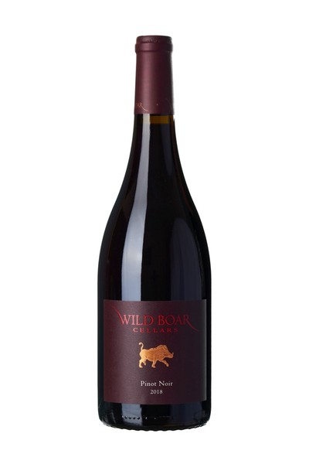

Pinot Noir #3
BOTH !
“Lucy you have some splaining to do”.
When researching this experiment we came across an East Coast winery (here in VA) that actually get their Pinot Noir grapes from…wait for it….Willamette County Oregano. That is why it is under the WILD BOAR label and not Stone Tower. I thought that this would be a interesting wildcard to throw in the mix. I hope you enjoyed it.

Slide 28


Step 5:
Draw your Conclusion
Step 6:
Share your Data
GOOD WINE IS GOOD WINE
NO MATTER WHICH COAST IT COMES
FROM

Slide 29

Let’s review our original question:
Would the same varietal grape taste distinctively different from different sides of the US?
Our results indicate that …….
I would like to vote on our overall favorite for the night (just because that is what we do).

Slide 30
East Coast
North Carolina
RayLen Vineyard and Winery
Virginia
Stanburn Winery
Pennsylvania
Armstrong Valley Vineyard and Winery

Slide 31
West Coast
California
River Road Family Vineyard
Washington State
Lost River Winery
Oregon
Coelho Winery

